Slide 1
NCD Situation in Guinea
Ministry of Health
Department of Public Health
Non-communicable Diseases Program
By
Naby Moussa BALDE

Slide 2
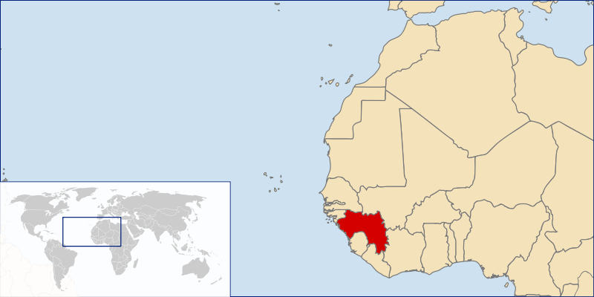
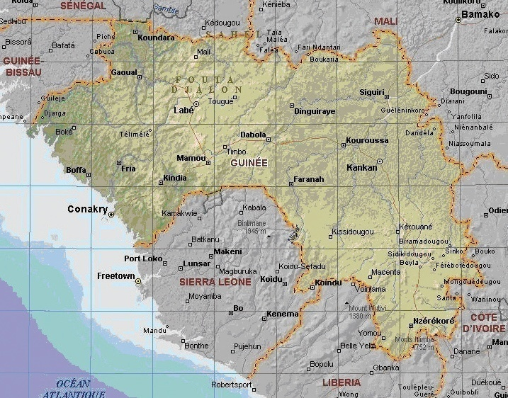
Guinea (Conakry)

Slide 3
Guinea Health Profile (Source WHO 2008)
Total population | 9,181,000
Gross national income per capita (PPP international $) | 1,130
Life expectancy at birth m/f (years) | 51/55
Healthy life expectancy at birth m/f (years, 2003) | 44/46
Probability of dying under five (per 1 000 live births) | 161
Probability of dying between 15 and 60 years m/f (per 1 000 population) | 380/305
Total expenditure on health per capita (Intl $, 2006) | 116
Total expenditure on health as % of GDP (2006) | 5.7

Slide 4
Main achievements in NCD in Guinea (1)
Very good political commitment
Good Involvement of Professionals working on NCD
Cancer Program:
Very Good cervix cancer screening program
National cancer registry
Diabetes Program:
Very good network (Specialized Diabetes Unit in 6/7 Regional Hospitals)
Comprehensive Program on Diabetes in Children (5 years)

Slide 5
Diabetes Clinics in Guinea
République de Guinée
Notes:
Tougue
Labe

Slide 6
Main achievements in NCD in Guinea (1)
WHO STEPS Survey
Several seminars to integrate 4 small programs
WHO inspired National Policy and Strategic Plan on NCD focuses on selected diseases/programs:
Cancer
Diabetes
Hypertension Cardiovascular diseases
Chronic respiratory diseases

Slide 7
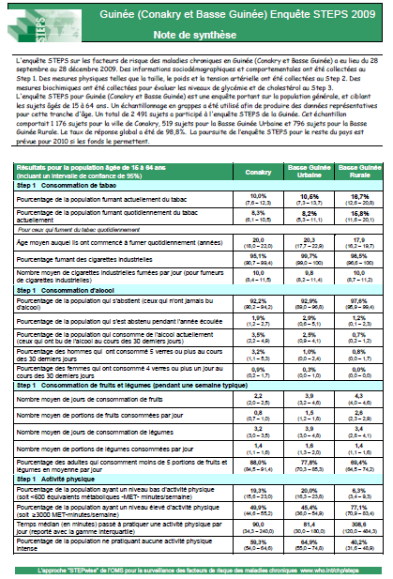
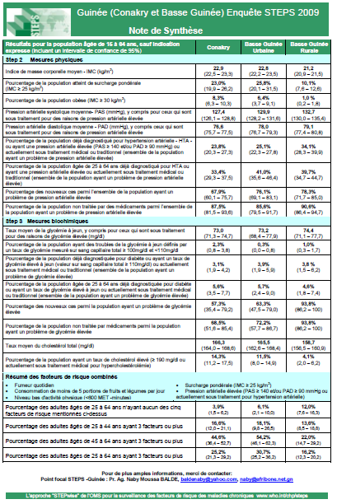
WHO STEPS Survey, Fact Sheet
Guinea (2/5), 2009
15-64 years
2 491 subjects

Slide 8
WHO STEPS Survey, Mains Results
Hypertension
Diabetes
More than 3 risk factors
Hypercholesterolemia

Slide 9
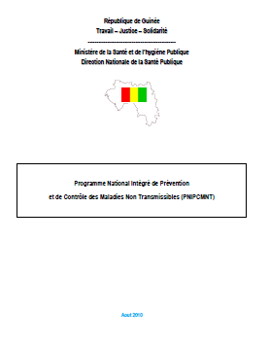
Covert page of National Policy and Strategic Plan on NCD (August 09)

Slide 10
Challenges in Guinea
☞ NCD Program:
Costing
Funding
☞ Implementation of NCD Program

Slide 11
Mains lessons learnt
Political commitment
Leadership
 Progress made in very hard context:
STEPS Survey in Sep 09 (‘political violence and Killings’)
Adoption and Creation of National policy and strategic plan on NCD (few months before presidential elections)

Slide 12
What next in Guinea
Costing with Financial and Technical Partners / Re formulating objectives? (more inter-sectorial?)
Fund raising
Implementation of activities

Slide 13
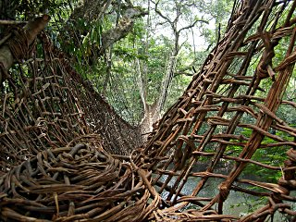
Traditional Bridge in Guinée forestière
Thank you for your attention

