Slide 1
Communicating effectively
on noncommunicable diseases
WHO-IUMSP seminar for programme managers of non-communicable diseases
8 May 2015, Lausanne, Switzerland

Slide 2
Challenges
What are your key
communications challenges?

Slide 3
Objectives
Learn some communications tips for using in your day-to-day work
Know how to use a risk communications framework
Become more confident in communicating with strategic partners and the media
Know where to find WHO resources that can help you in your work
Notes:
Facilitator explains that the workshop is designed to help participants in their work, and provides an opportunity to learn comms. tools and techniques and to practice them in a "safe" environment.
Much of the workshop will be interactive, with opportunities to learn from one another.

Slide 4
Challenge 1
We are not always
clear why we want
to communicate
Notes:
The most important questions to ask oneself regardless of the type of communication are these:
“Why am I speaking/writing/answering/presenting, etc?”
“What is the change I want to see as a result of my communication?”

Slide 5
Tip 1: Get a SOCO
Single
Overarching
Communications
Outcome

Slide 6
What is a SOCO?
The outcome or change you want to see in your audience as a result of communicating
The SOCO is not your message.
Notes:
Main idea: Introduce participants to SOCO
The SOCO, or Single Overarching Communications Outcome, is the change you want to see in your audience as a result of your communication.
It is an outcome and must therefore be expressed from the perspective of the audience
It is not an objective, which usually reflects your perspective.
It must be explicit about the change you want, and time-limited.
It must be realistic and achievable
It must, together with your interventions (programmatic, advocacy, etc.), contribute to a larger programme goal or objective.
It will be the fixed point on which you keep your mind when communicating. Messages are developed to achieve the SOCO only after considering the needs and nature of your target audience(s).

Slide 7
Developing your SOCO
What is your issue?
Who is your audience?
What is the critical, compelling, new piece of information that will be relevant to your audience?
What do you want your audience to change as a result of your message?
Notes:
Main idea: The following steps are suggested as a guide to developing your SOCO.
Step 1: What is your issue?
Step 2: Why do you want to focus on this issue and why do you want to focus on it now?
Step 3: Who needs to change their behaviour (audience)?
Step 4: What is the change that you want to see in your audience as a result of your communication? (THIS IS YOUR SOCO)

Slide 8
Example of a SOCO
Issue: Increase in cardiovascular disease in your country
Audience: Donor interested in investing in health in your country
Information relevant to audience: By health promotion campaigns and mobile clinics for monitoring blood pressure, cardiovascular disease could be reduced
What change do you want to see in your audience: A grant of US$ 100 000 over 1 year to invest in prevention of CVD

Slide 9
More examples of SOCOs
Journalist reports on activities that the Ministry of Health is leading to reduce use of tobacco products
Over-50s in Moscow get their blood pressure checked once a year
Local NGO decides to collaborate with your office on an project to increase the % of under-16s doing a regular sporting activity

Slide 10
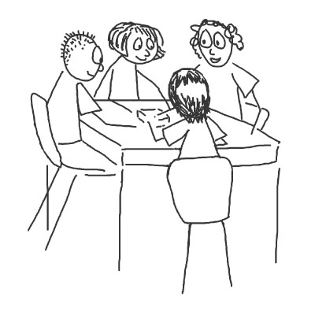
Exercise
In pairs, write a SOCO relevant
to your communications challenge
Notes:
Ask participants to write a SOCO relevant to their area of work.
Give 5 minutes.
They can work alone or with neighbours.

Slide 11
Challenge 2
We say too much
We are trained to be:
Logical
Complete
Accurate
Fear being understood

Slide 12
Scientists and experts speak like this!
Main message
Notes:
Main idea: Experts speak by beginning with a long, complete logical explanation leading to the POINT
Once you are clear about your SOCO, you know where you are going. Once you know where you are going, you must get there as fast as possible. Here is why:
Experts are trained to explain the situation and all possible aspects of an issue, as well as to be complete, accurate and lead people slowly and step-wise to a logical conclusion. If this was depicted graphically, it would look like a triangle on its head, with long explanations eventually leading to the point.

Slide 13
Information overload!
Today people are subjected to more information in a day than they were in the Middle Ages during an entire lifetime!
Notes:
There is an enormous amount of information out there competing with anything you want to convey. The sources of information increase continuously. Some of these sources contradict one another. You audience is distracted, overloaded with information and struggling to unravel contradictions.

Slide 14
The audience is thinking: What's in it for me?

Slide 15
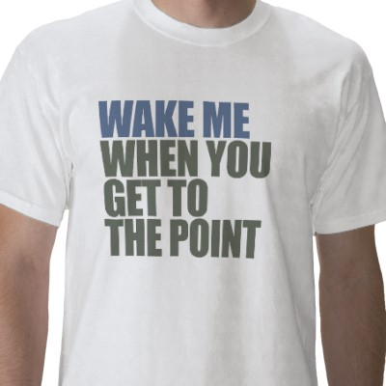
Tip 2: Get to the point!

Slide 16
Tip 2: Get to the point!
Main message
Notes:
Main idea: People listen well by hearing the point followed by reasons, evidence and explanations.
People do not listen or hear in the same way. We tend to listen when our attention is grabbed quickly and focus is achieved.
Once we are interested, we will listen to the explanation and other nuances. This becomes even more important in a world transformed by technology for communications.
Listeners, including experts listening to other experts, are inundated with competing information. We need to get to our point as fast as possible and explain the supporting information and nuances incrementally and in a decreasing order of relevance and importance to our audience.
Graphically, we would turn the triangle mentioned above so that the point is at the top. The POINT is a basic, common-sense and essential communications tip.

Slide 17
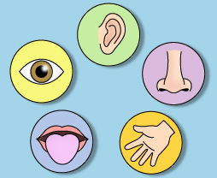
Psychology of memory
Multisensory combination
Memory retention increased by
multisensory learning
Do
Say
See
Hear
Memory
Read
Notes:
Main idea: We are wired to forget, not remember. Therefore we can use multisensory learning to increase memory retention.
When people have something to do, even if it is to call a number, visit a website, be vigilant, etc., they tend to remember messages more.

Slide 18
Psychology of memory
Primacy and recency
Matter to advertisers, writers,
entertainers and teachers
except compelling, new, or surprising information
Beginning
End
Vast cognitive wasteland
Notes:
Main idea: People only remember the beginning and the end, except if they are given compelling, new or surprising information in the middle.
People remember what is outstanding or things that have particular meaning to them.
The human brain chunks information into manageable sizes. Most people cannot retain more than seven plus or minus two pieces of information. It is safe not to expect people to remember more than five things. Three is optimal.
People understand and retain information if there are regular “breaks”. Present one idea at a time and take physical breaks if possible. This could mean presenting an idea and inviting questions or reflection before going on to the next.
Great educators, entertainers and salespersons know that people remember the beginning and the end. The middle is often a vast cognitive wasteland.

Slide 19
The fundamentals
Know your SOCO
Get to the point!
Remember your audience
Engage the senses
Notes:
Key messages from this session:
Take time to develop a single overarching communications outcome (SOCO) that expresses the specific change you want to see as a result of your communications. Do not start messaging without defining your SOCO.
Once you know your SOCO, keep focus on it. It will show you where to go, what to say and how to get back on your path if and when you are derailed, distracted or challenged.
The SOCO helps you clarify the POINT you want to make. Get to the POINT as fast as possible. Explain and elaborate as needed. Conclude again with your POINT for greater effect.
Take time to analyze your audiences ONCE you have your SOCO and BEFORE you start messaging.
Remember that your audiences are distracted, overloaded and sometimes even confused about your issue.
Engaging a number of senses can help increase memory retention.

Slide 20
Exercise : role play
It is Day 1 of a meeting with you’re the top donors to health programmes within your country.
During the coffee break, you spot the head of the AusAID delegation on her own. You know that AusAID has not previously shown any interest in supporting NCD-related activities.
Persuade her to come to meet with you to discuss AusAID’s possible support for a new project that you are establishing

Slide 21
Designing effective products

Slide 22
The 7 Cs of effective communications
Command attention
Clear message
Communicate a benefit
Consistency counts
Cater to the heart and head
Create trust
Call to action

Slide 23
How do these products match up?
World No Tobacco Day video 2014
https://www.youtube.com/watch?v=wb8_ctH1_X4&index=3&list=PLD163320D683D386F
World Health Day 2013
https://www.youtube.com/watch?v=LDWPJijPuBY
Notes:
Main idea : to reinforce key ideas from the session
Facilitators can ask what are the key points from the session before bringing up the slide.

Slide 24
Media and social media
Notes:
Can ask participants whether they have any experience dealing with the media and ask them to comment on their experiences.

Slide 25
What media says is news
Dramatic
Wide-reaching
Breakthrough
Unexpected
Conflict/controversy
Celebrity link
Corruption/negligence/fraud
Notes:
Main idea: The media like to report on news that covers the following topics (in the slide) and they choose the news agenda, not you. This is why it’s important to expect the media if a crisis around vaccination occurs. Vaccination is controversial and it’s advisable to always be prepared.
Examples:
Dramatic – H1N1
Wide-reaching = Many people affected – HIV/AIDS and TB
Breakthrough – expected Malaria vaccine
Unexpected – false linking of MMR and autism
Conflict – health minister vs. industry
Celebrity link – Refusal of then British prime minister Tony Blair to answer whether or not his children had had the MMR vaccine. This is important because by not answering it was assumed that they had not got the vaccine and people were asking why they should have it when the prime minister was not giving it to his children.
The media is more likely to cover a vaccination campaign if they know that a personality – soccer star, soap star – will be there. Remember the power of the photograph – it’s worth 1000 words.

Slide 26
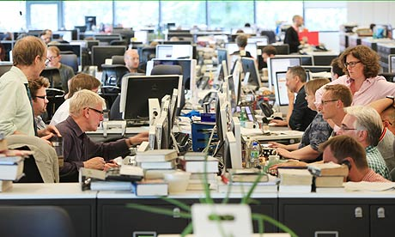
Today's reporter
Writes for more than one media: print, radio, TV, web/blogs
Is on a 24/7 production cycle
Works to tight deadlines
Is bombarded with releases, advisories, statements, much of which contain little "hard" news

Slide 27
The 5Ws and 1H of journalism
Basic questions you may be asked
who is affected; responsible
what has happened and what is being done about it?
where did it happen?
when did it happen?
why did it happen, and will it
happen again?
how did this happen?

Slide 28
10 golden rules
Never lie
Never say “no comment”
There is never an "off the record”
Be short, get to the point and always think of the audience
Stay calm and confident

Slide 29
10 golden rules (2)
Use simple language, avoiding jargon
Stay in control
It's OK to say "I don't know, but I'll find out”
Don't speculate
Beware of reporters' tactics
Remember that journalists are not interested in destroying your reputation or tricking you!

Slide 30
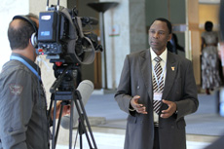
The role of a spokesperson
Communicate information that the public wants or needs to prevent and reduce illness, injury, or death.
Build trust and credibility.
Build support for the public health response.

Slide 31
You do not control what reporters write. You do control what comes out of your mouth. Remember… Interviews are not conversations.

Slide 32
Remember…
Face-to-face communication
38% voice
55% body language
7% words

Slide 33
Communicating risk

Slide 34
Risk is perceived differently by different people
Experts
Perception of risk is higher when hazard is serious
General public
Perception of risk is based on levels of outrage/fear
Notes:
Risk = a situation exposing someone to danger

Slide 35
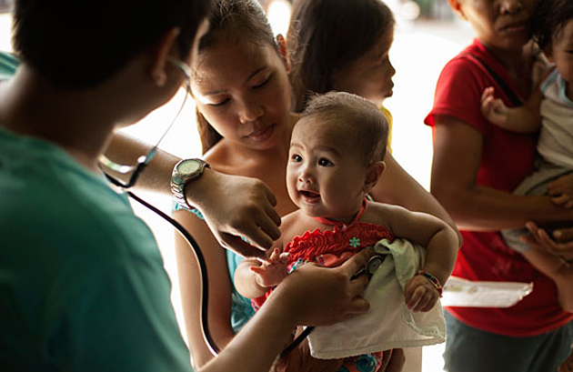
Risk is less acceptable to people if it…
Affects children
Man-made
Unfamiliar, poorly understood
Disastrous in scale (even if the probability is small)
Unfair or targets a particular group
Irreversible
Imposed involuntarily
Uncontrollable

Slide 36
Risk communication strategies
Health education and stakeholder relations
Precautionary advocacy
Outrage management
Crisis communication

Slide 37
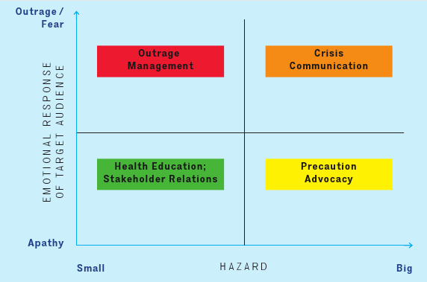
Risk communication strategies

Slide 38
Risk communication strategies
Outrage them to your levels of concern so that they take action
Arouse emotions
Required to prevent secondary crisis
“WATCH OUT!”

Slide 39
Risk communication strategies
Listen and acknowledge truth
Give facts about why there is no danger
"CALM DOWN”
(respectfully)

Slide 40
Risk communication strategies
Explain what is happening
Deal with emotions
“WE ARE ALL IN THIS TOGETHER”

Slide 41
Risk communication strategies
Communications surveillance
Provide regular updates
Identify and address concerns early on

Slide 42
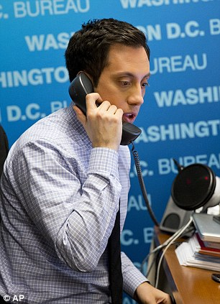
Exercise : role play
A national TV station has contacted your office (at the MoH) asking for an expert to speak about what the Ministry is doing to combat non-communicable diseases.
Your name has been put forward.
Prepare for the interview.
Notes:
Noncommunicable diseases
What do we actually mean by ncds?
What diseases are of particular concern in X ?
Why do you think this is?

Slide 43
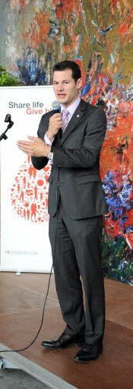
Monitoring
Review media reports/interviews
Did they include your key messages?
Did they quote you?
Were quotes used accurately?
Is any follow-up action required?
Notes:
Review of performance after interviews is important in order to do better in the future.
Media reports/articles should be checked/listened to after publication/airing.
If the reports/articles contain inaccuracies, follow up with the journalist may be appropriate.

Slide 44
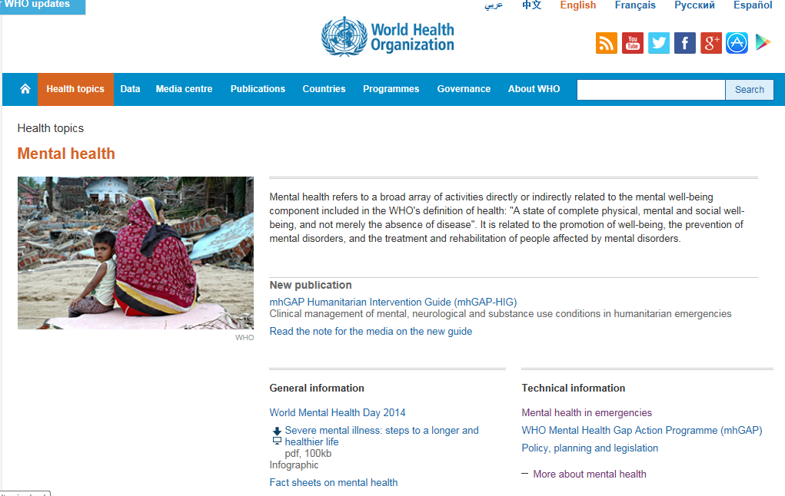
WHO information resources
Website
Fact sheets and FAQs
Feature stories
Videos/infographics/posters
Notes:
Review of performance after interviews is important in order to do better in the future.
Media reports/articles should be checked/listened to after publication/airing.
If the reports/articles contain inaccuracies, follow up with the journalist may be appropriate.

Slide 45
Communicating through video
World No Tobacco Day video 2014
https://www.youtube.com/watch?v=wb8_ctH1_X4&index=3&list=PLD163320D683D386F
World Health Day 2013
https://www.youtube.com/watch?v=LDWPJijPuBY
Notes:
Main idea : to reinforce key ideas from the session
Facilitators can ask what are the key points from the session before bringing up the slide.

Slide 46
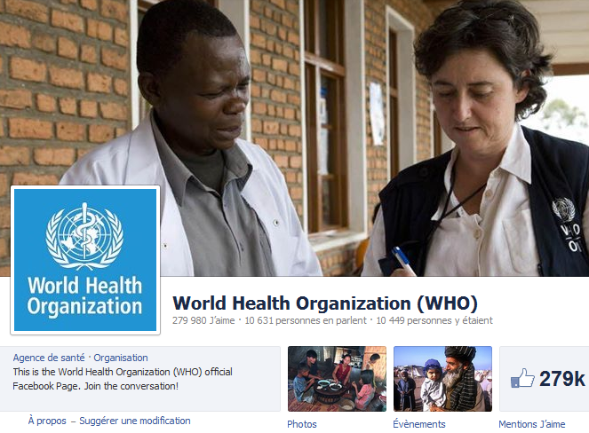
Social media channels
Facebook
Twitter
Google+
YouTube
Notes:
Different platforms have different strategies
At WHO, we focused first on Twitter, then FB, and now moving more to Google +
Note for facilitators: numbers on this page should be updated before presenting
WHO uses social media to communicate risk, reach audiences quickly, build relationships and manage reputation

Slide 47
Wrap-up
One thing that you will do differently as a result of today’s session

Slide 48
Who we communicate with
Colleagues
Regulatory authorities
Manufacturers
Governmental officials
Donors
Partners
Media
Public
Family and friends
Notes:
Key idea: identify audiences with whom we communicate
Facilitators can ask the question of participants before bringing up the bullets on the slide.

Slide 49
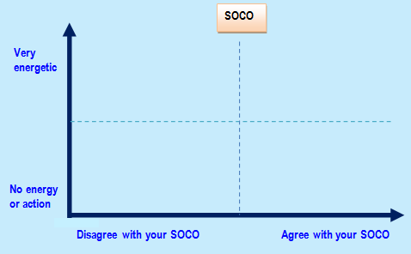
Stakeholder or audience analysis
Blockers
(Active Resisters)
Champions
(Active Supporters)
Avoiders
(Passive Resisters)
Silent Boosters
(Passive Supporters)
Notes:
Explain the matrix and the names we give to the persons/groups in each quadrant.

Slide 50
Communications strategies
Blockers Monitor what they are saying and who is listening to them Ignore if they are not influential Confront if their influence is significant Counteract by giving facts and enlisting champions | Champions Give them information Acknowledge their contribution Let them champion your cause
Avoiders Inform or ignore Get critical mass of champions to influence them | Silent boosters Educate, enable, inform and motivate Energize them by involving champions they admire
Notes:
Key idea : once you have defined and categorized your audiences, you can start to think about strategies
Step 7: Decide which groups or persons are best to target to achieve your SOCO. Think of what needs to be done at what time. This is the beginning of your communications strategy.
Step 8: For each target group, think about what their needs, wants and concerns are.
How can they be reached?
What languages and levels of complexity of messages will suit them?
What channels can best reach them ?
How can you make your messages compelling ?
Step 9: Review your analysis at specific time intervals or when the situation or context changes.

