Slide 1
The 2011 Political Declaration and the 2014 review: implications for NCD programme managers
9th WHO-IUMSP course, Lausanne,
4 – 8 May 2015
Dr Nick Banatvala, WHO Geneva, Switzerland

Slide 2




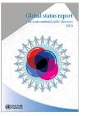


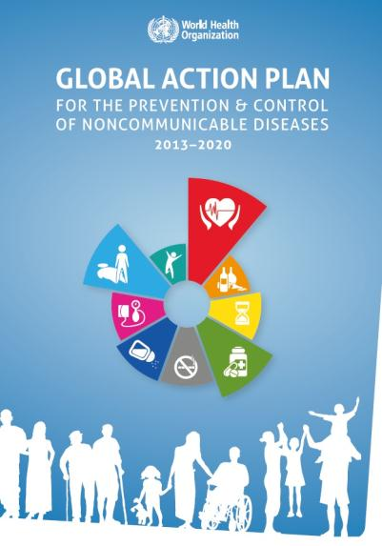
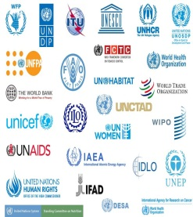


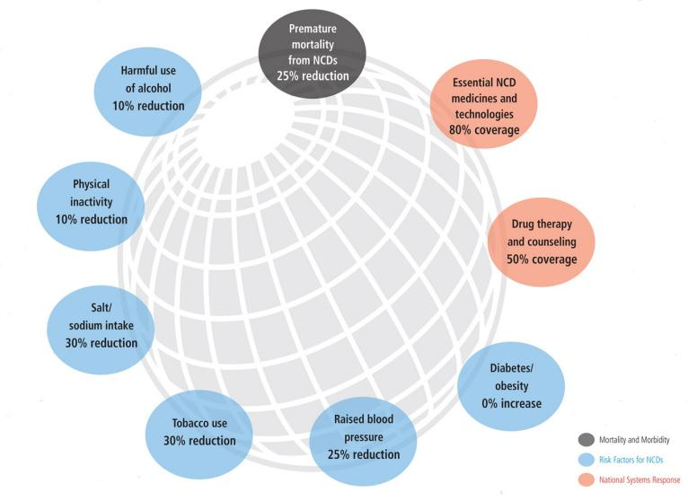
2000
Global Strategy for the Prevention and Control of NCDs
2003
Global Strategy on Diet,
Physical Activity and Health
2004
2008-2013 Action Plan on the Global Strategy for the
Prevention and Control of NCDs
2008
Global Strategy to Reduce the Harmful Use of Alcohol
2009
First WHO Global Status Report on NCDs
2010
2011
UN Task Force on NCDs
UN Political Declaration on NCDs
Moscow Declaration
2013
2014
UN General Assembly Comprehensive Review 2014 on NCDs
2015
Country Framework for Action to engage sectors beyond health on NCDS
Adoption of the
Post-2015 development agenda
2025
Attainment of the 9 global targets for NCDs by 2025
World Health Assembly
UN General Assembly
2030
Attainment of the 9 global targets for NCDs by 2030 (
as part of the post-2015 development agenda)
ECOSOC

Slide 3
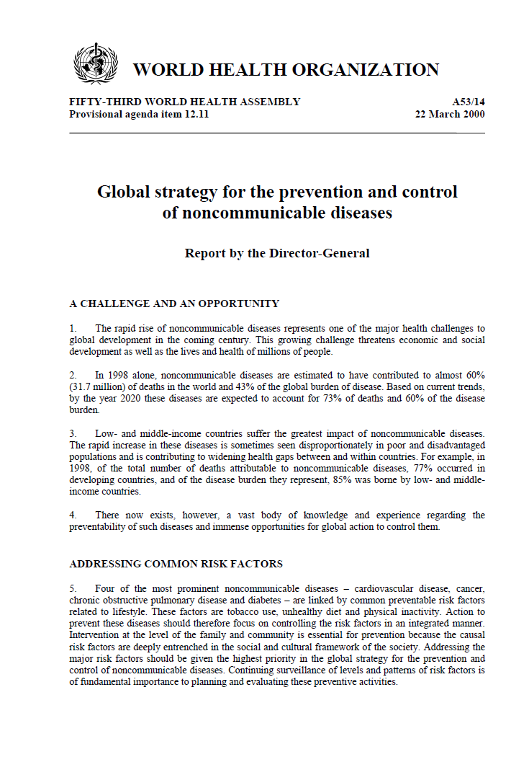
            The 2000 global strategy for the prevention and control of NCDs
              4 diseases and 3 risk factors – harmful use of alcohol added afterwards
              Goal of reducing morbidity, disability and premature mortality from NCDs
              3 objectives
                Mapping the epidemic
                Reducing individual and population exposure to risk factors
                Strengthening health care
              Components: surveillance, prevention/health promotion and healthcare management
              Clear roles for the three partners

Slide 4







World Health Assembly in 2000:
There is a clear vision on how to address NCDs
Surveillance
Mapping the epidemic of NCDs
Prevention
Reducing the level of exposure to risk factors
Management
Strengthen health care for people with NCDs
Notes:
We know what we need to do at country level

Slide 5
NCDs are the single biggest cause of death
10%
60 million
5.1 M
50 million
26.9 M
(above the age of 60)
Now we talk about below the age of 70, and in 2015 we refer to the figure of over 14 million
40 million
30 million
Source: WHO global estimates 2008
9.1 M
(premature deaths - below the age of 60)
20 million
15.7 M
10 million
0
Total deaths in the world (2008)
Group III - Injuries
Low-income countries
Group II – Other deaths from NCDs
Group II – Premature deaths from NCDs (below 60 years), which are preventable
Group I – Communicable diseases, maternal, perinatal and nutritional conditions

Slide 6
90% of global premature deaths from NCDs occur
in low- and middle-income countries
2.9M
25 million
13.6M
20 million
Total deaths (2008)
15 million
Source: WHO global estimates 2008
10 million
5.3M
1M
0.5M
8.3M
2.3 M
6.6M
0.8M
1.4M
4.4M
5.6M
1M
1.4M
0.6M
1.2M
High-income countries
Upper middle-income
Lower middle-income
Low-income countries
Group III - Injuries
Low-income countries
Group II – Other deaths from NCDs
Group II – Premature deaths from NCDs (below 60 years), which are preventable
Group I – Communicable diseases, maternal, perinatal and nutritional conditions

Slide 7
Four types of NCDs account for most deaths in all regions
100%
80%
60%
40%
20%
0%
WHO Region
for Africa
WHO Region for the
Eastern Mediterranean
WHO Region
for the Americas
WHO Region
for Europe
WHO Region for
South-East Asia
WHO Region for the
Western Pacific
Other NCDs
Diabetes
Respiratory diseases
Cancers
Cardiovascular diseases

Slide 8
Clear focus on 4 NCDs and 4 common risk factors for NCDs
 | Tobacco use | Unhealthy diets | Physical inactivity | Harmful use of alcohol
Heart disease and stroke | ✓ | ✓ | ✓ | ✓
Diabetes | ✓ | ✓ | ✓ | ✓
Cancer | ✓ | ✓ | ✓ | ✓
Chronic lung disease | ✓
Notes:
four groups of NCDs that constitute around 80%of NCD deaths and that share the same risk factors and therefore also the same strategies

Slide 9
First Summit of CARICOM Heads of Government on
Chronic, Noncommunicable Diseases
15 September 2007, Port of Spain
WHO invited to address Heads of Government
First time commitment at this sort of level for NCDs
Magnitude, socioeconomic impact highlighted
The need to implement national responses
Summit Declaration with a commitment for regional and national response
Notes:
9

Slide 10
2009: UN Economic and Social Council Ministerial
ECOSOC High-level Segment (Geneva, 6-9 July)
  hears many calls for a Special Session of the General Assembly on NCDs – Why?
NCDs reflected in the ECOSOC Ministerial Declaration
Notes:
10

Slide 11
2009: UN General Assembly
Prime-Minister of Trinidad and Tobago calls for a Special Session of the General Assembly on NCDs. In his address he highlighted:
    The Global Economic Situation
    Reform of the International Economic System
    CARICOM. Middle Income Countries and Haiti
    Security
    Climate Change
    NCDs: “I now propose to this august Assembly, that a Special Session of the United Nations General Assembly on Non-Communicable Diseases be convened at the earliest opportunity."
    Food Security
    UN reform
Notes:
11

Slide 12
December 2009 – May 2010:
Drafting of a UN resolution for HLM on NCDs at the UNGA
Drafting process led by the Caribbean Community (CARICOM)
Cameroon on behalf of Member States who are members of the Group of African States
78 Member States sponsored the draft resolution
Notes:
A total of 78 countries sponsored the draft resolution (indicated in red on this slide), including Cameroon, which sponsored the draft resolution on behalf of Member States who are members of the Group of African States (indicated in red stripes on this slide).
--------------------------------
Original sponsors:
Antigua and Barbuda, Australia, Bahamas, Bangladesh, Barbados, Belize, Brazil, Canada, Chile, China, Colombia, Cyprus, Dominica, Dominican Republic, El Salvador, Germany, Grenada, Guatemala, Guyana, Haiti, India, Ireland, Jamaica, Luxembourg, Malaysia, Malta, New Zealand, Papua New Guinea, Paraguay, Peru, Portugal, Qatar, Saint Kitts and Nevis, Saint Lucia, Saint Vincent and the Grenadines, Samoa, Solomon Islands, Suriname, Thailand, Trinidad and Tobago, United Kingdom of Great Britain and Northern Ireland and Uruguay
The following countries were added to the list of sponsors:
Azerbaijan, Belgium, Bolivia (Plurinational State of), Bulgaria, Cameroon∗, Croatia. Cuba, Finland, France, Georgia, Greece, Hungary, Israel, Italy, Japan, Kazakhstan, Maldives, Marshall Islands, Mexico, Monaco, Montenegro, Nauru, Nicaragua, Pakistan, Palau, Panama, Russian Federation, Serbia, Singapore, Slovenia, Spain, Switzerland, Timor-Leste, Tonga, Turkey and United States of America
∗ On behalf of the States Members who are members of the Group of African States

Slide 13
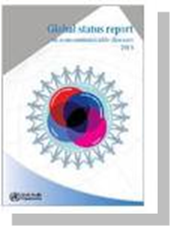
Global Status Report: interventions that work
Population-based interventions addressing NCD risk factors | Tobacco use | Excise tax increases Smoke-free indoor workplaces and public places Health information and warnings about tobacco Bans on advertising and promotion
 | Harmful use of alcohol | Excise tax increases on alcoholic beverages Comprehensive restrictions and bans on alcohol marketing Restrictions on the availability of retailed alcohol
 | Unhealthy diet and physical inactivity | Salt reduction through mass media campaigns and reduced salt content in processed foods Replacement of trans-fats with polyunsaturated fats Public awareness programme about diet and physical activity
Individual-based interventions addressing NCDs in primary care | Cancer | Prevention of liver cancer through hepatitis B immunization Prevention of cervical cancer through screening (visual inspection with acetic acid [VIA]) and treatment of pre-cancerous lesions
 | Cardiovascular disease and diabetes | Multi-drug therapy (including glycaemic control for diabetes mellitus) for individuals who have had a heart attack or stroke, and to persons at high risk (> 30%) of a cardiovascular event within 10 years Providing aspirin to people having an acute heart attack
Notes:
04/05/2015
13

Slide 14

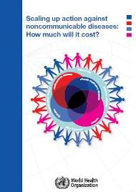
The cost of inaction in developing countries over the next 15 years is enormous
(compared to the cost of action)
Cost of inaction in middle- and low-countries:
US$ 7 trillion
(2011-2025)
Cost of action in middle- and low-countries:
US$ 170 billion

Slide 15
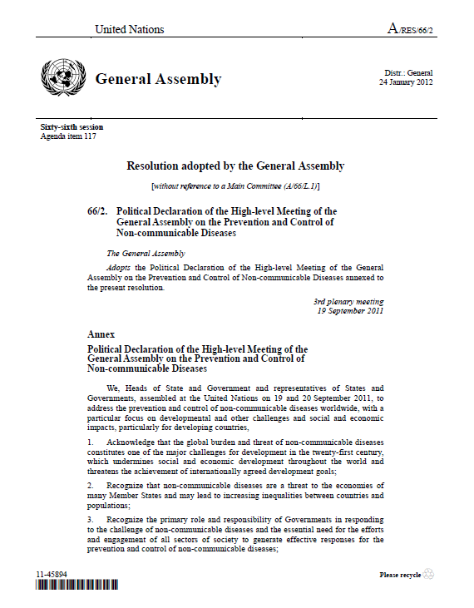
19-20 September 2011: UN General Assembly HLM. New York
2nd time in the history of the UN that the GA meets on a health issue
Countries adopted a 13-page action-oriented outcome document to shape global agendas for generations to come.
Articulated roles and responsibilities for Member States and others including WHO

Slide 16
The Political Declaration…
A whole-of-government and a whole-of-society effort
Reducing risk factors and create health-promoting environments
Strengthening national policies and health systems
Encouraging international cooperation, including collaborative partnerships
Promoting research and development
Strengthening monitoring and evaluation
Follow up and way forward

Slide 17
The Political Declaration…
NCD agenda has to be led by governments
Roles and responsibilities for WHO and the wider the UN system, with specific actions
Roles and responsibilities for civil society and the private sector
“Ensured” that NCDs was in the system at the highest level for the future

Slide 18
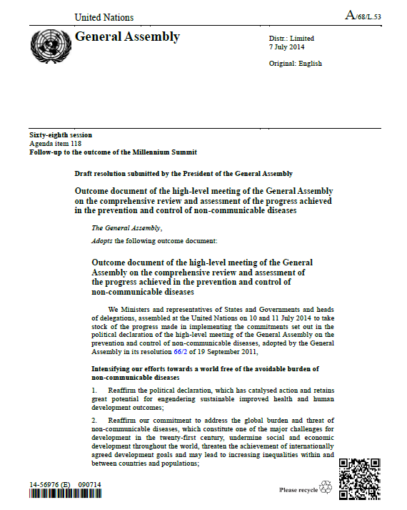

Slide 19
2014 Comprehensive review and assessment outcome document: national commitments, engaging with partners across all sectors…
Enhancing governance
Reducing risk factors and underlying SDH
Strengthening and orientating health systems
Integrating HIV/AIDS and NCD programmes
Including NCDs into SRH and CDC programmes
Consider GAP Appx 1 to ensure a comprehensive approach to NCDs
Monitor NCD trends and progress
Strengthen international cooperation wrt plans and best practice in health promotion, legislation, regulation, health systems
Strengthen N-S, S-S and triangular cooperation
Continue to explore adequate, predictable and sustained resources through domestic, bilateral, regional and multilateral channels, including traditional and voluntary financing mechanisms.

Slide 20
2014 Comprehensive review and assessment outcome document: national commitments: governance…
Setting national targets and process indicators
Developing national multisectoral plans
Raising awareness on NCDs
Integrating NCDs into national development plans including the UNDAF
Establish a national multisectoral mechanism such as a commission for a whole of government and whole of society response
Strengthen MoH capacity for strategic leadership
Align international cooperation with national plans
Ensure national policies and plans are resourced

Slide 21

United Nations General Assembly
Roadmap of national commitments from Heads of State and Government to address NCDs
2011 UN Political Declaration on NCDs
2014 UN Outcome Document on NCDs
Roadmap of concrete national commitments, including one time-bound commitment:
By 2013, consider developing national multisectoral policies and plans
Reiterated the same roadmap of national commitments, including four time-bound commitments:
By 2015, consider setting national targets, taking into account the nine global targets for NCDs to be attained by 2025
By 2015, consider developing national multisectoral policies and plans, taking into account the WHO Global NCD Action Plan 2013-2020
By 2016, reduce risk factors for NCDs through the implementation of interventions building on the guidance set out in Appendix 3 of the WHO Global NCD Action Plan 2013-2020
By 2016, strengthen health systems through people-centred primary health care and universal health coverage, building on the guidance set out in Appendix 3 of the WHO Global NCD Action Plan 2013-2020

Slide 22

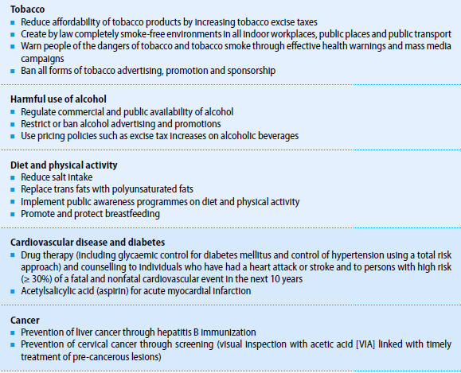
WHO Global NCD Action Plan 2013-2020 including a set of very-effective and affordable interventions for all Member States ("best buys")

Slide 23



Accountability Framework:
Holding governments accountable at the World Health Assembly and the UN General Assembly
2015
WHA68 (2016)
2020
WHA73 (2021)
2025
WHA78
(2026)
2015
WHA68
(2016)
2017
WHA69
(2018)
2020
WHA73
(2021)
2015
Progress
monitor
2016
Progress
monitor
2017
UNGA*
(2018)
* 3rd HLM

