Slide 1
Addressing the social determinants of health
Silvia Stringhini, social epidemiologist, IUMSP

Slide 2
Objectives
Understand the role of social factors as determinants of NCDs
Address the social determinants of NCDs
Recognize interventions impacting on social inequalities in NCDs
Outline
Social inequalities in NCDs
Underlying mechanisms, prevention strategies
The UN and the social determinants of NCDs
Take home messages

Slide 3
Social inequalities in NCDs

Slide 4
Inequalities in male life expectancy at birth between and within countries
Country | Male life expectancy at birth
Angola | 40
UK, Glasgow (Calton) | 54
India | 62
Lithuania | 65
Mexico | 72
United States | 75
Cuba | 76
Switzerland | 79
UK, Glasgow (Lenzie N.) | 82
Sources: WHO, World Health Statistics 2008; Hanlon, Walsh & Whyte 2006; Murray et al. 2006
Notes:
Inequalities in health between countries are large (male life expectancy at birth 40 years in Angola and 79 years in Switzerland). However, inequalities in health within countries can be of the same magnitude: in Glasgow (Scotland), male life expectancy at birth ranges between 54 years in the most deprived district to 82 years in the least deprived.

Slide 5
Social inequalities in NCDs within countries
Systematic differences in health observed along axes of socioeconomic position, gender, race/ethnicity and geography, even when health care is universally accessible
Social inequalities in CD and NCDs
Health risk accumulates over time beginning at conception → social determinants of health act across the lifecourse

Slide 6
Cardiovascular disease mortality in the Whitehall II cohort (UK)
3.5
SES powerfully predicts NCDs
Effect of SES ~ smoking
2.2
Source: Stringhini S et al. JAMA, 2010.
Notes:
Socioeconomic status is a powerful predictor of NCDs and its effect might be comparable to that of cigarette smoking for certain health outcomes

Slide 7
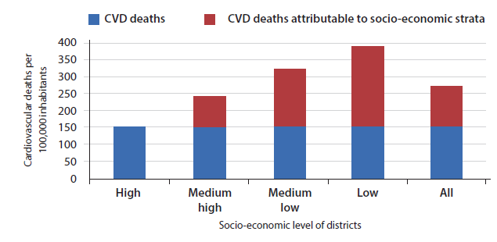
Cardiovascular disease mortality in Brazil (Porto Alegre)
Cardiovascular deaths of people aged 45-64 by city district
Source: Bassanesi S et al. Arq Braz Cardiol, 2008.
Premature death rate for CVD 2.6 times higher in poorer districts of the city

Slide 8
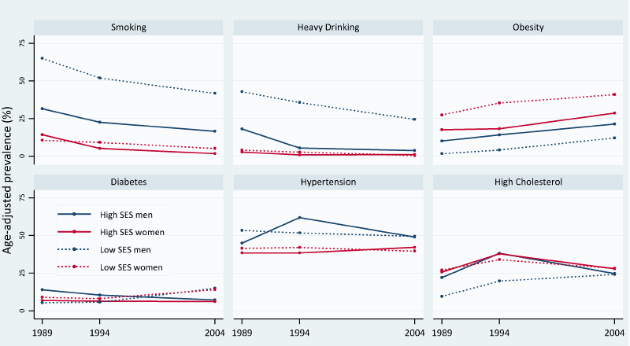
Trend in the social patterning of NCDs risk factors. Repeated surveys in the Seychelles.
Prevalence of NCDs risk factors (exception of smoking in men) often higher among the rich in LICs and higher among the poor in MICs.
But secular shift towards the poor along the progression of the epidemiological transition.
Sources: Stringhini et al IJC 2012.

Slide 9
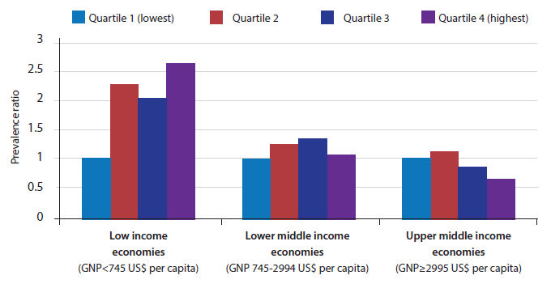
Obesity prevalence in women by education in countries at different levels of development
Obesity more prevalent among more educated women in low income countries.
Less prevalent among high educated women in upper middle income countries.
Sources: Monteiro CA et al. Int J Obes Relat Metab Disord, 2004.

Slide 10
Change in prevalence of overweight/obesity among women from 7 African countries1992-2005
Prevalence of overweight/obesity higher among high vs low educated women.
But obesity decreases over time in high SES and increases in low SES.
Sources: Ziraba et al BMC Public Health 2009.

Slide 11
Social inequalities in NCDs: underlying mechanisms

Slide 12
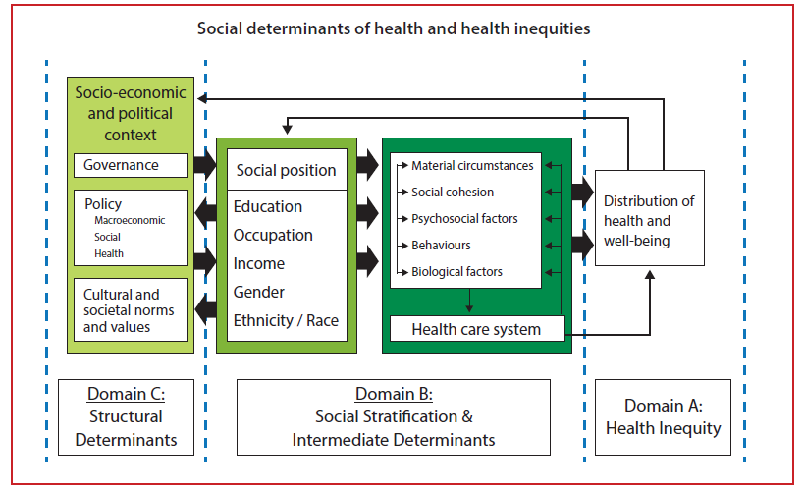
Framework for the social determinants of health (WHO CSDH)
Sources: Closing the gap in a generation: Health equity through action on the social determinants of health. Final report of the Commission on the Social Determinants of Health (CSDH). Geneva: WHO; 2008.

Slide 13
Social inequalities in NCDs: underlying mechanisms
ENVIRONMENTAL EXPOSURES
- Pollution
- Living/working conditions
Lifecourse SES
PSYCHOSOCIAL EXPOSURES
- Social relationships/support
- Job strain
HEALTH
BEHAVIORAL EXPOSURES
- Lifestyle factors
ACCESS TO/USE OF HEALTH CARE
Environmental, psychosocial and behavioural exposures major factors explaining the link between SES and health.
Social patterning of behavioral factors explains largest part of social differences in NCDs(40-60%).
Increasing role of environmental exposures.
Access to/use of health care accounts for <15% of SES differences in health in US/Europe. No studies in LMICs but probably high.

Slide 14
Social stratification of behavioural risk factors for NCDs
TOBACCO USE: By 2030, 70% of tobacco related deaths in LMICs. In every region of the world, lower income groups more likely to use tobacco. Prevalence generally higher in men but increasing in women.
HARMFUL USE OF ALCOHOL: More prevalent among lower socioeconomic groups in LMICs and in men than women.
PHYSICAL INACTIVITY: Higher prevalence in LMICs than HICs. In HICs, lower prevalence in higher socioeconomic groups while in LMICs (especially LICs) higher prevalence in lower socioeconomic groups.
UNHEALTHY DIET: Higher quality diet associated with affluence in most countries. However, nutrition transition touches higher socioeconomic groups first in LMICs, so higher consumption of processed and refined foods and trans fats in higher income groups in LMICs, who abandon first traditional dietray patterns.. But changes over time.

Slide 15
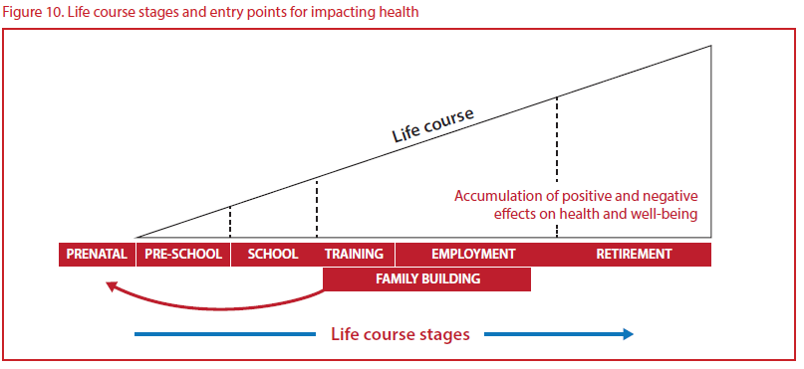
Lifecourse perspective on NCDs
Early years of life key determinants of health at older ages
Early disadvantage has lifelong effect on health and NCDs
Two pathways: cumulative damage over time and biological embedding of adversities during sensitive periods (ie: in utero, social determinants of epigenetic modifications)
Importance of addressing social determinants in sensitive periods such as pregnancy and adolescence

Slide 16
Social inequalities in NCDs: prevention strategies

Slide 17
Social inequalities in NCDs: prevention strategies
Burden NCDs
Existing social inequalities in NCDs
SCENARIO 1
Whole population approach: ‘agentic’ prevention strategies
Whole population approach:
‘structural’ prevention strategies
SCENARIO 2
Low SES
High SES
IDEAL
Prevention strategies relying on individuals' capacity to respond (“agentic”) are likely to increase the health gap between SES groups → disproportionally benefit high SES individuals
Structural strategies likely not only to reduce NCD burden but also have impact on social inequalities in NCDs (example: ban on public smoking affects everybody the same).
Notes:
Let’s assume that we know which are major determinants of NCDs and that they are more prevalent in lower socioeconomic groups. So let’s also assume that this line represents existing social inequalities in health and that this would be the ideal situation, with low mortality and no inequalities. Of course the ideal scenario is very unlikely to happen. However, one type of intervention could be based on agentic prevention strategies which rely on individual’s capability. In this case, if the intervention is targeting important determinants of NCDs the population burden would be reduced, however, inequalities in NCDs would increase because people from lower SES groups are less likely to respond to these kind of prevention strategies. On the other hand, if structural prevention strategies are implemented, individuals are in some way “forced” to respond to interventions so structural prevention strategies would not only reduce the burden of NCDs but also reduce social inequalities in NCDs.

Slide 18
Structural prevention strategies likely to reduce social inequalities in health
– acting on proximal determinants:
Fluoridation of drinking water
Clean indoor air laws
Elimination of trans fats/reduction or salt content in foods by jurisdiction
Mandatory folate fortification of cereal-grain products
Free child care
– acting on distal determinants:
Redistributive policies aimed at reducing socio-economic disparities
Policies promoting public education and public health care
Policies promoting safer work places
Notes:
Example of “structural” prevention strategies are: fluoridation of drinking water

Slide 19
Key enabling of action on social determinants of NCDs
High level political commitment
Building support for action requires showing that improving social conditions can improve population health and support other development objective
Challenging as may require action against powerful lobbies (tobacco, pharmaceutical, food and beverage companies)
Analysis of cost of health inequities may provide powerful argument
Governance mechanism to coordinate multisectorial responses
Coherent governmental approach
Joint action across distinct departments
Robust structures for monitoring
Build on Global Monitoring Framework by establishing national NCDs targets and indicators related to social determinants of health
Useful tool: WHO Urban Health Equity Assessment and response Tool
Evaluation and accountability
Notes:
GWM adopted by world health asembly in 2013

Slide 20
Intervention strategies to reduce social inequalities in health should:
Consider the diffusion of innovations theory: differences in uptake between early adopters (likely high SES) and later adopters (likely low SES), who may require special efforts.
Assess where the proposed intervention falls on a continuum from agency to structure→ Strategies relying on individual agency more likely to worsen social inequalities in NCDs.
Issue of lifecourse. Important to limit the consequences of exposure to low SES in critical periods of development as they will impact health in adulthood.
Be multisectorial.
Notes:
Assess where the proposed intervention falls on a continuum from agency (pertaining to an individual’s capacity to make the choice to act) to structure (pertaining to social institutions and norms that shape the actions of individuals).

Slide 21
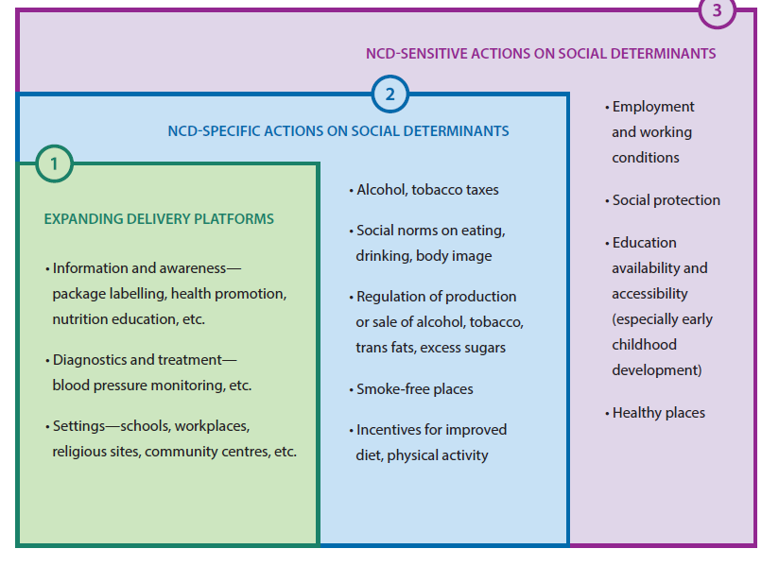
Typologies of mutilsectorial actions
Sources: UNDP: Addressing the social determinants of non-communicable diseases. 2013

Slide 22
Expanding delivery platforms
Using settings outside the health system (school, workplaces, religius centers) to deliver conventional interventions
Monitoring of NCDs risk factors in school
Food labelling
Health promotion and nutrition education in schools
→ Focus on individual decision making and less on the context in which decision are made: may increase health inequalities

Slide 23
NCDs specific actions on social determinants
Laws, policies and programmes whose primary purpose is action on social determinants of NCDs
Tobacco taxes (decrease social inequalities in tobacco use)
Increase import duties on fizzy drinks
Laws that restrict density of fast foods
Incentives to vendors to sell fruit and vegetables in poor areas
Very effective
Example: Taxes on sugary beverages or bans in alchool sachets
2007: Government of Nauru implements a “sugar levy”; 2002: French Polynesia introduces taxes on sugar-sweetened beverages
2012: Zambia bans the manufacture, sale and consumption of strong liquor sachets, popular among youths and lower socioeconomic groups→ decrease of number of people with alcohol intoxication

Slide 24
NCDs sensitive actions on social determinants
Policies and laws addressing the distribution of power and resources throughout society
Improvements in employment and working conditions
Social protection policies
Improvements in education system
Laws for safe and healthy living environments (including regulation of pollution)
Very effective
Example: Brazil Bolsa Familia’s conditional cash transfer system
Cash transfers to poor families with children that resulted in improved food security, nutritional outcomes among young children and reduced school absence and child labour

Slide 25
Hyderabad nutrition trial (1987-90), India
Food supplementation to pregnant women in 15 poor Indian rural villages (14 villages controls)
Baseline (1987-90)
Children born to supplemented mothers +61g birthweight
Follow-up (2003-05)
14mm taller
Same fat mass
Lower risk of cardiovascular disease
Insulin resistance (HOMA): 20% lower
Arterial stiffness: 3% lower
Systolic blood pressure: 0.6mm Hg lower
Sources: Kinra et al. BMJ 2008.

Slide 26
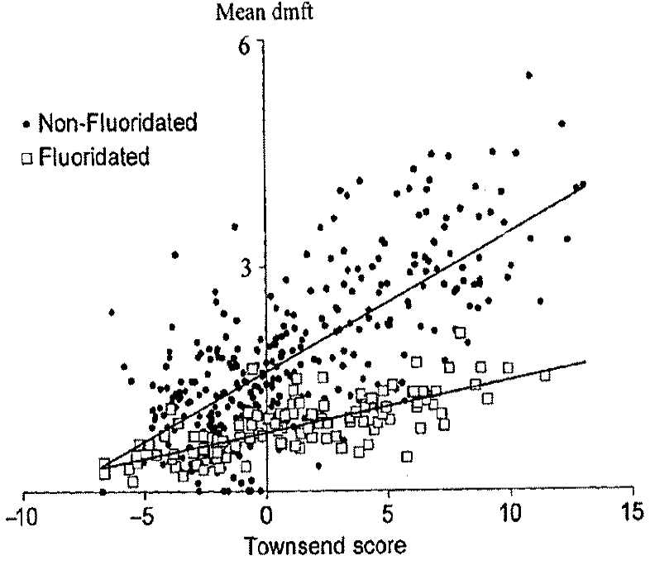
Water fluoridation (1993-94), United Kingdom
Water fluoridation in 7 districts vs 7 control of same SES
Decayed theet (DT)
Mean 0.87 in fluoridated district; 1.8 in non-fluoridated district (p<0.0001)
The intervention benefits most the most disadvantaged areas
→inequalities reduced
DECAYED THEET
Probably same effects for other structural interventions such as trans fats/salt reduction in food
DEPRIVATION
Sources: Riley et al. IJE 1999.

Slide 27
Social inequalities in NCDs: Rio Political Declaration on Social Determinants of Health (October 2011)
More relevant acknowledgments:
Health inequities within and between countries are politically, socially and economically unacceptable, as well as unfair and largely avoidable
Health inequities arise from the societal conditions in which people are born, grow, live, work and age
Good health requires a universal, comprehensive, equitable, effective, responsive and accessible quality health system
More relevant actions:
Work across different sectors and levels of government
Develop inclusive policies (specific attention to vulnerable groups)
Strengthen occupational health safety
Promote and strengthen universal access to social services
Build, strengthen and maintain health financing and risk pooling systems

Slide 28
Social inequalities in NCDs: WHO Global NCDs Monitoring Framework (March 2012)
The global reporting system should give ample attention to disaggregated data for the indicators to be able to ascertain trends in inequality.
Monitor core indicators for NCDs by key dimensions of equity including gender, age, and socioeconomic status.
“Global monitoring framework should set targets that aim to reduce inequities and take the key social determinants into account.”

Slide 29
Social inequalities in NCDs: WHO Global Action Plan for the Prevention and Control of NCDs for 2013-2020
→ Promote health and equity in relation to prevention and control of NCDs.
When making public health decisions, consideration should be given to cost-effectiveness and affordability, implementation capacity, feasibility, impact on equity and poverty, as well as the balance between population wide interventions and individual interventions.
Policies, plans and services for the prevention and control of NCDs need to take account of health and social needs at all stages of the life course, starting with maternal health, ..., and continuing through proper infant feeding practices, ..., followed by promotion of a healthy working life, healthy ageing and care for people with NCDs in later life.

Slide 30
Social inequalities in NCDs: Action Plan for European Strategy for the Prevention and Control of NCDs
→ A focus on equity. Specific attention to whether social determinants affect people’s opportunities to make and sustain healthy choices.
→ A life course approach. Exposure to the risk of NCDs accumulates throughout the life course, starting with influences that occur during pregnancy and continuing through early childhood, adolescence and adulthood.
→ Balance population-based and individual approaches. Most cases of disease are found in those at low or moderate risk, and only a minority of cases are in those at high risk.
→ Disseminate and advocate for improved universal access to more comprehensive and equity-sensitive packages of NCD interventions.

Slide 31
Social inequalities in NCDs: Take home messages

Slide 32
Take home messages
For policies aimed at reducing social inequalities in NCDs crucial to consider that different SES groups are likely to respond differently to prevention strategies targeting the whole population → prioritizing “structural” prevention strategies
Whenever possible, the fact that SES acts across the lifecourse to affect NCDs risk should be considered → attention to exposures in early life which are not only relevant for communicable diseases but also for NCDs (also emphasized in the global action plan for the prevention and control of NCDs 2013-2020)
Critical to put health equity in all policies.
Health equity issues are more and increasingly present in the global agenda of international organisations (UN, WHO) → good window of opportunities in LMICs to implement policies developed to prevent and control NCDs, with specific attention to their social distribution

Slide 33
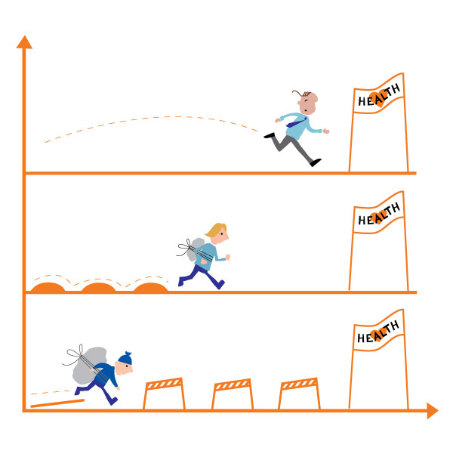
Thanks for your attention
Source: National strategy to reduce social inequalities in health, The Norwegian Institute of Public Health (2006-2007)

