Slide 1
Subject | Details
Title | The role of the National Programme Manager in advocacy and partnerships
Presenter | Menno van Hilten
Objective | Improve communication and partnership skills of National Programme Managers
Expected outcome | National Programme Managers provided with the basic tools and skills to convince decision-makers that addressing NCDs merit increased investment
Suggested reading before the session | None
Suggested reading after the session | www.who.int/ncd

Slide 2
Menno van Hilten
External Relations Officer
Noncommunicable Diseases and Mental Health
World Health Organization

Slide 3
10:30-12:00
The role of the National Programme Manager in advocacy and partnerships

Slide 4

Objectives of the session:
Convince decision makers that addressing NCDs merit increased investment
Format:
Exercises
Explain tool following first exercise
Interactive
Informal
Interruptions encouraged ☺
Time management:
10:30 – 12:00
Background reading:
This slide deck
www.who.int/ncd

Slide 5

People remember...
20% of what they hear
40% of what they hear and see
80% of what they discover for themselves

Slide 6

Expectations
After this session, you'll have the basic tools (and skills) to convince decision-makers that:
Addressing NCDs merit increased investment
Action to address NCDs carries substantial benefits

Slide 7
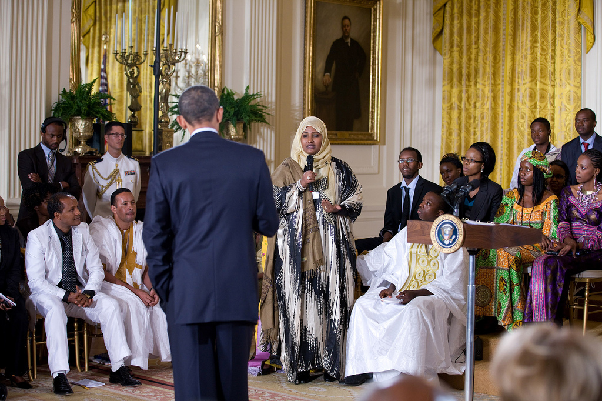
If you have a chance to speak to
US President Obama for 2 minutes,
what would you tell him about NCDs?

Slide 8

Challenge 1
What is the point?
We are not always clear WHY we speak, write or make a presentation

Slide 9

Challenge 2
We are trained to be logical, complete, accurate, evidence-based and fear being misunderstood.

Slide 10

Challenge 3
We tend to concentrate on what we know and don't always think of why our message is important to listeners, viewers or the audience …now

Slide 11
Scientists, experts and programme managers speak like this
Challenge 4
Ministers and
decision-makers
speak like this
"I need 30 minutes of your time to share 40 years of my accumulated technical expertise"
"We must make the prevention and control NCDs and the improvement of maternal health top priorities on the development agenda"
"Yesterday's article in the Lancet discusses the prevention of pre-eclampsia in diabetic women."

Slide 12
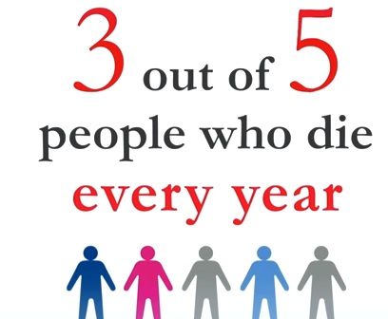
Example 1: NCDs
"Dear President Obama"
www.youtube.com/watch?v=-i_3nonEq0E&feature=share&list=PL3FB3D1EAAD2DBE57

Slide 13

Example 2: NCDs
"Dear President Obama"
http://www.youtube.com/watch?v=rdp8IZWWAT0&list=PLD163320D683D386F&index=14

Slide 14
Example: NCDs
"Dear President Obama"
In all developing countries, and by any metric, NCDs now account for a large enough share of premature deaths and poverty to merit a public policy response.
A global vision and affordable solutions exist to prevent 14 million people from dying prematurely each year from NCDs.
At WHO, we witness how programme managers in developing countries are increasingly challenged to formulate effective strategies to address NCDs. Donors, like USAID, should start considering these requests for technical assistance, even if these problems are not included in the MDGs.
All governments have committed themselves to a 25% reduction in mortality from NCDs in 2025. You have a unique opportunity to take a leadership role in advancing this agenda by including NCDs in USAID's agenda.

Slide 15

"Communications 101"
Elements of communication:
Sender
Message
Target Audience
Proof points
Channel
Time

Slide 16



Organizing your thoughts
Positioning statement
The point
What is your topic?
What is relevant now for the person you are speaking to?
What do you want to see changed?
Ongoing situation
Message: the four O's
Opportunities
One recommendation
Operationalization

Slide 17
G-20
media
donors
UNGA
International
Development
Agencies
World
Bank
Minister of Foreign Affairs
and Planning
Target Audiences
UN
Agencies
Ministers of Health/WHA
Focal points in MoH
Counterparts in other Ministries
(agriculture, finance, trade, transport, urban planning, education and sport)
National NGO leaders
Civil Society/Population/People with NCDs

Slide 18
G-20
media
donors
UN
International
Development
Agencies
World
Bank
Minister of Foreign Affairs
and Planning
Target Audiences
UN
Agencies
Ministers of Health
NCD focal points in MoH
NCD counterparts in other Ministries
(agriculture, finance, trade, transport, urban planning, education and sport)
National NGO leaders
Civil Society/Population/People with NCDs

Slide 19
Example 3: NCDs
"Dear President Obama"
Ongoing
situation
In all developing countries, and by any metric, NCDs now account for a large enough share of premature deaths and poverty to merit a public policy response.
A global vision and affordable solutions exist to prevent 14 million people from dying prematurely each year from NCDs.
At WHO, we witness how programme managers in developing countries are increasingly challenged to formulate effective strategies to address NCDs. Donors, like USAID, should start considering these requests for technical assistance, even if these problems are not included in the MDGs.
All governments have committed themselves to a 25% reduction in mortality from NCDs in 2025. You have a unique opportunity to take a leadership role in advancing this agenda by including NCDs in USAID's agenda.
Opportunities
One
recommendation
Operationalization

Slide 20
How do you quickly translate a 'positioning statement' into a presentation?

Slide 21

In all developing countries, and by any metric, NCDs now account for a large enough share of premature deaths and poverty to merit a public policy response.

Slide 22
14.2 million people die every year from NCDs between the ages 30 and 69:
Most of these premature deaths could have been prevented
14.2 million

Slide 23
More than 85% of people who die from NCDs between the ages of 30 and 69
live in a developing country
14.2 million

Slide 24
More than 85% of people who die from NCDs between the ages of 30 and 69
live in a developing country
11%
59%
16%
14%

Slide 25
Huge disparities exist across countries in relation to the probability of death from
an NCD between the ages of 30-69

Slide 26
Prevalence of diabetes is highest in the Eastern Mediterranean
15%
Men
Age-standardized prevalence of diabetes in adults aged 25+ years (2008)
Source: WHO Global Status Report on NCDs (2010)
Women
10%
5%
Africa
Americas
Eastern-
Mediterranean
Europe
South-
East Asia
Western
Pacific

Slide 27
Prevalence of physical inactivity is highest in the Americas
50%
Men
Women
40%
30%
20%
10%
0%
Africa
Americas
Eastern-
Mediterranean
Europe
South-
East Asia
Western
Pacific

Slide 28
High blood pressure continues to go up
40%
30%
High-income countries
% of population
Upper Middle-income countries
Lower middle-income countries
20%
Low-income countries
10%
0
1980
2008
Raised blood pressure (2008)
Source: WHO NCD Country Profiles (2010)

Slide 29
Overweight continues to increase
70%
60%
50%
High-income countries
40%
Upper Middle-income countries
% of population
Lower middle-income countries
30%
Low-income countries
20%
10%
0%
1980
2008
Overweight (2008)
Source: WHO NCD Country Profiles (2010)

Slide 30
The global burden on NCDs:
Why is this occurring?
NCDs
Raised blood pressure
Overweight/obesity
Raised blood glucose
Raised lipids
Tobacco use
Unhealthy diet
Physical inactivity
Harmful use of alcohol
Globalization
Urbanization
Population ageing
Metabolic/
physiological
risk factors
Behavioural
risk factors
Underlying drivers

Slide 31
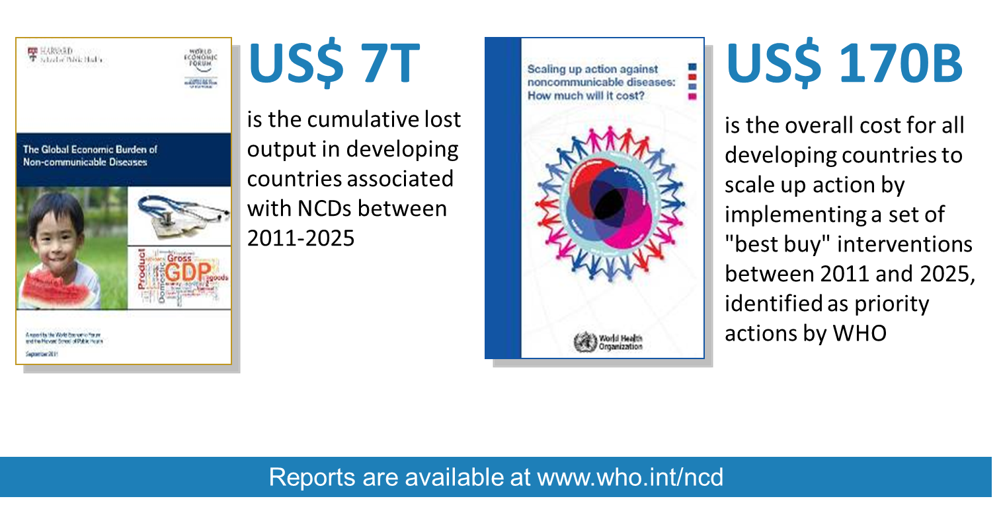
The cost of inaction in developing countries over the next 15 years is enormous
(compared to the cost of action)

Slide 32
The poorest people in developing countries are affected the most:
Why NCDs are a development issue
Globalization
Urbanization
Population ageing
Poverty
Populations in low- and middle-income countries
Increased exposure to
common modifiable risk factors
Loss of household income
NCDs
Limited access to
effective and equitable health-care services
Poverty at household level
More than 12 million people die before the age of 70
in developing countries from noncommunicable diseases

Slide 33
The poorest people in developing countries are affected the most:
Example: Poorest people smoke the most
45
Smoking prevalence (2004)
Lowest household income quintiles
40
35
30
25
Highest household income quintiles
(percentage)
20
15
10
5
0
Low-income countries
Lower-middle
Upper-middle-income
High-income
Income

Slide 34
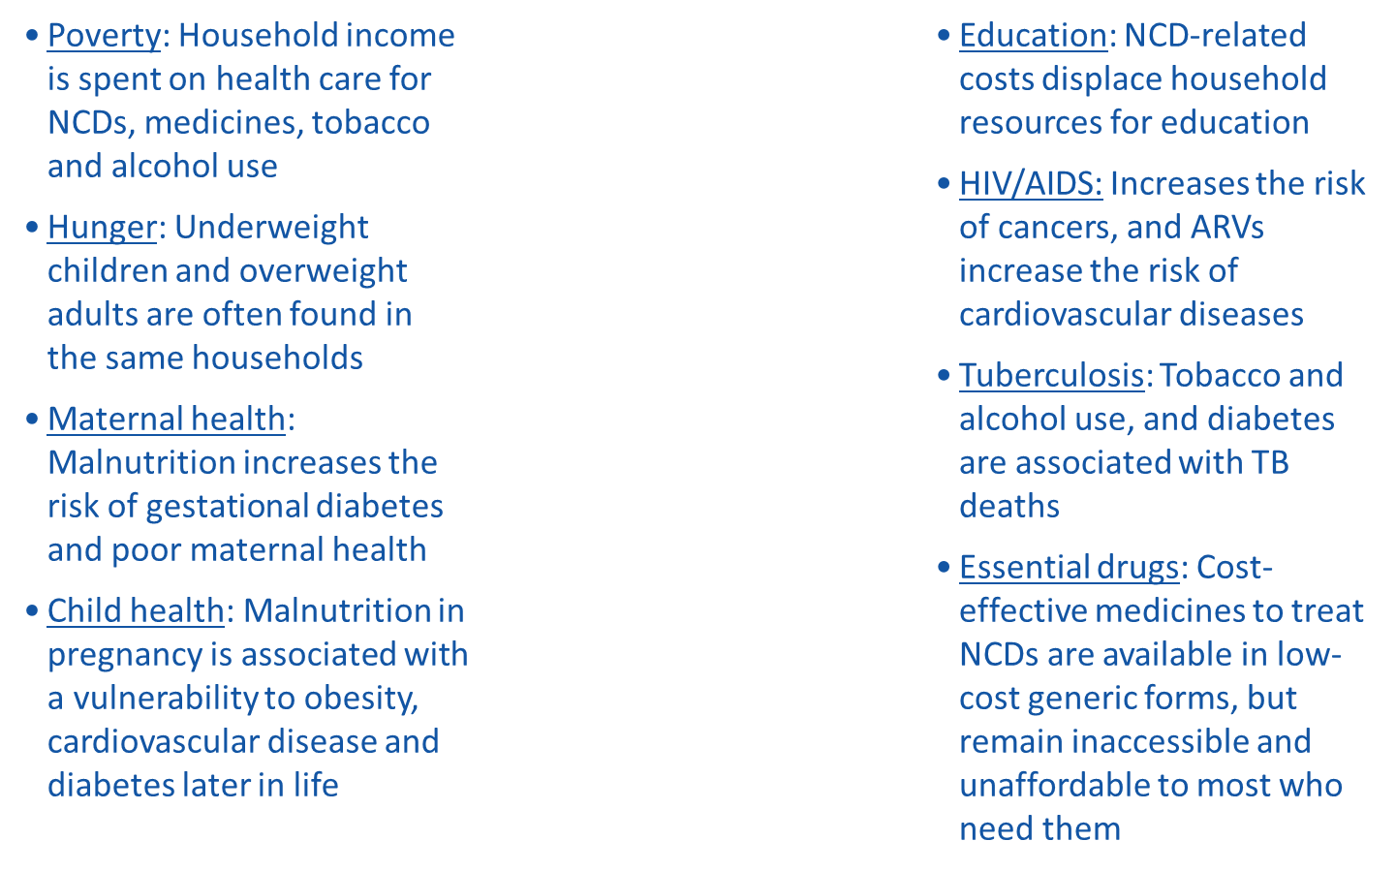
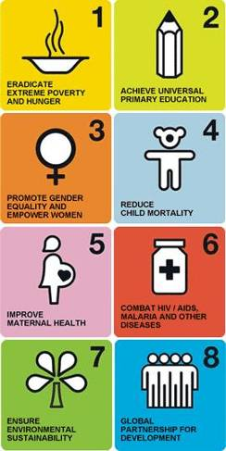
The poorest people in developing countries are affected the most:
Example: NCDs undercut the attainment of the MDGs

Slide 35
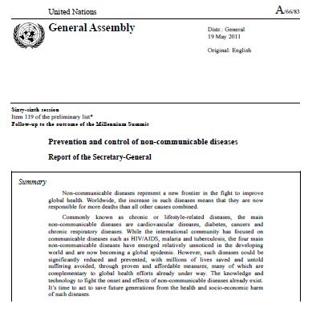
UN Secretary-General:
NCDs in developing countries are hidden, misunderstood and underrecorded
A rapidly rising epidemic in developed and developing countries …
… with serious socio-economic impacts, particularly in developing countries
Workable solutions exist to prevent most premature deaths from NCDs and mitigate the negative impact on development.
The way forward: these solutions need to be mainstreamed into socio-economic development programmes and poverty alleviation strategies

Slide 36

A global vision and affordable solutions exist to prevent
14 million people from dying prematurely each year from NCDs.

Slide 37
High-level Meeting
113 Member States
Political Declaration
Establish multisectoral national plans by 2013
Integrate NCDs into health-planning processes and the national development agenda
Promote multisectoral action through health-in-all policies and whole-of-government approaches
Build national capacity
Increase domestic resources
Assignments for WHO
Develop a global monitoring framework and targets
Develop a global implementation plan 2013-2020
Provide technical support to developing countries
Identify options for partnerships
Coordinate work with other UN Agencies
Measure results
34 Presidents and Prime-Ministers
3 Vice-Presidents and
Deputy Prime-Ministers
51 Ministers of Foreign Affairs and Health
11 Heads of UN Agencies
100s of NGOs
Political commitments: UN High-level Meeting on NCDs (New York, 19-20 September 2011)
Road map: WHO Global Action Plan for the Prevention and Control of NCDs 2013-2020
2011
World Health Assembly in May 2013:
Global Action Plan for the Prevention and Control of NCDs

Slide 38







WHO Global Action Plan for the Prevention and Control of NCDs (2013-2020)
Objective 1
To raise the priority accorded to the prevention and control of NCDs in global, regional
and national agendas and internationally agreed development goals, through strengthened international cooperation
and advocacy
Objective 2
To strengthen national capacity, leadership, governance, multisectoral action and partnerships to accelerate
country response for the prevention and control of NCDs
Objective 3
To reduce modifiable risk factors for NCDs and underlying social determinants through
creation of health-promoting environments
Objective 4
To strengthen and orient health systems to address the prevention and control of noncommunicable diseases and
the underlying social determinants through people-centred primary health care and universal health coverage
Objective 5
To promote and support national capacity for high-quality research and development for the prevention and
control of NCDs
Objective 6
To monitor the trends and determinants of NCDs and evaluate progress in their prevention
and control

Slide 39
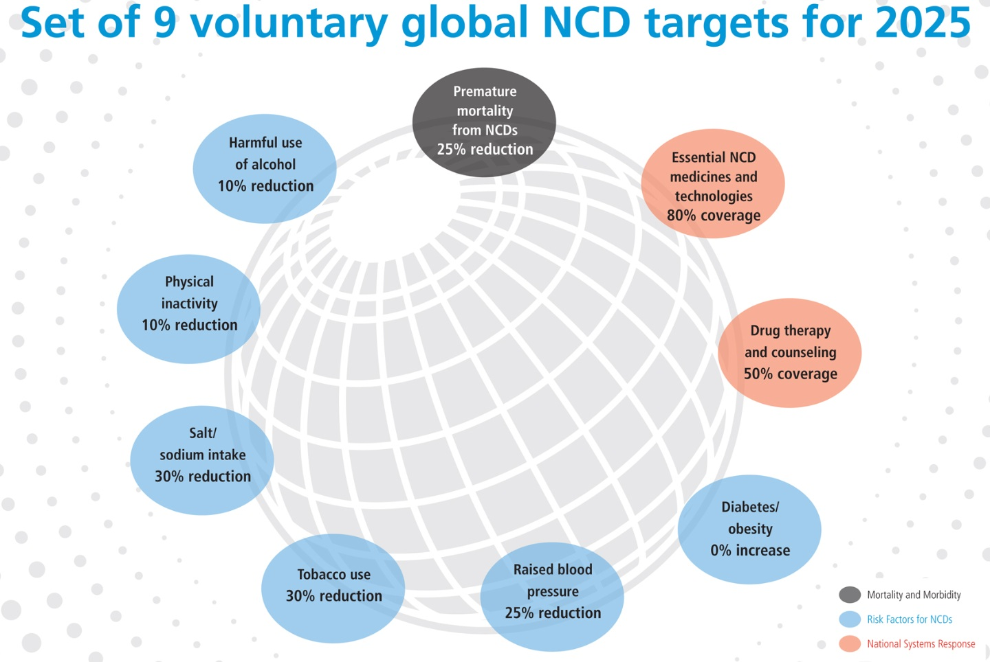
Set of 9 voluntary global targets on NCDs for 2025

Slide 40
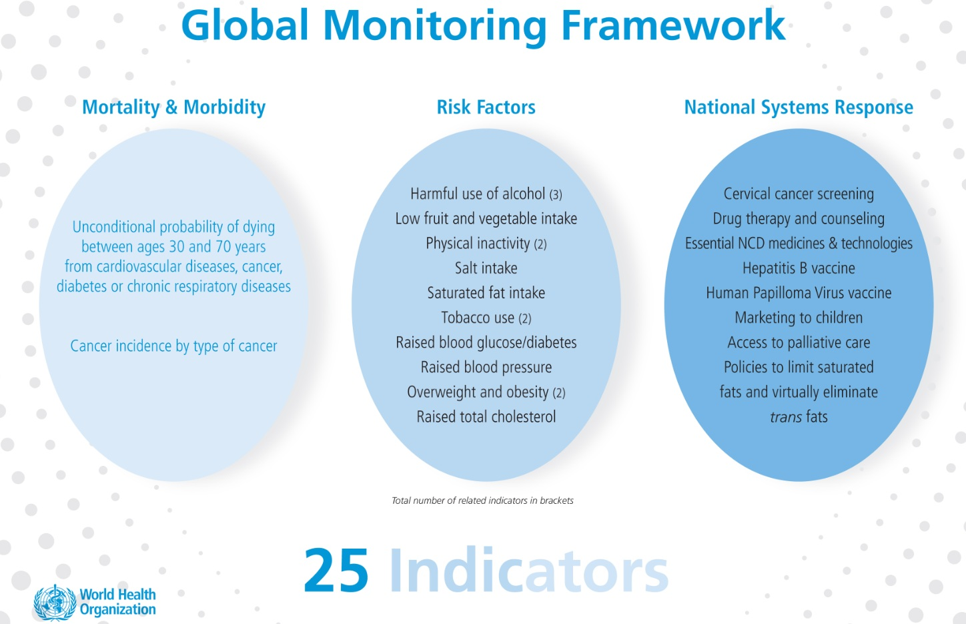
Global Monitoring Framework for NCDs

Slide 41
Reporting on indicators
2016
WHA67
2021
WHA74
2026
WHA79

Slide 42
Set national targets and indicators
Member States have committed themselves to "consider the development of national targets based on national situations", building on the 9 voluntary global targets
National targets can be more or less ambitious than the global ones
National adaptation of global targets should be guided by:
  Current performance,
  Current level of exposure
  Programmes planned and in place
WHO is developing a Toolkit on NCD Surveillance, which will include a module on setting national targets and measuring results
Early adopter countries: India and others

Slide 43

Rio+20:
"NCDs constitute one of the major challenges for sustainable development"
“ We understand the goals of sustainable development can only be achieved in the absence of a high prevalence of debilitating communicable and NCDs, and where populations can reach a state of physical, mental and social well-being. ” (paragraph 138)
“ We acknowledge that the global burden and threat of NCDs constitutes one of the major challenges for sustainable development in the twenty-first century. ” (paragraph 141)

Slide 44

At WHO, we witness how programme managers in developing countries are increasingly challenged to formulate effective strategies to address NCDs.
Donors, like USAID, should start considering these requests for technical assistance, even if these problems are not included in the MDGs

Slide 45
Official Development Assistance (2007)
18%
US$ 120 Billion per year
Including US$22 Billion for health
Provided by 26 governments to
141 developing countries
Objective: poverty alleviation
(= MDGs)
Health

Slide 46

Growth in global commitments (2001-2007)
(measured in growth of Official Development Assistance)
HIV/AIDS
42.9%
Health Policy
5.5%
Infectious Disease Control
5.7%
Reproductive Health Care
6.4%
Total ODA growth 2001-2007:
$14.9 billion
Health ODA growth for NCDs:
?
Basic Health Care
4.2%
Malaria Control
5.4%
Family Planning
0.3%
TB Control
3.0%
Basic Nutrition
1.7%
Medical Services
0.3%
Basic Health Infrastructure
0.7%
Medical Research
1.3%
Medical Education
0.6%
Health Education
0.2%
Water Supply/Sanitation
14.6%
Water Resources Policy
4.0%
Basic Drinking Water Supply
2.5%
Waste Management
1.2%
River Development
0.5%
Water Resources Protection
-0.8%
Water Education
0%
0
5
10
15
20
25
30
35
40
45%
50
(Source: Kaiser Family Foundation, 23 July 2009, based on OECD/DAC)

Slide 47
Analysis of 144 Country Cooperation Strategies | Number
Supporting the achievement of the health-related Millennium Development Goals (primarily Goals 4, 5 and 6) bringing together HIV/AIDS, tuberculosis, malaria, and maternal and child health, with a focus on integrated service delivery. | 119
Promoting risk reduction, prevention, treatment and monitoring of noncommunicable diseases, mental health, disability and injuries. | 136
Strengthening the structure, organization and financing of health systems, with a particular focus on achieving universal coverage, strengthening human resources for health and increasing access to medical technologies including medicines. | 134
Surveillance of, and response to, disease outbreaks and acute public health emergencies, and the effective management of humanitarian disasters. | 119

Slide 48
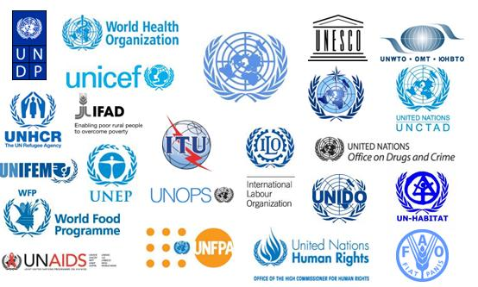
WHO cannot do it alone
WHO Country Cooperation Strategy
UN Common Country Assessment
UN Development Assistance Framework

Slide 49
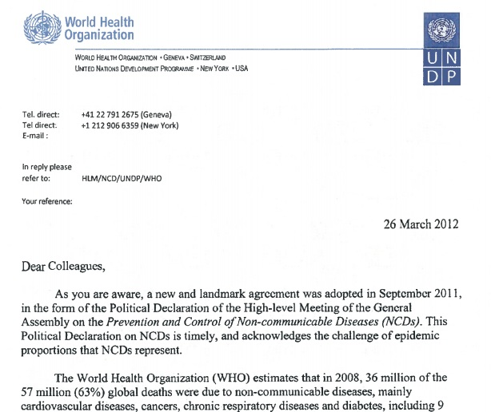
UNDAF is a strategic instrument to raise the priority given to NCDs
http://www.who.int/nmh/highlights/undaf/en/index.html

Slide 50

How do finance action?
"The potential to increase taxation on tobacco and alcohol exists in many developing countries. Even if only a portion of the proceeds were allocated to health, access to services would be greatly enhanced."

Slide 51

All governments have committed themselves to a 25% reduction in mortality from NCDs in 2025.
You have a unique opportunity to take a leadership role in advancing this agenda by including NCDs in USAID's agenda.

Slide 52









Recent developments:
Bilateral donors have started to integrate NCDs into ODA policies
NCDs are integrated in bilateral ODA policies:
Australia (AusAID)
Denmark
EC/DG Dev (EuropeAid)
France
Germany
Luxembourg
Norway
Switzerland
UK (DFID)

Slide 53
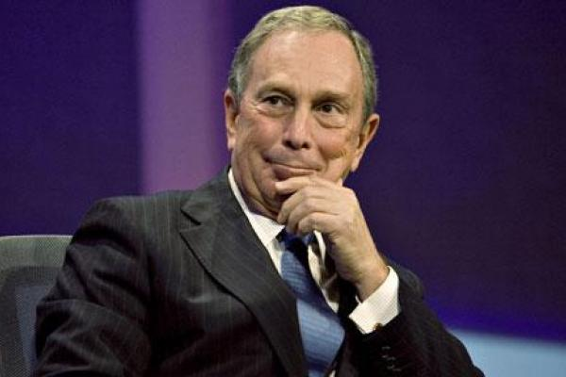
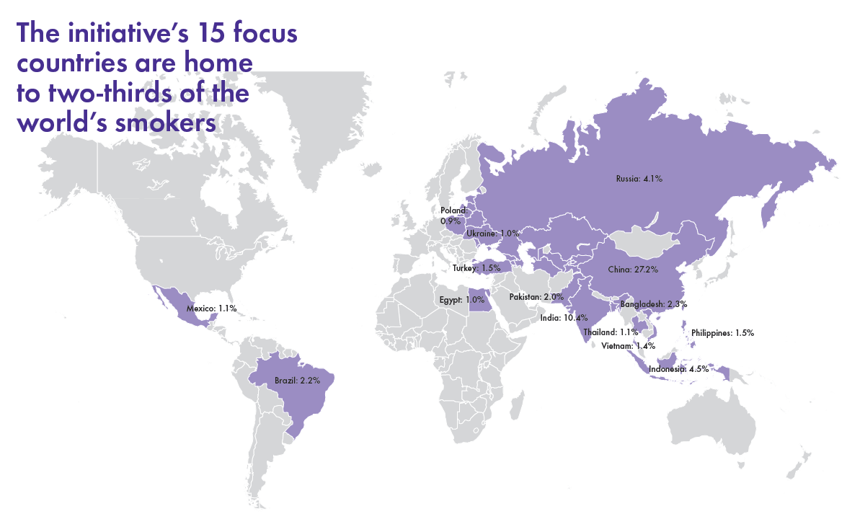
The Bloomberg Initiative to reduce tobacco use

Slide 54
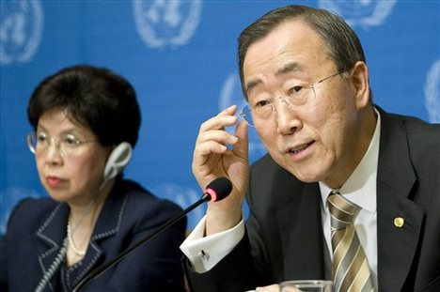

Slide 55
Example: NCDs
"Dear President Obama"
Ongoing
situation
In all developing countries, and by any metric, NCDs now account for a large enough share of premature deaths and poverty to merit a public policy response.
A global vision and affordable solutions exist to prevent 14 million people from dying prematurely each year from NCDs.
At WHO, we witness how programme managers in developing countries are increasingly challenged to formulate effective strategies to address NCDs. Donors, like USAID, should start considering these requests for technical assistance, even if these problems are not included in the MDGs.
All governments have committed themselves to a 25% reduction in mortality from NCDs in 2025. You have a unique opportunity to take a leadership role in advancing this agenda by including NCDs in USAID's agenda.
Opportunities
One
recommendation
Operationalization

Slide 56
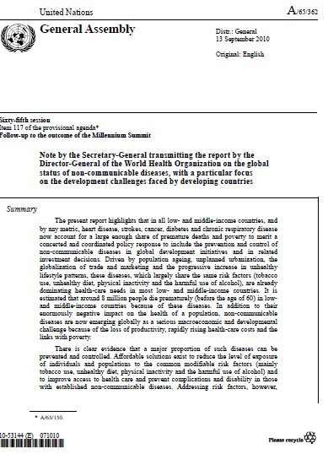
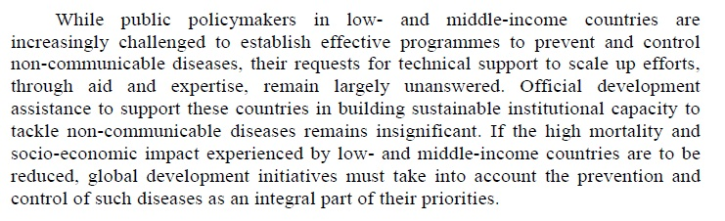
Positioning statement even made it to the
United Nations General Assembly

Slide 57

Exercise 2
If you had a chance to speak to the Minister of Planning in your country for
2 minutes, what would tell her/him about NCDs?

Slide 58
G-20
media
donors
UN
International
Development
Agencies
World
Bank
Minister of Foreign Affairs
and Planning
UN
Agencies
Target Audiences
Ministers of Health
NCD focal points in MoH
NCD counterparts in other Ministries
(agriculture, finance, trade, transport, urban planning, education and sport)
National NGO leaders
Civil Society/Population/People with NCDs

Slide 59
"Dear Minister of Planning"
Based on current data, we know that NCDs now account for a large enough share of premature deaths and poverty in our country to merit a concerted and coordinated public policy response.
A global vision and affordable solutions exist to address risk factors and enhance primary care to prevent up to [x] million premature deaths from NCDs per year.
We are increasingly challenged to formulate effective strategies to address NCDs. We should seek technical assistance from donors, even if these problems are not included (yet) in the MDGs.
We should ensure that our domestic efforts are placed at the forefront of any international efforts by integrating NCDs into national development processes, following on from the UN High-level Meeting on NCDs that took place in September 2011.

Slide 60
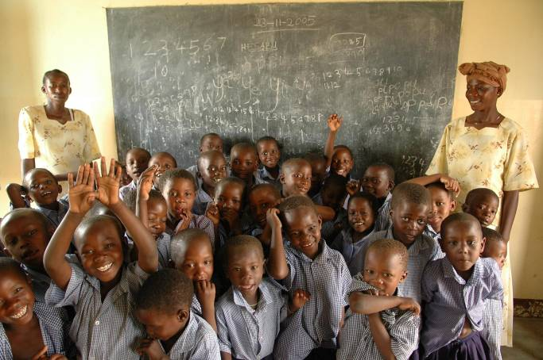
Exercise 3
If you had a chance to meet with a school class of children today, what would you tell them in 2 minutes about NCDs?

Slide 61
G-20
media
donors
UN
International
Development
Agencies
World
Bank
Minister of Foreign Affairs
and Planning
UN
Agencies
Target Audiences
Ministers of Health
NCD focal points in MoH
NCD counterparts in other Ministries
(agriculture, finance, trade, transport, urban planning, education and sport)
National NGO leaders
Civil Society/Population/People with NCDs

Slide 62

Main Challenge
Stand-alone public health messages are very hard to convey to individuals
Reducing the level of exposure to communities to risk factors, while strengthening the capacity of individuals to make healthier choices that foster good health
>> SOCIAL MOBILIZATION

Slide 63
"Dear Children"

Slide 64
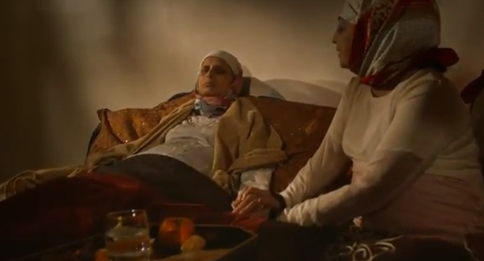
Control your blood pressure
http://www.youtube.com/watch?v=LDWPJijPuBY

Slide 65

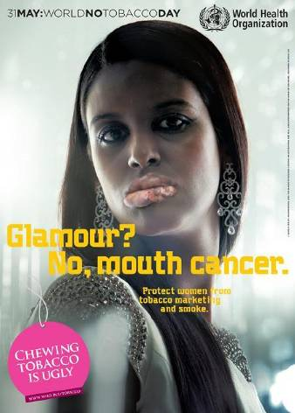
www.who.int/tobacco

Slide 66
The seven C's of social mobilization
1. Command attention
2. Clarify message
3. Communicate a benefit
4. Consistency counts
5. Cater to the heart and the head
6. Create trust
7. Call to action
Ongoing situation
Opportunities
One recommendation
Operationalization

Slide 67

The seven C's of social mobilization
1. Command attention
2. Clarify message
3. Communicate a benefit
4. Consistency counts
5. Cater to the heart and the head
6. Create trust
7. Call to action
Ongoing situation
Opportunities
One recommendation
Operationalization

Slide 68



Slide 69
What is social mobilization?
A broad scale movement to engage people's participation in achieving a specific development goal through self-reliant efforts.
It involves all relevant segments of society: decision and policy makers, opinion leaders, bureaucrats and technocrats, professional groups, religious associations, commerce and industry, communities and individuals.
Decentralized process involving a range of players engaged in interrelated and complementary efforts and takes into account the felt needs of the people
Seeks to empower individuals and groups for action
(as defined by UNICEF)

Slide 70
What are the components of social mobilization?
The "community" as a whole is mobilized around a particular programme or innovation and comes to incorporate its offerings into felt needs and expectations.
  Political mobilization
  Government mobilization
  Community mobilization
  Corporate mobilization
  Beneficiary mobilization

Slide 71
Aims of social mobilization
Increase people's awareness, knowledge and ability to organize for self-reliance
To help people to be motivated and to know about their rights and duties, and to begin to demand satisfaction of their needs
To understand and modify people's ideas and beliefs
To mobilize all available resources.

Slide 72
Five integrated communications actions essential for "Communications for behavioural impact"
Public Relations/Advocacy/Administrative Mobilization, for putting the particular healthy behaviour on the public and administrative/programme management agenda via the mass media: news coverage, talk shows, soap operas, celebrity spokespersons, discussion programmes; meetings/discussions with various categories of government and community leadership, service providers, administrators; official memoranda; partnership meetings.
2. Community Mobilization, including use of participatory research, community group meetings, partnership meetings, traditional media, music, song and dance, road shows, community drama, leaflets, posters, pamphlets, videos, home visits.
3. Sustained Appropriate Advertising, (in MRIP fashion – Massive, Repetitive, Intense, Persistent), via radio, television, newspapers and other available media, engaging people in reviewing the merits of the recommended behaviour vis-à-vis the “cost” of carrying it out.
4. Personal Selling/Interpersonal Communication/Counselling, at the community level, in homes and particularly at service points, with appropriate informational literature and additional incentives, and allowing for careful listening to people’s concerns and addressing them.
5. Point-of-Service Promotion, emphasising easily accessible and readily available solutions to health problems. The key in planning COMBI programmes is to strive for an integrated approach with a judicious blending and selection of communication actions appropriate to the behavioural outcome desired, and not to believe that one single kind of communication intervention is all-powerful.

Slide 73
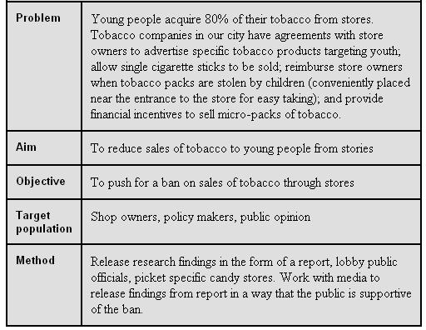
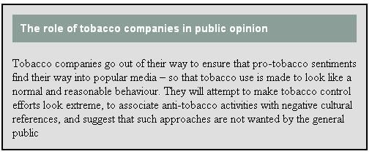
Example

Slide 74
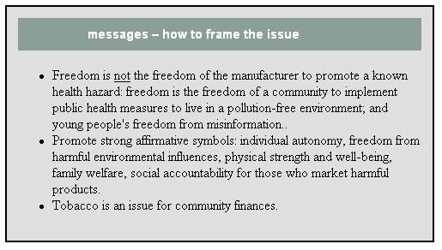
Example

Slide 75
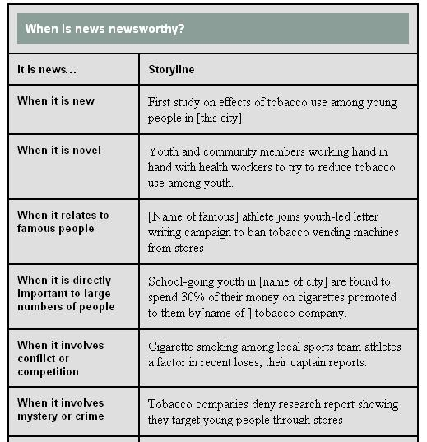
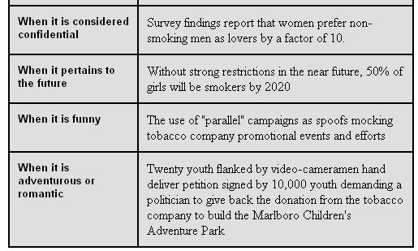
Example

Slide 76

Exercise 4
If you could meet a donor representative today, what would you tell him/her in 2 minutes about NCDs?

Slide 77
G-20
media
donors
UN
International
Development
Agencies
World
Bank
Minister of Foreign Affairs
and Planning
UN
Agencies
Target Audiences
Ministers of Health
NCD focal points in MoH
NCD counterparts in other Ministries
(agriculture, finance, trade, transport, urban planning, education and sport)
National NGO leaders
Civil Society/Population/People with NCDs

Slide 78



















Slide 79
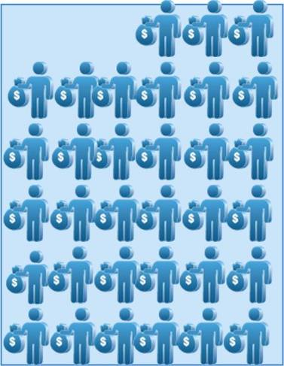
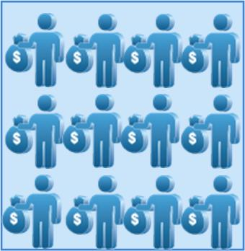
The average number of donors per country is growing
1960s
2001-2005

Slide 80
WHO Country Cooperation Strategy
UN Common Country Assessment
UN Development Assistance Framework

Slide 81
UN Common Country Assessment
UN Development Assistance Framework
http://www.who.int/nmh/highlights/undaf/en/index.html

Slide 82
"Dear Donor"
The rapidly rising burden of NCDs, in particular amoung the poorest and the most vulnerable ones, may increase the level of malnutrition and reversing the achievement of MDG 1 (Eradicate extreme hunger and poverty) and the health-related goals of the MDGs and the progress made in the past two decades.
A national vision and affordable solutions exist to address risk factors and enhance primary care to prevent up to [x] million premature deaths from NCDs per year in our country. MDGs provides opportunities for synergy, as do strategies for poverty alleviation.
We should include the prevention and control of NCDs as an integral part of work on national development and in related investment decisions.
We can start doing so by expanding the technical capacity of the Ministry of Health in the area of NCDs, so that NCDs will be included in national development plans.

Slide 83

The resource mobilization cycle
Resource Mobilization
Assessing
Positioning
Mobilizing
Delivering
Credis:

Slide 84
Frequently Asked Questions by Donors about NCDs
How does the magnitude and trends of NCDs have a major socio-economic impact in developing countries?
How are the poorest quintiles within developing countries are disproportionally affected by NCDs, their risk factors and their socio-economic impact?
Which evidence-based interventions to prevent and control NCDs are cost-effective for developing countries?
When implemented in developing countries, will these interventions (a) improve health outcomes from NCDs among the lowest income quintile; (2) contribute to poverty reduction among the lowest income quintile?
Are technical assistance packages available which are aimed at building institutional capacities within developing countries to prevent and control NCDs?
Are estimates on a national "price tag" national funding gaps are available (i.e. difference between costed national plans, and available domestic and international resources)?
What is the self-enlightened interested of tax payers in OECD/DAC donor countries to support their international development agencies in addressing NCDs in developing countries?

Slide 85
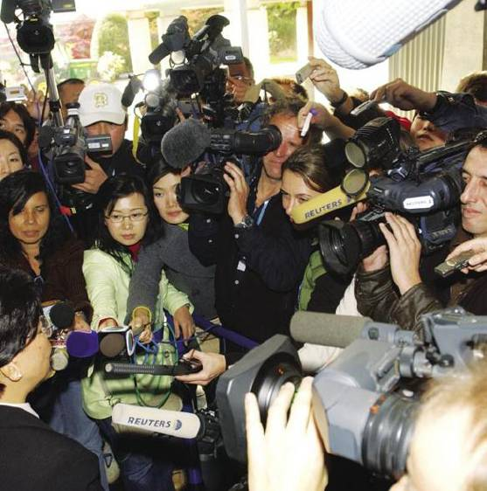
Exercise 5
If you could speak to a journalist of a leading newspaper today, what would you tell him/her in two minutes on NCDs?

Slide 86
G-20
media
donors
UN
International
Development
Agencies
World
Bank
Minister of Foreign Affairs
and Planning
UN
Agencies
Target Audiences
Ministers of Health
NCD focal points in MoH
NCD counterparts in other Ministries
(agriculture, finance, trade, transport, urban planning, education and sport)
National NGO leaders
Civil Society/Population/People with NCDs

Slide 87
What are your talking points?
Interviews are not conversations
Prepare 4 key messages (four O's) to be used repeatedly as the cornerstone of your responses
Double-check that that the key messages explain
  So what?
  Why is this so compelling?
  Why now?
  The reasons or benefits

Slide 88
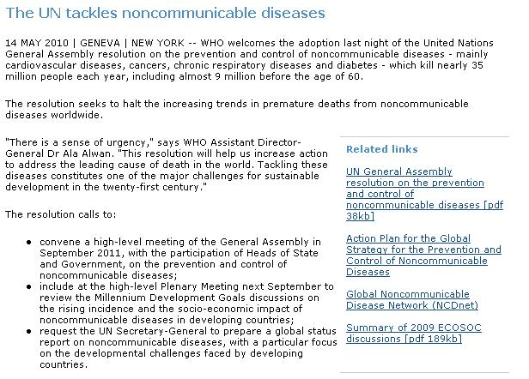
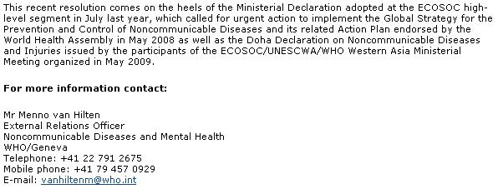

Slide 89
WHO's 10 golden rules
Never, never, never lie
Never say "No comment"
There is never a "off the record"
Be short, get to the point and always think of the audience
Stay calm, confident and in charge
Use simple language, avoid jargon
Stay in control
It's OK to say "I don't know, but I'll find out"
Don't speculate
Beware of reporters' tactics

Slide 90
Reporters' tactics
Speculative questions
Hearsay questions
Negative repeat questions
Putting words into your mouth
Presupposition questions
False facts and incorrect information
Feeding the mike

Slide 91

Partnerships

Slide 92
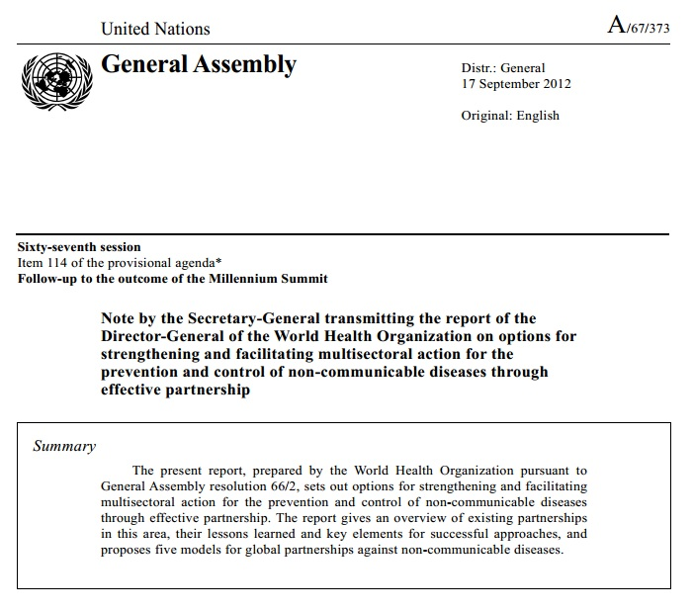
http://www.who.int/nmh/events/2012/20121128.pdf

Slide 93
Multisectoral action?
Why?
Health gains for NCDs can be achieved much more readily by influencing public policies in sectors like trade, taxation, education, agriculture, urban development, food and pharmaceutical production than by making changes in health policy alone
What?
Set national targets for NCDs
Implement a core set of interventions
How?
Political leadership
Whole-of-government action
Managing conflict of interests

Slide 94
NCD partnerships at the national level
Functions of partnerships:
Advocacy and awareness
Capacity building
Financing and resource mobilization
Product development and innovation
Product access
Coordination mechanisms

Slide 95
NCD partnerships at the national level
The partnership demonstrates a clear added value for public health
The partnership has a clear goal that concerns a priority area of work for the government
Partnerships are guided by the technical norms and standards established by WHO
The partnership supports national development objectives
The partnership ensures appropriate and adequate participation of stakeholders

Slide 96
NCD partnerships at the national level
The roles of partners are clear
Transaction costs related to a partnership must be evaluated, along with the potential benefits and risks
Pursuit of public-health goals takes precedence over the special interests of participants.
The structure of the partnership corresponds to the proposed functions
The partnership has an independent external evaluation and/or self-monitoring mechanism
More info at:
http://apps.who.int/gb/ebwha/pdf_files/WHA63/A63_44-en.pdf

Slide 97

Questions

Slide 98
Q2: If I could talk to President Obama for 1 minute about NCDs, I would tell him …
"I need 30 minutes of your time to share 40 years of academic knowledge on NCDs"
"Yesterday's Lancet article on diabetes is worth reading"
"We must make the prevention and control of NCDs a top priority on the international development agenda"
"He may want to consider taking a course on NCDs and public health"

Slide 99
Q2: What is the basic tool that WHO uses to develop most of its communication products on NCDs?
"The four O's"
"The seven C's"
"The 10 golden rules"
"UN Development Assistant Framework"

Slide 100
Q3: When I talk to the press about NCDs ….
"It is OK to lie if I don't know the answer"
"It is OK to be lengthy and use jargon"
"It is OK to say I don't know but I'll find out"
"It is OK to say 'No comment'"

Slide 101

Thank you
vanhiltenm@who.int

