Slide 1
Working towards meeting the global diabetes target for 2025: a comprehensive approach through public health and health care
Gojka Roglic

Slide 2
What is diabetes ?
Diabetes mellitus is a metabolic disorder of multiple aetiology, characterized by chronic hyperglycaemia with disturbances of carbohydrate, fat and protein metabolism resulting from defects in insulin secretion, insulin action, or both.
WHO, 1999

Slide 3
Clinical stages: normoglycaemia IGT/IFG diabetes
Type 1
Autoimmune
Idiopathic
Type 2
Predominantly insulin resistance
Predominantly insulin secretory defects
Gestational diabetes
Other specific types

Slide 4
Natural History of Diabetes
People
without Diabetes
Undiagnosed
Diabetes
Diagnosed
Diabetes
Low
Risk
High
Risk
Macrovascular complications
Microvascular complications

Slide 5
Number of persons with diabetes in the world (WHO, 2010)
346 million in 2008

Slide 6
Predicted number of persons with diabetes in the world (IDF Atlas, 2011)
552 million in 2030

Slide 7
Top 10 countries in the number of persons with diabetes (millions)
2011
1. India 90.0
2. China 61.3
3. USA 23.7
4. Russian Fed 12.6
5. Brazil 12.4
6. Japan 10.7
7. Mexico 10.3
8. Bangladesh 8.4
9. Egypt 7.3
10. Indonesia 7.3
( IDF Atlas, 2011)

Slide 8
Top 10 countries in diabetes prevalence in the world
( IDF Atlas, 2010)
Age-adjusted prevalence of diabetes in 20-79 yr age group (%) | Rank and country
25.7 | 1. Kiribati
22.2 | 2. Marshall Islands
21.1 | 3. Kuwait
20.7 | 4. Nauru
20.2 | 5. Lebanon
20.2 | 6. Qatar
20.0 | 7. Saudi Arabia
19.9 | 8. Bahrain
19.5 | 9. Tuvalu
19.2 | 10. United Arab Emirates

Slide 9
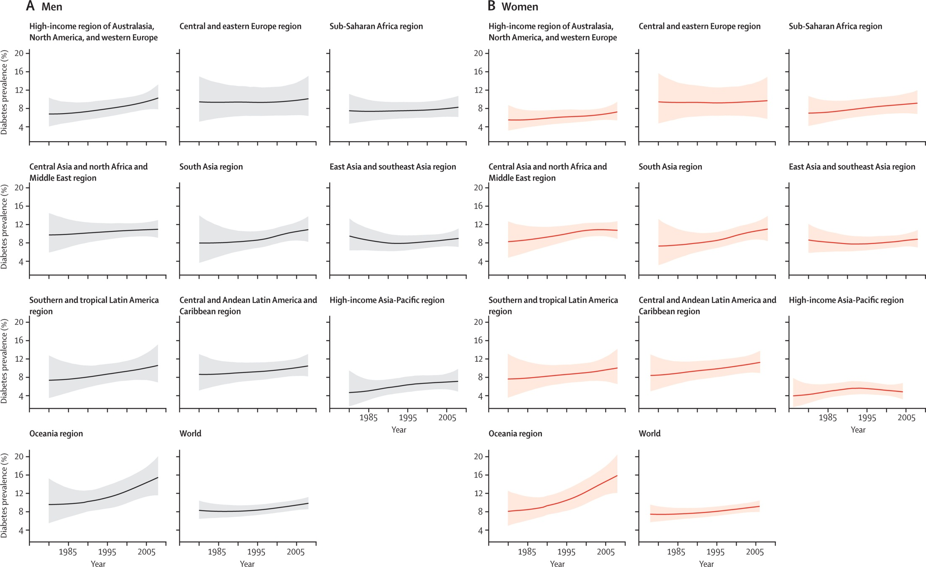
Diabetes prevalence trend 1980-2008 (Danaei et al, 2011)

Slide 10

Diabetes prevalence trend 1980-2008 (Danaei et al, 2011)

Slide 11
Incidence of (diagnosed) type 2diabetes
UK population 25-79yrs 4.7/1000 p-y
(Hippisley-Cox, 2009)
Finnish population 40-69yrs 4.5/1000 p-y
(Montonen, 2005)
Chinese women 25+ yrs 5.4/1000 p-y
(Villegas, 2008)
US female nurses 38-63yrs 3.8/1000 p-y
(Bazzano, 2008)

Slide 12
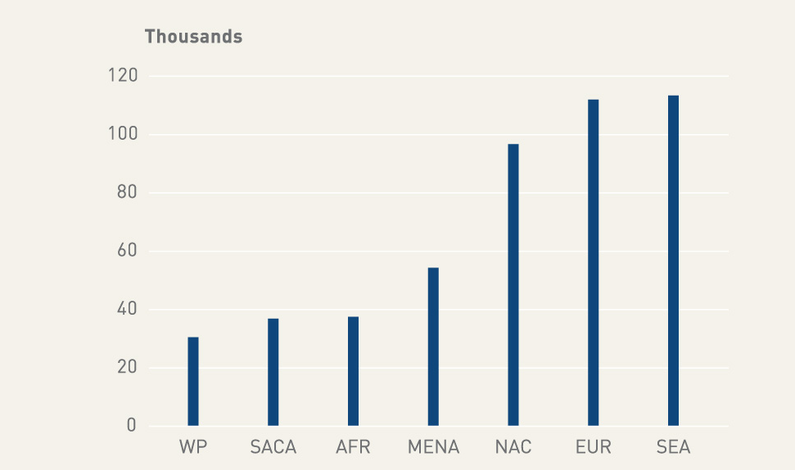
FIGURE 2.4
Estimated number of prevalent cases of type 1 diabetes in children, 0-14 years, by region, 2010 (IDF Atlas, 4th ed)

Slide 13
Incidence of type 1 diabetes in children (per 100,000)
Country | Period | Incidence | Reference
Finland | 1990-99 | 40.9 | DIAMOND, 2006
Australia | 2000-06 | 22.6 | Catanzariti, 2009
USA, Allegheny | 1990-94 | 17.8 | DIAMOND, 2006
Brazil (Passo Fundo) | 1996-99 | 8.0 | DIAMOND, 2006
China (22regions) | 1990-95 | 0.1 - 4.5 | DIAMOND, 2006
Venezuela, Caracas | 1990-94 | 0.1 | DIAMOND, 2006

Slide 14
Incidence of type 1 diabetes in children (per 100,000)
Country | Period | Incidence | Reference
Jordan | 1992-96 | 3.6 | Ajlouni, 1999
Iran | 1991-96 | 3.7 (<29yrs) | Pishdad, 2005
Saudi Arabia | 1986-97 | 12.3 | Kulaylat, 2000
Chile | 2000-05 | 6.2 | Torres-Avilés, 2005
India (Bangalore) | 1995-200 | 3.9 | Kumar, 2008
Thailand (North-East) | 1991-95 | 0.3 | Panamonta, 1997
Thailand (North-East) | 1996-2005 | 0.6 | Panamonta, 2011

Slide 15
Is there a diabetes epidemic?

Slide 16
Possible causes of increasing diabetes prevalence (from Colagiuri et al, Diabetologia 2005)
Ageing of the population
Younger age at onset
Decreasing mortality
Increasing incidence (risk)

Slide 17
Major risk factors for type 2 diabetes (strong or moderately evidence)
Unmodifiable
Modifiable
Age
Diabetes in 1st degree relative
Ethnicity (SE Asian, Afro-Caribbean, Hispanic white, Native American)
History of GDM
Obesity
Physical inactivity

Slide 18
Prevalence of overweight and obesity in population aged over 15 years (WHO STEPS Surveys)

Slide 19
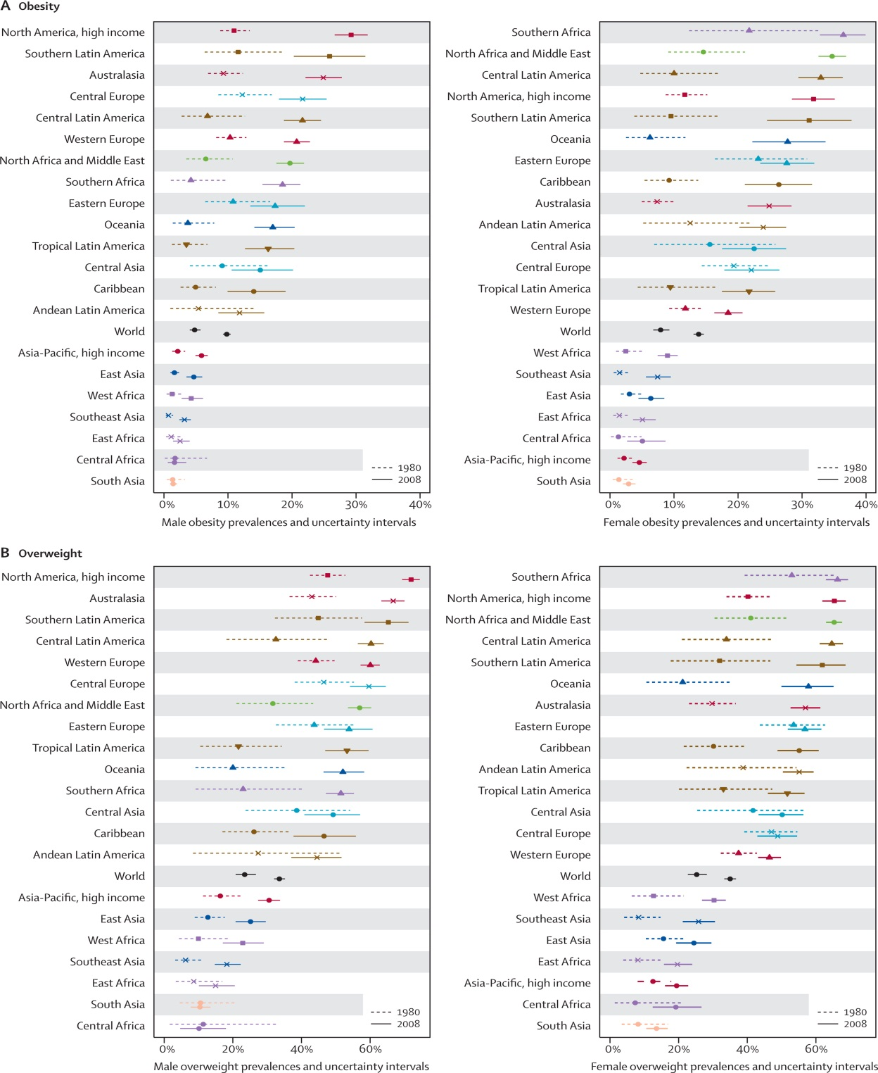
Obesity/overweight prevalence 1980 and 2008 ( Finucane et al, 2011)

Slide 20
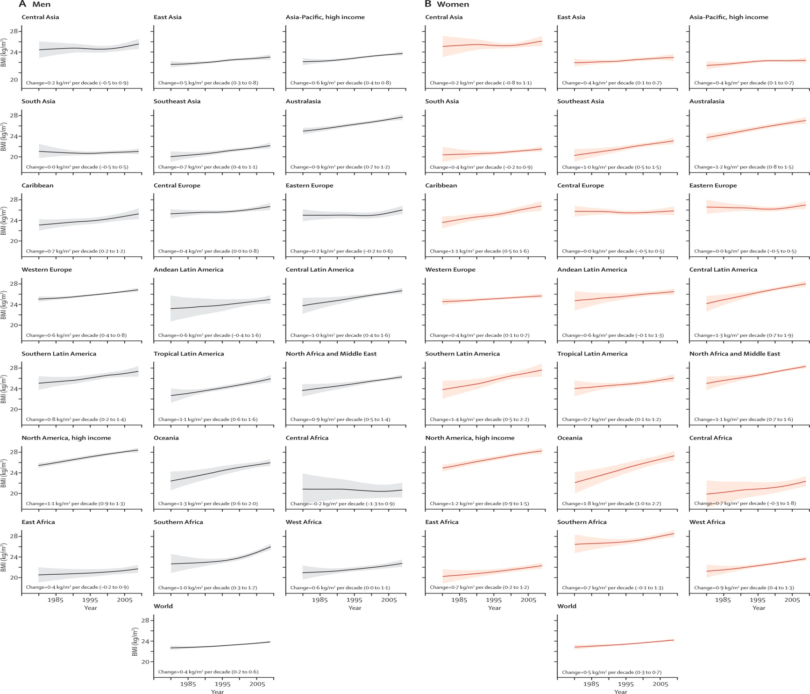
BMI trends 1980-2008 ( Finucane et al, 2011)

Slide 21
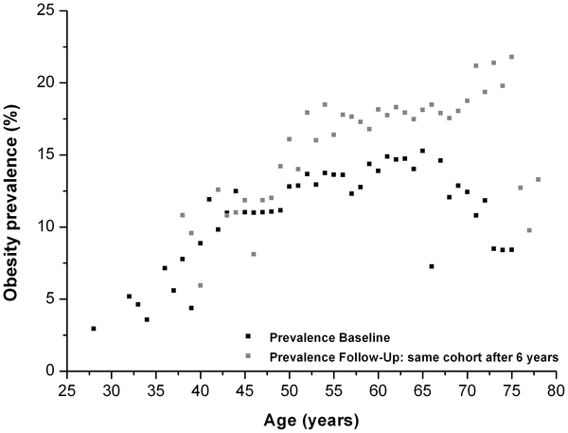

Figure 1. Association of obesity prevalence and age among men of theDiogenes cohort.
von Ruesten A, Steffen A, Floegel A, van der A DL, et al. (2011) Trend in Obesity Prevalence in European Adult Cohort Populations during Follow-up since 1996 and Their Predictions to 2015. PLoS ONE 6(11): e27455. doi:10.1371/journal.pone.0027455
http://www.plosone.org/article/info:doi/10.1371/journal.pone.0027455

Slide 22
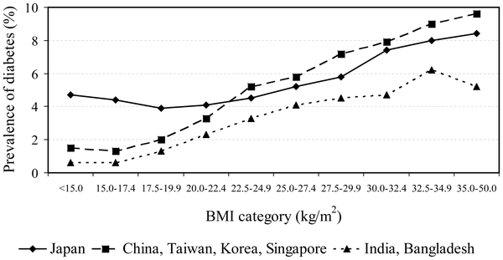
Relationship between BMI and diabetes prevalence in Asia (Boffetta, 2011)

Slide 23
Estimated projected urban and rural populations in the world, 1950-2030

Slide 24

Relative risk of Type 2 diabetes by different levels of occupational physical activity (from Hu et al, Diabetologia 2003)
* adjusted for age, sex, BMI, systolic BP, smoking, education, other physical activity (n= 6898 Men+7392 women, 35-64 years old)

Slide 25
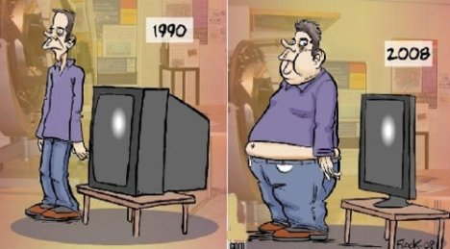
A very curious thing

Slide 26
Possible causes of increasing diabetes prevalence (from Colagiuri et al, 2005)
Ageing of the population
Younger age at onset
Decreasing mortality
Increasing incidence (risk)
Explain only 20-25% increase in prevalence

Slide 27
RISING PREVALENCE OF DIABETES IN URBAN INDIA
(Mohan, 2006)
1989 - 2005
Within a span of 14 years, the prevalence of diabetes increased by 72.3%

Slide 28
Global voluntary targets:
Halt the rise in diabetes and obesity by 2025
Reduce prevalence of insufficient physical activity by 10%

Slide 29
Preventing diabetes

Slide 30
Prevention of Type 1 diabetes
Possible to identify those at very high risk through:
  Family history
  Genetic background (HLA haplotypes)
  Auto-antibodies to insulin and pancreas β cells

Slide 31
Prevention of Type 1 diabetes
Interventions that have been tried in high risk individuals include:
  Antioxidant drugs e.g. nicotinamide
  Insulin (oral, parenteral)
None of them shown to work

Slide 32
Prevention of type 1 diabetes
In the population?

Slide 34
Increasing Type 1 incidence in Finland 1980 – 2005
(Harjutsala, 2008)

Slide 35
Putative Type 1 diabetes environmental risk factors:
Viral infections?
Maternal nutrition in pregnancy?
Infant nutrition?
Environmental toxins?
Protective effect of intestinal parasites?

Slide 36
Prevention of type 2 diabetes
In persons at high risk?

Slide 37


Slide 38
Distribution of blood glucose in the population
30
Current initiatives focus on those at high risk
% of
population
16.8%
IGT
4.5%
diabetes
20
10
2
4
6
8
10
12
14
16
18
20
22
2 hour plasma glucose (mmol/l)
  Williams DRR, et al. Diabetic Med 1995;12:30-5

Slide 39
Diabetes Prevention Study intervention (Tuomilehto et al, 2001)
Seven sessions with nutritionist during first year of study, then every 3 months
Individualised guidance on increasing their levels of physical activity
Supervised, circuit-type resistance training sessions

Slide 40
Probability of remaining free of diabetes
Risk reduction: 58%
Tuomilehto J, et al. NEJM 344(18):1343-50

Slide 41
Sustainability of lifestyle effect
1.00
Control
Intervention
0.75
Probability of remaining free of diabetes
Intensive intervention ceased after about 4 years
0.50
0.25
Post-intervention period hazard ratio = 0.61 (0.38–0.98)
0.00
0
1
2
3
4
5
6
7
8
9
10
Follow-up time, years
Lindstrom J et al. Lancet 2006;368:1673-1679.

Slide 42
Lifestyle & Prevention of DM in subjects with IGT
Clinical Trials: DM as the Primary Outcome
Study | N | IGT Pop | Age | FU Yrs | FU % | Rx | RRR
Finnish DPS | 522 | BMI > 25 | 55 | 3.2 | 92 | Diet/Ex | 58%
DPP | 2161 | BMI > 24 FPG >5.3 | 51 | 3 | 93 | Diet/Ex | 58%
DaQing | 259 | Groups | 45 | 6 | 92 | Diet/Ex | 38%
Kosaka | 458 | Men; BMI = 24 | ~55 | 4 | 92 | Diet/Ex | 67%
India DPP | 269 | Any IGT | 46 | 2.5 | 95 | Diet/Ex | 29%
Notes:
42

Slide 43
Pharmacologic agents in Prevention of DM in subjects with IGT: Clinical Trials with: DM as the primary outcome
Study | N | IGT Pop | Age | FU Yrs | FU % | Rx | RRR
DPP | 2155 | BMI>24; FPG>5.3 | 51 | 2.8 | 93 | Met | 31%
Indian DPP | 269 | Any | 46 | 2.5 | 95 | Met | 26%
STOP NIDDM | 1419 | FPG>5.6 + IGT | 54 | 3.2 | 96 | Acarbose | 25%
XENDOS | 3277 | Any + BMI>30 | 43 | 4 | 43 | Orlistat | 37%
DREAM | 5269 | IGT or IFG | 55 | 3.0 | 94 | Rosiglit. | 60%

Slide 44
Cardiovascular Disease Prevention Trials with Diabetes as Secondary Outcome
Reference | Diab/ Total N | Diabetes Outcome | Treatment | HRR (95% CI)
CAPPP. Hansson: Lancet 1999 | 717/ 4673 | “WHO” | Captopril vs. conventional | 0.86 (0.74 – 0.99)
West of Scotland. Freeman: Circul. 2000 | 139/ 5974 | FPG > 7.0 mM + other | Pravastatin | 0.70 (0.50 – 0.98)
HOPE. Yusuf: JAMA 2001 | 257/ 5720 | Self-reported | Ramipril | 0.66 (0.43 - 0.85)
LIFE: Dahlöf: Lancet 2002 | 560/ 7998 | WHO | Losartan vs. atenolol | 0.75 (0.63 – 0.88)

Slide 45
What we know…
Diabetes is preventable…
- in those at high risk (IGT)
- in different settings
- in the long-term
- using an intensive behavioural approach

Slide 46
But…
not feasible to find all those at risk using an oral glucose tolerance test
intervention too time-consuming / costly
to implement on a large-scale
consider population-based approach to
prevention?

Slide 47
Prevention of type 2 diabetes
In the population?

Slide 48
Reducing New Diabetes
People
without diabetes
Population
Approach
High Risk
Approach
Low
Risk
High
Risk

Slide 49
n
Level of risk factor
Level of risk factor
High-risk approach
Population-based
approach
Notes:
First diagram is current approach – Dr-centred –sick / high risk person, will treat them to reduce risk factor of level in population. Approaches to disease prevention might include population-based strategies to shift the distribution of glycaemia alongside individual-based approaches among those at high risk. Population-based strategies should be considered a priority alongside medical management. By lowering the mean level of risk factors, in particular PG levels, this approach aims to shift the whole distribution of exposure in a favourable direction to alter some of the society’s norms of behaviour regarding diet and physical activity. If we change everybody’s behaviour just a little bit, might have more impact than changing a few people’s behaviour at high risk…small change approach

Slide 50
Which behaviours to focus on?
Weight reduction > 5% body weight
Fat intake < 30% total energy
Saturated fat intake < 10% total energy
Fibre >15g / 1,000kcal
Exercise > 4hrs/wk
Notes:
If we want to change everybody’s behaviour a little bit, which behaviours should we focus on?

Slide 51
Merely a matter of personal choice?
An element of personal responsibility
But if we want people to make health choices we have to make healthy choices available

Slide 52
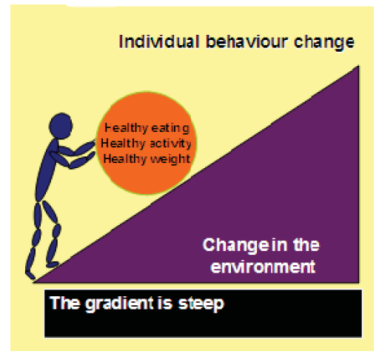
Individual & environmental factors
Source: C.Bonfiglioni. Reporting Obesity. COO, University of Sydney, 2007
Notes:
52

Slide 53
WHO GLOBAL NCD ACTION PLAN 2013 -2020
Objective 3
To reduce modifiable risk factors for noncommunicable diseases and underlying social determinants through creation of health-promoting environments

Slide 54
Primary prevention of type 2 diabetes in the population
Intuitively appealing, but little evidence
  Finnish Diabetes Programme (some success in high risk groups)
  Mauritius NCD programme
  Singapore National Healthy Lifestyle Programme (Bhalla, 2006)
  (Un)natural experiments
    Japan (Goto, 1958)
    Netherlands (Hermanides, 2008)
    Cuba (Franco, 2007)
    Paris (anecdotal)
    England (anecdotal)

Slide 55
Interventions in the Mauritius Noncommunicable Diseases Programme, 1987
Promotion of healthy lifestyle
Change of cooking oil composition to reduce saturated fat content

Slide 56

Prevalence of hypercholesterolaemia (Mauritius)

Slide 57
Prevalence of Diabetes:
Mauritius* - 1987-1998
25
Prevalence %
19.5
20
16.9
14.3
15
10
5
0
1987
1992
1998
+Age standardised

Slide 58
Prevalence of DM in 2009
>20%
Magliano, 2012

Slide 59
Interventions in the Singapore National Healthy Lifestyle Programe 1992-2004 (adapted from Bhalla, 2006)
 | Intervention
Diabetes | Mass media promotion of healthy lifestyles, food labelling
Obesity
Hypercholesterolaemia
Hypertension
Physical activity | Mass media campaign, mass exercise events led by the Prime Minister
Smoking | Mass media attack and legislation

Slide 60
Age-standardised prevalence of diabetes and associated risk factors in Singapore 1992-2004 (adapted from Bhalla, 2006)
 | 1992 | 1998 | 2004
Diabetes (%) | 10.0 | 9.5 | 7.8
Obesity (%) | 5.3 | 6.2 | 6.8
No regular exercise (%) | 86.5 | 83.0 | 75.0
Hypertension (%) | 24 | 28 | 24
Hypercholesterolaemia (%) | 21.4 | 26.0 | 18.1
Smoking (%) | 17.8 | 15.0 | 12.5

Slide 61
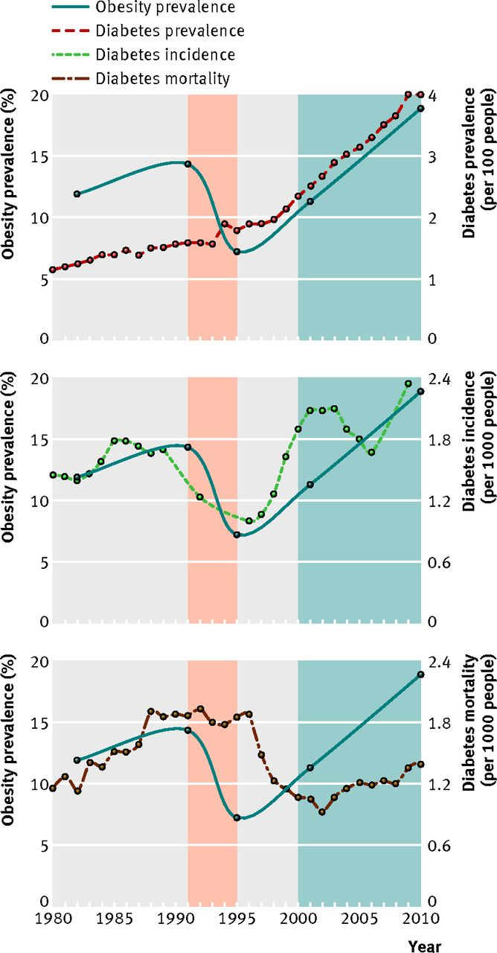

Fig 3 Prevalence of obesity and diabetes, incidence, and mortality in Cuba, 1980-2010.
Franco et al. ,2013
©2013 by British Medical Journal Publishing Group
Notes:
Fig 3 Prevalence of obesity and diabetes, incidence, and mortality in Cuba, 1980-2010. Red shaded area=period of economic crisis; blue shaded area=period of economic recovery. Diabetes prevalence increased by 2.93% per year from 1980 to 1997, and 6.27% per year from 1997 to 2010. Diabetes mortality increased by 5.85% per year from 1980 to 1989, but fell by 0.68% per year from 1989 to 1996 and 13.95% per year from 1996 to 2002, before increasing by 3.31% per year from 2002 to 2010

Slide 62
Number of deaths attributable to diabetes
3.4 million in 2008 (WHO 2010)
3.9 million in 2010 (IDF 2010)
HIV/AIDS deaths in 2010: 1.8 million (WHO 2011)

Slide 63
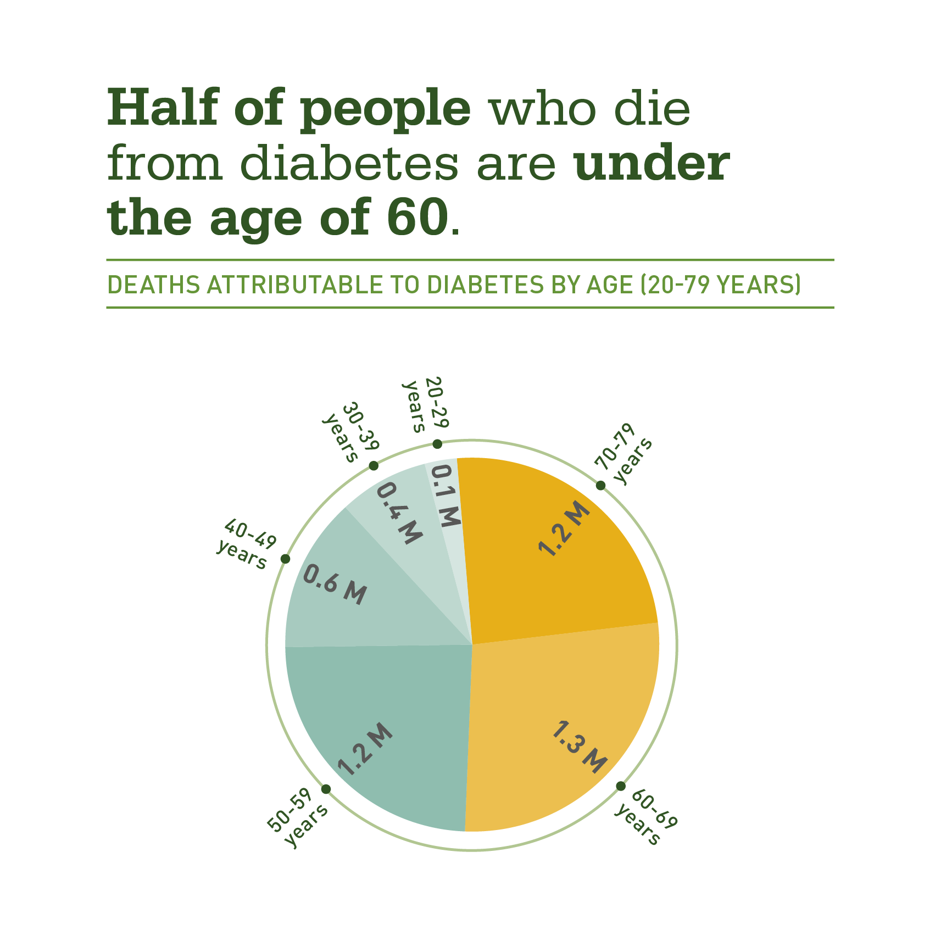
Notes:
Estimating deaths from diabetes is difficult because it is rarely reported as the cause of death in medical records. However, studies using the risk of death due to diabetes in different populations allow us to generate more realistic estimates of the true mortality burden. The estimates are almost certainly an underestimate but show us that a substantial proportion of deaths occur in people under the age of 60 and many even under the age of 50. This is well before the life expectancy in many countries and is a result of the serious complications that can develop in untreated diabetes.

Slide 64
Voluntary global target
A 25% reduction in overall mortality from cardiovascular diseases, cancer, diabetes or chronic respiratory diseases by 2025

Slide 65
Voluntary global target
At least 50% of people at >=30% risk of heart attack receiving drug therapy and lifestyle counselling 2025
Diabetes increases risk of CVD event

Slide 66
Voluntary global target
At least 80% availability of affordable basic technologies and essential medicines in public and private facilities by 2025
Diabetes increases risk of CVD event

Slide 67
Preventing complications of diabetes

Slide 68
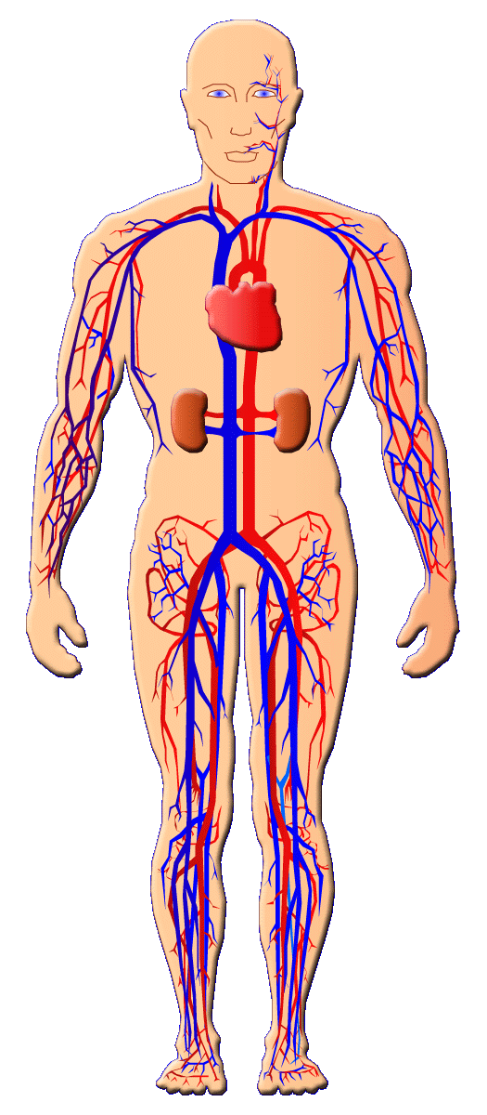


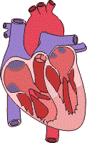
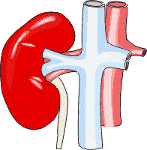
Diabetes Complications
Leading cause
of blindness
in working age
adults
2- to 4- fold
increase in
cardiovascular
mortality
and stroke
Diabetic
Retinopathy
Stroke
Diabetic
Nephropathy
Cardiovascular
Disease
Leading cause of
end-stage renal disease
Diabetic
Neuropathy
Leading cause of ulcer & non-traumatic
lower extremity amputations
Notes:
68
Diabetic microvascular complications are most commonly manifested in the eyes, kidneys, and nerves.
Diabetic retinopathy and diabetic macular oedema: Diabetes is the leading cause of new cases of blindness in adults between the ages of 20 and 74 years.¹ After 15 years of diabetes, 2% of patients become blind and 10% develop severe visual disability.⁴
Diabetic nephropathy: In end-stage renal disease, diabetes accounts for about 35% to 40% of new cases.¹ People with diabetes make up the fastest-growing group of renal dialysis and transplant recipients.³
Diabetic neuropathy and amputations: Diabetes is the leading cause of nontraumatic lower-extremity amputations, accounting for 50% of amputations in the United States. About 60% to 70% of people with diabetes have some degree of diabetic nerve damage.⁴
There is also a high frequency of atherosclerosis (macrovascular disease) leading to increased risk of stroke and/or heart attack.
Cardiovascular disease: People with diabetes are 2 to 4 times more likely to die from heart disease than people without diabetes. Cardiovascular disease is responsible for 50% of diabetes-related deaths.²
Stroke: A person with diabetes is 2 to 4 times more likely to suffer a stroke than a person without diabetes.¹
1. National Diabetes Information Clearinghouse. Diabetes Statistics–Complications of Diabetes. http://www.niddk.nih.gov/health/diabetes/pubs/dmstats/dmstats.htm Accessed May 1, 2001.
Diabetes mellitus is associated with a wide variety of microvascular and macrovascular complications.

Slide 69
What is the burden of diabetic complications ?
No global/country estimates….
  Very few population-based studies
  Lack of standardized definitions

Slide 70
Can complications of diabetes be prevented/delayed ?
Yes, convincing evidence from rigorous trials
However, great inequities in access to quality treatment
Notes:
70

Slide 71
Type 1 diabetes
DIABETES CONTROL AND COMPLICATIONS TRIAL (DCCT)
The effect of intensive treatment of diabetes on the development and progression of long-term complications in insulin-dependent diabetes mellitus
NEJM,1993

Slide 72
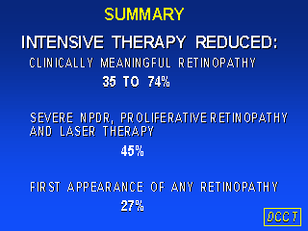

Slide 73
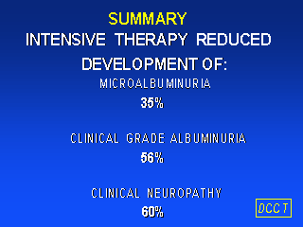

Slide 74
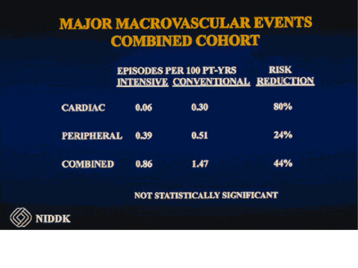

Slide 75
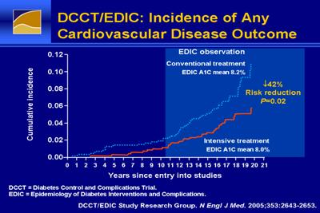

Slide 76
The UK
Prospective
Diabetes
Study
(UKPDS)
Type 2 diabetes

Slide 77
UKPDS
multi-centre
randomised controlled trial
of different therapies
of type 2 diabetes

Slide 78
Prevention of complications in Type 2 diabetes - Glucose Control, UKPDS
The intensive glucose control policy maintained a lower HbA_{1c} by mean 0.9 % over a median follow up of 10 years from diagnosis of type 2 diabetes with reduction in risk of:
  12% for any diabetes related endpoint p=0.029
  25% for microvascular endpoints p=0.0099
  16% for myocardial infarction p=0.052
  24% for cataract extraction p=0.046
  21% for retinopathy at twelve years p=0.015
  33% for albuminuria at twelve years p=0.000054

Slide 79
Prevention of complications in Type 2 diabetes - Blood Pressure Control, UKPDS
A tight blood pressure control policy which achieved
blood pressure of 144 / 82 mmHg gave reduced risk of
24% for any diabetes-related endpoint p=0.0046
32% for diabetes-related deaths p=0.019
44% for stroke p=0.013
37% for microvascular disease p=0.0092
56% for heart failure p=0.0043

Slide 80
Priority interventions in preventing and treating diabetes and its complications in developing countries (Disease Control Priorities in Developing Countries, 2nd ed)
Feasible and cost saving
Glycaemic control in people with HbA1c>9%
Blood pressure control in people with BP>165/95
Foot care in people with high risk of ulcers
*at least 1 randomized controlled trial

Slide 81
Other effective interventions in preventing the onset/progression of diabetic complications*
Intervention | Benefit
Early retinal photocoagulation Foot care in high risk for ulcer ACE-inhibitor in type 2 ACE inhibitor in type 1 Angiotensin II receptor blk in type 2 | 60-70% in serious vision loss 50-60% in serious foot disease 24% nephropathy, 24% death 50% AER in microalbuminuric pts 13% AER in normoalbuminuric pts progression to proteinuria & ESRD
*at least 1 randomized controlled trial

Slide 82

Discovery & Development of Insulin
Reliable industrial supply by late 1922
Nobel Prize in 1923

Slide 83
90 years after its discovery, insulin is not accessible to millions of people who need it!

Slide 84
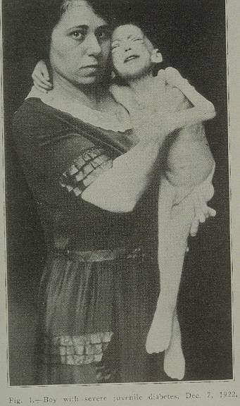

Slide 85
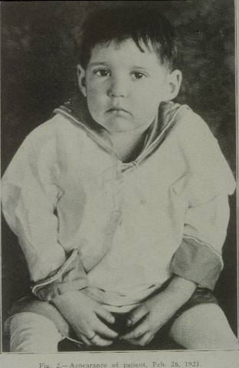

Slide 86
Median life expectancy of a child with newly diagnosed type 1 diabetes
Rural Mozambique – 7 months (Beran, 2005)
Mali - 8 years (Sidibe, 2005)

Slide 87
Availability (%) of selected essential medicines in primary care facilities , low-income & low middle-income countries
Selected essential medicines |  | Low-income | Low middle-income
Atenolol |  | 0.0 | 69.2
Enalapril |  | 0.0 | 69.2
Calcium channel blocker |  | 0.0 | 69.2
Glyceryl trinitrate |  | 0.0 | 53.8
Statins |  | 0.0 | 23.1
Insulin intermediate-acting |  | 0.0 | 30.8
Insulin soluble |  | 0.0 | 30.8
Metformin |  | 0.0 | 69.2
Glibenclamide |  | 14.3 | 69.2
Frusemide |  | 14.3 | 69.2
Hydrochlorothiazide |  | 85.7 | 69.2
Beclometasone inhaler |  | 0.0 | 15.4
Prednisolone |  | 0.0 | 69.2
Salbutamol inhaler |  | 0.0 | 30.8
Aspirin |  | 0.0 | 69.2
Glucose solution for injection |  | 57.1 | 53.8

Slide 88
Availability (%) of basic diagnostic tests in primary care facilities , low-income & low middle-income countries
Tests |  |  | Middle-income | Low-income | Low middle-income
Urine albumin |  |  | 64 | 100 | 46
Urine glucose |  |  | 71 | 100 | 54
Urine ketones |  |  | 79 | 0 | 0
Blood glucose |  |  | 93 | 0 | 0
Blood cholesterol |  |  | 14 | 0 | 8
Serum creatinine |  |  | 0 | 0 | 8

Slide 89
Low public sector availability leads patients to the private sector, where medicines are unaffordable
Notes:
This slide shows the number of days' wages that the lowest-paid government worker needs to spend each month to purchase diabetes treatment from the private sector. For the purposes of this study the standard treatment regimen was defined as glibenclamide 5mg, 2x/day together with metformin 500mg, 3x/day.
The treatment regimen costs over 2 days wages in the majority of countries, reaching 8 days wages in Ghana. This data is for generic medicines, as shown in the previous slide costs escalate when brand products are used. One can also imagine the impact of a concomitant condition such as hypertension on treatment affordability.
When considering the affordability of chronic disease medicines it must also be borne in mind that these are ongoing expenditures. They are therefore much less amenable to financial coping mechanisms, such as borrowing or selling assets, than one-time expenditures to treat acute conditions.

Slide 90
WHO GLOBAL NCD ACTION PLAN 2013 -2020
Objective 4
To strengthen and orient health systems to address the prevention and control of
noncommunicable diseases and the underlying social determinants through people-centred
primary health care and universal health coverage

Slide 91
Treatment protocols for physician and non-physician health workers (WHO- PEN)

Slide 92

Screening for type 2 diabetes

Slide 93
Definition of screening (Wald, 2001)
  Systematic application of a test/enquiry, to identify individuals at sufficient risk of a specific disorder to benefit from further investigation or action, among persons who have not sought medical attention because of symptoms of that disorder
Support to member states to enhance the health of their populations

Slide 94
Conditions for screening
Does the condition represent an important health problem that imposes a significant burden on the population?
YES

Slide 95
Conditions for screening
Is the natural history well understood?
YES

Slide 96
Conditions for screening
Does the disease have a recognizable preclinical (asymptomatic) stage during which it can be diagnosed?
YES

Slide 97
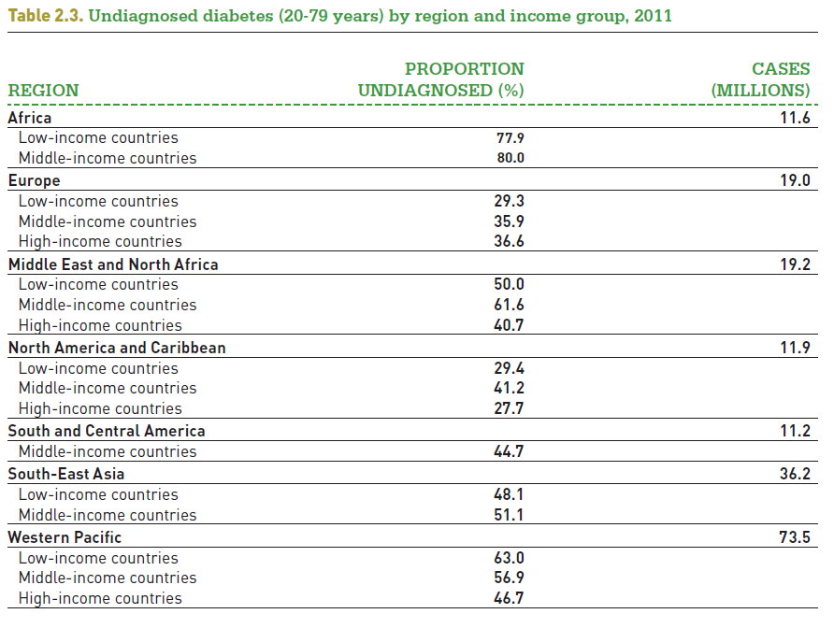
Undiagnosed diabetes
Notes:
97

Slide 98
Duration of preclinical period in Type 2 diabetes
It is estimated that type 2 diabetes is typically diagnosed at 5-12 years of duration

Slide 99
Conditions for screening
Are there reliable and acceptable tests that detect asymptomatic diabetes?
YES

Slide 100
Two major screening methods:
Questionnaires (diabetes score)
Biochemical tests (blood, urine)

Slide 101
Questionnaires:
Some have been shown to perform well (e.g. Finnish Diabetes Risk Score), but are population-specific

Slide 102
Biochemical tests:
Test | Sample | Cut-off | Sensitivity | Specificity
Urine glucose | Random | Trace | 18-64% | 99%
Venous glucose | Fasting | >=7mmol/l | 40-59% | 96-99%
Venous glucose | Fasting | >=6.1mmol/l | 66-95% | 90-96%
Venous glucose | 2h-OGTT | >=11.1mmol/l | 90-93% | 100%
Capillary glucose | Fasting | >=5.5mmol/l | 90% | 94%
Capillary glucose | Random | >=7.2mmol/l | 80% | 80%
Capillary glucose | Random | >=8.0mmol/l | 69% | 95%

Slide 103
Conditions for screening
Does treatment after early detection yield superior benefits?
Possibly YES, not proven

Slide 104
Possibly, because:
Benefits of improved glycemic and cardiovascular risk factor control in people with diabetes have been established in rigorous trials

Slide 105
But, what about diagnosing asymptomatic individuals?
Currently, only 1 randomized controlled trial (ADDITION Study, UK) showed 10-year mortality not lower in screened population (Simmons, 2012)
Adherence to treatment in absence of symptoms?
Other available evidence suffers from bias:
  Selection (volunteers)
  Lead time (artificial lengthening of duration)
  Length time (screening detects milder cases)
  Overdiagnosis (false positives give impression of better outcome)

Slide 106
Conditions for screening
Is it cost-effective?
Uncertain

Slide 107
Cost-effectiveness of screening for type 2 diabetes
Universal screening – NO
Selective screening (high risk groups with high DM prevalence and cardiovascular risk) – POSSIBLY, NOT PROVEN

Slide 108
Cost-effectiveness of screening for type 2 diabetes
Selective screening (high risk groups with high DM prevalence and cardiovascular risk) – POSSIBLY, NOT PROVEN (ADDITION Study)

Slide 109
Conditions for screening
Are facilities and resources available to treat all newly detected cases?
No, in most settings!

Slide 110
Use resources to screen for undiagnosed type 2 diabetes?
        OR
Use resources to improve care of the already diagnosed?

Slide 111
Screening for type 1 diabetes ?
Rare illness
Short asymptomatic period
No

Slide 112
Update of the WHO classification and diagnosis of hyperglycaemia first detected in pregnancy

Slide 113
Most commonly used guidelines for the diagnosis of GDM
Organisation | Fasting Plasma glucose | Glucose Challenge | 1-h plasma glucose | 2-h plasma glucose | 3-h plasma glucose
WHO 1999* | ≥ 7.0 | 75g OGTT | Not required | ≥ 7.8 | Not required
American Congress of Obstetricians and Gynecologists** | ≥5.3 | 100g OGTT | ≥10.0 | ≥8.6 | ≥7.8
Canadian Diabetes Association** | ≥5.3 | 75g OGTT | ≥10.6 | ≥8.9 | Not required
International Assoc of Diab in Pregnancy Study Group (IADPSG)* | ≥5.1 | 75g OGTT | ≥10.0 | ≥8.5 | Not required
*one value is sufficient for diagnosis
** two or more values are required for diagnosis
Notes:
22/05/2013
113

Slide 114
1999 WHO definition of Gestational Diabetes Mellitus
" GDM is a carbohydrate intolerance resulting in hyperglycaemia of variable severity with onset or first recognition during pregnancy"

Slide 115
Current definition of gestational diabetes covers a wide range of blood glucose values………..
Type 1 diabetes + Type 2 diabetes + nondiabetic hyperglycaemia in pregnancy
IADPSG distinguishes "overt diabetes" from GDM
Notes:
22/05/2013
115

Slide 116
Only IADPSG criteria are based on the association of non-diabetic glycaemia and adverse maternal and perinatal outcome of index pregnancy
Notes:
22/05/2013
116

Slide 117
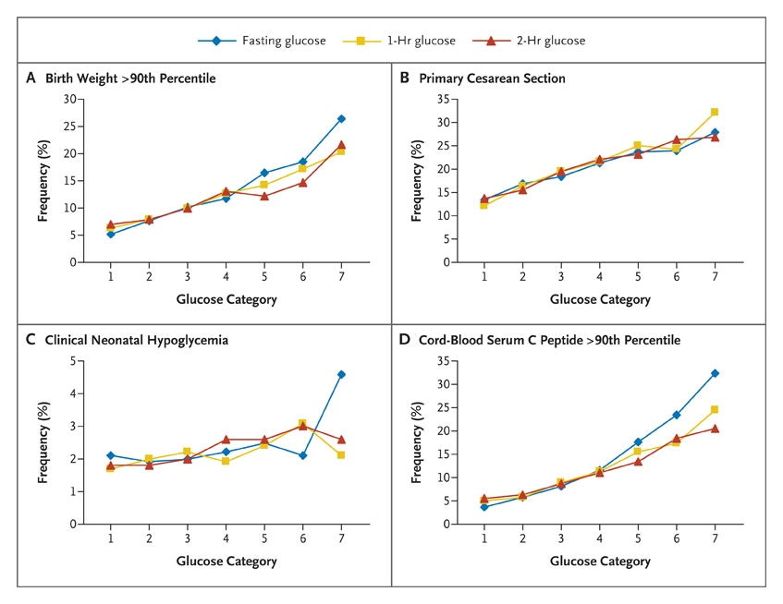

Frequency of Primary Pregnancy Outcomes across the Glucose Categories
The HAPO Study Cooperative Research Group. N Engl J Med 2008;358:1991-2002.
Notes:
Figure 1. Frequency of Primary Outcomes across the Glucose Categories. Glucose categories are defined as follows: fasting plasma glucose level — category 1, less than 75 mg per deciliter (4.2 mmol per liter); category 2, 75 to 79 mg per deciliter (4.2 to 4.4 mmol per liter); category 3, 80 to 84 mg per deciliter (4.5 to 4.7 mmol per liter); category 4, 85 to 89 mg per deciliter (4.8 to 4.9 mmol per liter); category 5, 90 to 94 mg per deciliter (5.0 to 5.2 mmol per liter); category 6, 95 to 99 mg per deciliter (5.3 to 5.5 mmol per liter); and category 7, 100 mg per deciliter (5.6 mmol per liter) or more; 1-hour plasma glucose level — category 1, 105 mg per deciliter (5.8 mmol per liter) or less; category 2, 106 to 132 mg per deciliter (5.9 to 7.3 mmol per liter); category 3, 133 to 155 mg per deciliter (7.4 to 8.6 mmol per liter); category 4, 156 to 171 mg per deciliter (8.7 to 9.5 mmol per liter); category 5, 172 to 193 mg per deciliter (9.6 to 10.7 mmol per liter); category 6, 194 to 211 mg per deciliter (10.8 to 11.7 mmol per liter); and category 7, 212 mg per deciliter (11.8 mmol per liter) or more; and 2-hr plasma glucose level — category 1, 90 mg per deciliter (5.0 mmol per liter) or less; category 2, 91 to 108 mg per deciliter (5.1 to 6.0 mmol per liter); category 3, 109 to 125 mg per deciliter (6.1 to 6.9 mmol per liter); category 4, 126 to 139 mg per deciliter (7.0 to 7.7 mmol per liter); category 5, 140 to 157 mg per deciliter (7.8 to 8.7 mmol per liter); category 6, 158 to 177 mg per deciliter (8.8 to 9.8 mmol per liter); and category 7, 178 mg per deciliter (9.9 mmol per liter) or more.

Slide 118
Frequency of Primary Pregnancy Outcomes across the Glucose Categories
NO OBVIOUS CUT-OFF DIAGNOSTIC POINT
The HAPO Study Cooperative Research Group. N Engl J Med 2008;358:1991-2002.
Notes:
Figure 1. Frequency of Primary Outcomes across the Glucose Categories. Glucose categories are defined as follows: fasting plasma glucose level — category 1, less than 75 mg per deciliter (4.2 mmol per liter); category 2, 75 to 79 mg per deciliter (4.2 to 4.4 mmol per liter); category 3, 80 to 84 mg per deciliter (4.5 to 4.7 mmol per liter); category 4, 85 to 89 mg per deciliter (4.8 to 4.9 mmol per liter); category 5, 90 to 94 mg per deciliter (5.0 to 5.2 mmol per liter); category 6, 95 to 99 mg per deciliter (5.3 to 5.5 mmol per liter); and category 7, 100 mg per deciliter (5.6 mmol per liter) or more; 1-hour plasma glucose level — category 1, 105 mg per deciliter (5.8 mmol per liter) or less; category 2, 106 to 132 mg per deciliter (5.9 to 7.3 mmol per liter); category 3, 133 to 155 mg per deciliter (7.4 to 8.6 mmol per liter); category 4, 156 to 171 mg per deciliter (8.7 to 9.5 mmol per liter); category 5, 172 to 193 mg per deciliter (9.6 to 10.7 mmol per liter); category 6, 194 to 211 mg per deciliter (10.8 to 11.7 mmol per liter); and category 7, 212 mg per deciliter (11.8 mmol per liter) or more; and 2-hr plasma glucose level — category 1, 90 mg per deciliter (5.0 mmol per liter) or less; category 2, 91 to 108 mg per deciliter (5.1 to 6.0 mmol per liter); category 3, 109 to 125 mg per deciliter (6.1 to 6.9 mmol per liter); category 4, 126 to 139 mg per deciliter (7.0 to 7.7 mmol per liter); category 5, 140 to 157 mg per deciliter (7.8 to 8.7 mmol per liter); category 6, 158 to 177 mg per deciliter (8.8 to 9.8 mmol per liter); and category 7, 178 mg per deciliter (9.9 mmol per liter) or more.

Slide 119
Most frequent adverse pregnancy outcomes in hyperglycaemia
 | Congenital anomalies/ miscarriage | Perinatal mortality | Neonatal macrosomia | Future DM in offspring | Hypertensive disorders of pregnancy | Future DM in mother
Type 1 DM | + | + | + | + | + | n/a
Type 2 DM | + | + | + | + | + | n/a
Non-diabetic hyperglycaemia | ? | ? | + | ? | + | +
Notes:
22/05/2013
119

Slide 120
Despite the knowledge of the continuous association of glycaemia and several short and long-term undesirable pregnancy outcomes……..
How much of the burden of obstetric complications can be attributed to hyperglycaemia?
How much of the future burden of diabetes (and obesity) could be avoided by rigorously treating diabetic and non-diabetic hyperglycaemia in pregnancy?
Notes:
22/05/2013
120

Slide 121
Distribution of leading causes of maternal death (WHO, 2006)
Cause of death | Developed countries | AFRICA | ASIA | LATIN AMERICA & CARIBBEAN
Haemorrhage | 13.4% | 33.9% | 30.8% | 20.8%
Hypertensive disorders | 16.1% | 9.1% | 9.1% | 25.7%
Infection/sepsis | 2.1% | 9.7% | 11.6% | 7.7%
Abortion | 8.2% | 3.9% | 5.7% | 12.0%
Obstructed labour | 0.0% | 4.1% | 9.4% | 13.4%
Anaemia | 0.0% | 3.7 | 12.8% | 0.1%
Embolism | 14.9% | 2.0% | 0.4% | 0.6%

Slide 122
Comparison of 1990 and 2010 maternal mortality ratio (MMR, maternal deaths per 100 000 live births), by World Bank income group (WHO, 2012)
Income group | MMR 1990 | MMR 2010 | % change in MMR 1990-2010 | Average annual MMR change 1990-2010
Low income | 810 | 410 | -49 | -3.3
Lower middle income | 560 | 260 | -53 | -3.7
Upper middle income | 120 | 53 | -55 | -3.9
High income | 16 | 14 | -15 | -0.8

Slide 123
Neonatal mortality decline 1990-2011 (WHO&UNICEF 2012)
Millennium Development Goal Region | Reduction (%) in neonatal mortality 1990-2011
Northern Africa | 55
Sub-Saharan Africa Latin America&Caribbean Caucasus & Central Asia Eastern Asia Southern Asia South-eastern Asia Western Asia Oceania | 24 55 33 61 32 46 42 23
Notes:
22/05/2013
123

Slide 124
Does treatment of hyperglycaemia in pregnancy prevent adverse pregnancy outcomes?
 | Congenital anomalies/ miscarriage | Perinatal mortality | Neonatal macrosomia | Future DM in offspring | Hypertensive disorders of pregnancy | Future DM in mother
Type 1 DM | + | + | + | ? | + | n/a
Type 2 DM | + | + | + | ? | + | n/a
Non-diabetic hyperglycaemia | ? | ? | + | ? | + | ?
Notes:
22/05/2013
124

Slide 125
Widespread enthusiasm for screening pregnant women for hyperglycaemia…….
Notes:
22/05/2013
125

Slide 126
Survey of country policies for GDM screening by glucose measurement (Jiwani, 2012)
27/51 countries have a policy of universal screening
2/27 universal screening at first visit only
13/27 universal screening at 24-28 weeks only
9/27 universal screening at first visit and at 24-28 weeks
Notes:
22/05/2013
126

Slide 127
What is the evidence on the benefits of screening for GDM to reduce maternal and child morbidity and mortality?……..
No direct evidence, future RCTs unlikely
Notes:
22/05/2013
127

Slide 128
Impact of universal screening for GDM on adverse outcomes using the 1999 WHO criteria: a simulation study (Falavigna, 2013)
GDM prevalence according to WHO: 10%
GDM prevalence according to IADPSG: 15% (13% - 17,3%)
Incidence of LGA Births: 9,5% (9% - 10%)
Incidence of Pre-eclampsia: 4,8% (3% - 7%)
Frequency of Caesarean Section: 19% (10% - 30%)
No screening Screening
Outcome | Incidence (95%CI) | Incidence (95%CI) | GRADE | Quality Coments
LGA Births | 9.48% (8.98-9.98) | 8.95% (8.43-9.41) | Very low + ○ ○ ○ | Downgraded due to indirect evidence (-2)
Pre-eclampsia | 4.81% (2.96-6.81) | 4.54% (2.79-6.44) | Very low + ○ ○ ○ | Downgraded due to indirect evidence (-2)
Caesarean delivery | 19.2% (9.8-29.2) | 18.9% (9.7-28.9) | Very low + ○ ○ ○ | Downgraded due to indirect evidence (-2) and lack of blinding (-1)
Notes:
128

Slide 129
Climate Change and GDM
Controversy about the extent of the problem
Controversy about the degree of harm
Emotive argument that we need to do something for future generations, especially the children
Controversy about the diagnostic methods, the interventions and how effective these will be

