Slide 1
NCDs: global situation and response
Dr Nick Banatvala
Senior Adviser to the Assistant Director General
for Noncommunicable Diseases and Mental Health

Slide 2
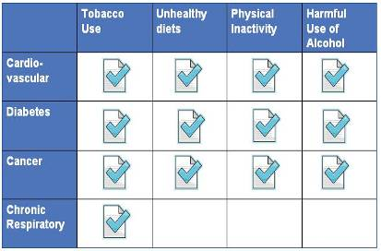
Noncommunicable diseases (NCDs):
Cardiovascular diseases (e.g. heart diseases, stroke)
Cancers
Diabetes
Chronic respiratory diseases (e.g. asthma)
Risk factors for noncommunicable diseases:
Tobacco use
Unhealthy diet
Physical inactivity
Harmful use of alcohol

Slide 3

The top-10 causes of death
Source:
Low-income countries | Middle-income countries
Lower respiratory infections Coronary heart disease Diarrhoeal diseases HIV/AIDS Stroke and cerebrovascular disease Chronic pulmonary disease Tuberculosis Neonatal infections Malaria Premature and low birth weight | Stroke and cerebrovascular disease Coronary heart disease Chronic pulmonary disease Lower respiratory infection Trachea, bronchus, lung cancers Road traffic accidents Hypertensive heart disease Stomach cancer Tuberculosis Diabetes mellitus

Slide 4
NCDs are the single biggest cause of death
10%
60 million
5.1 M
50 million
26.9 M
(above the age of 60)
40 million
30 million
Source: WHO global estimates 2008
9.1 M
(below the age of 60)
20 million
15.7 M
10 million
0
Total deaths in the world (2008)
Group III - Injuries
Low-income countries
Group II – Other deaths from NCDs
Group II – Premature deaths from NCDs (below 60 years), which are preventable
Group I – Communicable diseases, maternal, perinatal and nutritional conditions

Slide 5
Four types of NCDs account for most deaths in all regions
100%
80%
60%
40%
20%
0%
WHO Region
for Africa
WHO Region for the
Eastern Mediterranean
WHO Region
for the Americas
WHO Region
for Europe
WHO Region for
South-East Asia
WHO Region for the
Western Pacific
Other NCDs
Diabetes
Respiratory diseases
Cancers
Cardiovascular diseases

Slide 6
90% of global premature deaths from NCDs occur
in low- and middle-income countries
2.9M
25 million
13.6M
20 million
Total deaths (2008)
15 million
Source: WHO global estimates 2008
10 million
5.3M
1M
0.5M
8.3M
2.3 M
6.6M
0.8M
1.4M
4.4M
5.6M
1M
1.4M
0.6M
1.2M
High-income countries
Upper middle-income
Lower middle-income
Low-income countries
Group III - Injuries
Low-income countries
Group II – Other deaths from NCDs
Group II – Premature deaths from NCDs (below 60 years), which are preventable
Group I – Communicable diseases, maternal, perinatal and nutritional conditions

Slide 7
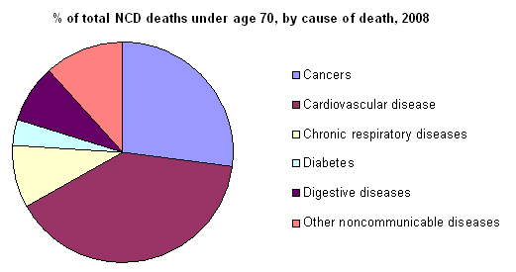
Premature deaths from NCDs
44% of all NCD deaths occur before the age of 70
A higher proportion (48%) of all NCD deaths are estimated to occur in people under the age of 70 in low- and middle income countries, compared with 26% in high income countries

Slide 8
NCDs
Raised blood pressure
Overweight/obesity
Raised blood glucose
Raised lipids
Tobacco use
Unhealthy diet
Physical inactivity
Harmful use of alcohol
Globalization
Urbanization
Population ageing
Causal links
Metabolic/
physiological
risk factors
Behavioural
risk factors
Underlying drivers
Social Determinants of Health

Slide 9
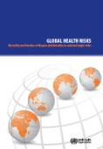
Leading causes of attributable global mortality and burden of disease (2004)
Attributable Mortality
Attributable DALYs
%
High blood pressure 12.8
Tobacco use 8.7
High blood glucose 5.8
Physical inactivity 5.5
Overweight and obesity 4.8
High cholesterol 4.5
Unsafe sex 4.0
Alcohol use 3.8
Childhood underweight 3.8
Indoor smoke from solid fuels 3.3
59 million total global deaths in 2004
%
Childhood underweight 5.9
Unsafe sex 4.6
Alcohol use 4.5
Unsafe water, sanitation 4.2
High blood pressure 3.7
Tobacco use 3.7
Suboptimal breastfeeding 2.9
High blood glucose 2.7
Indoor smoke from solid fuels 2.7
Overweight and obesity 2.3
1.5 billion total global DALYs in 2004

Slide 10
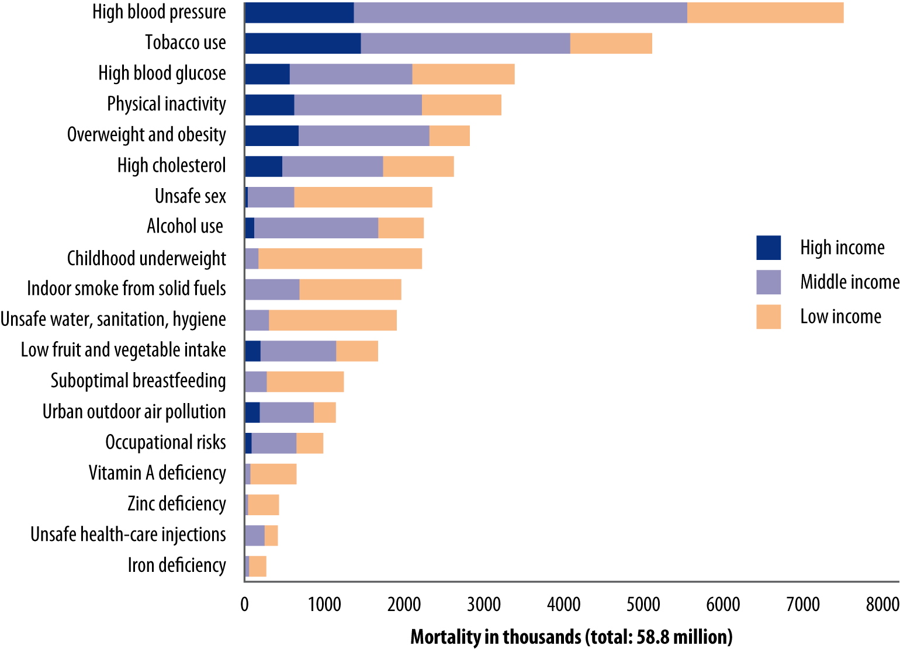
Deaths attributed to 19 leading factors (2004)

Slide 11
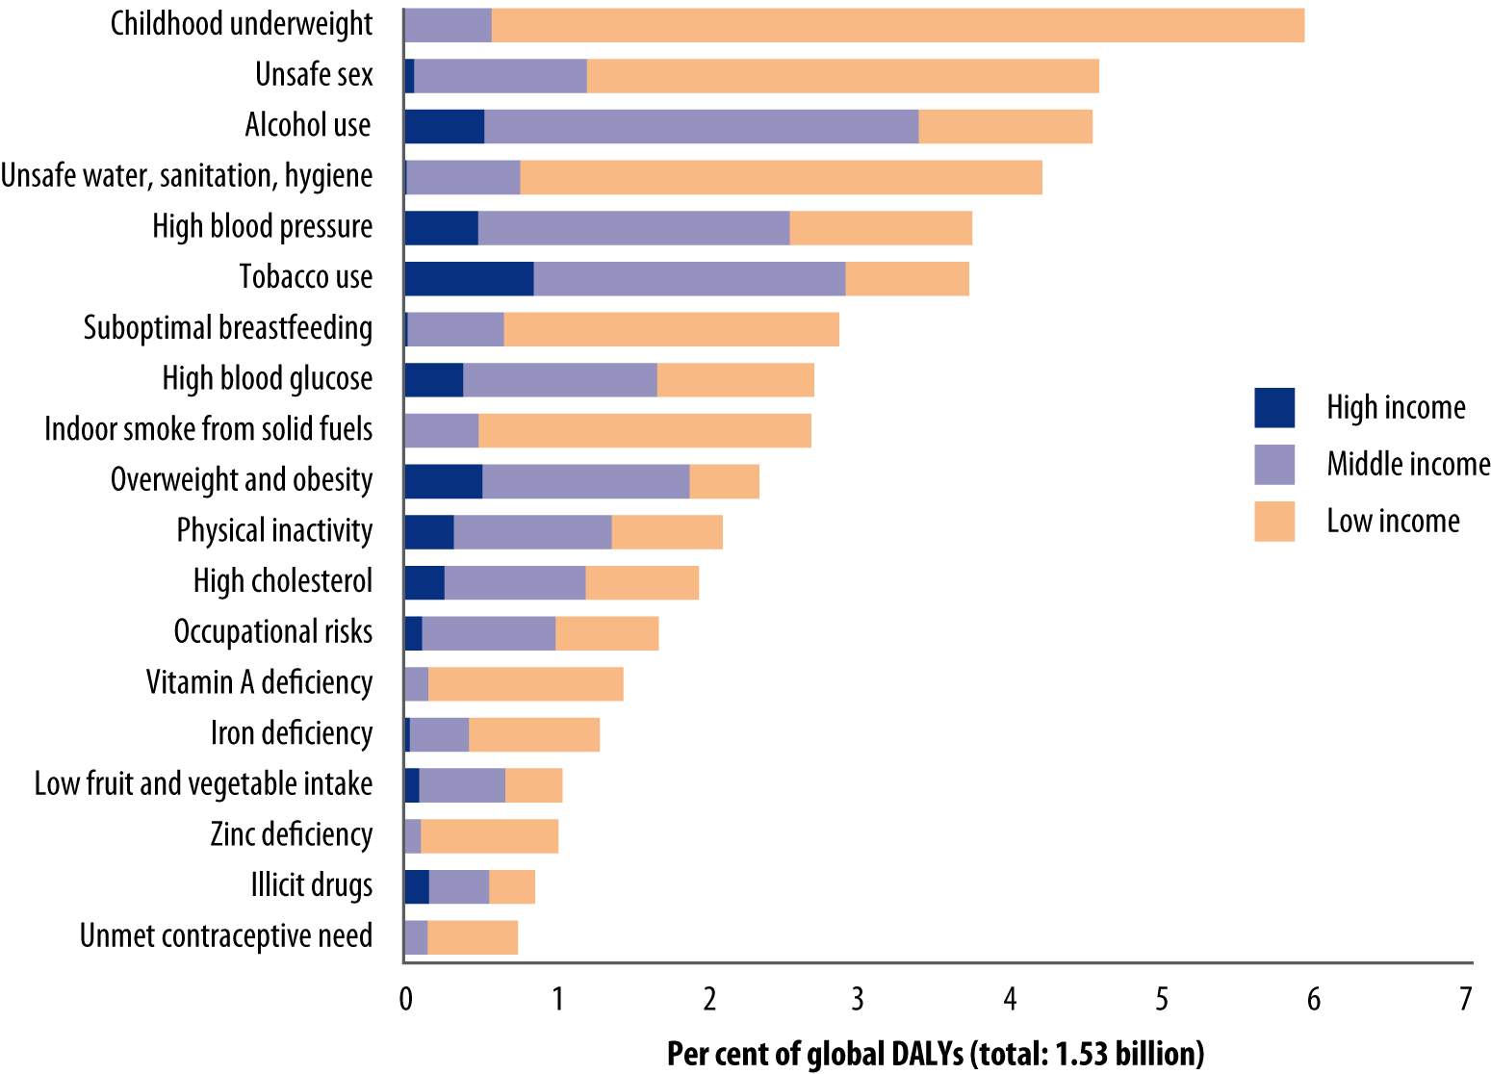
Percentage of DALYs attributed to 19 leading risk factors (2004)

Slide 12
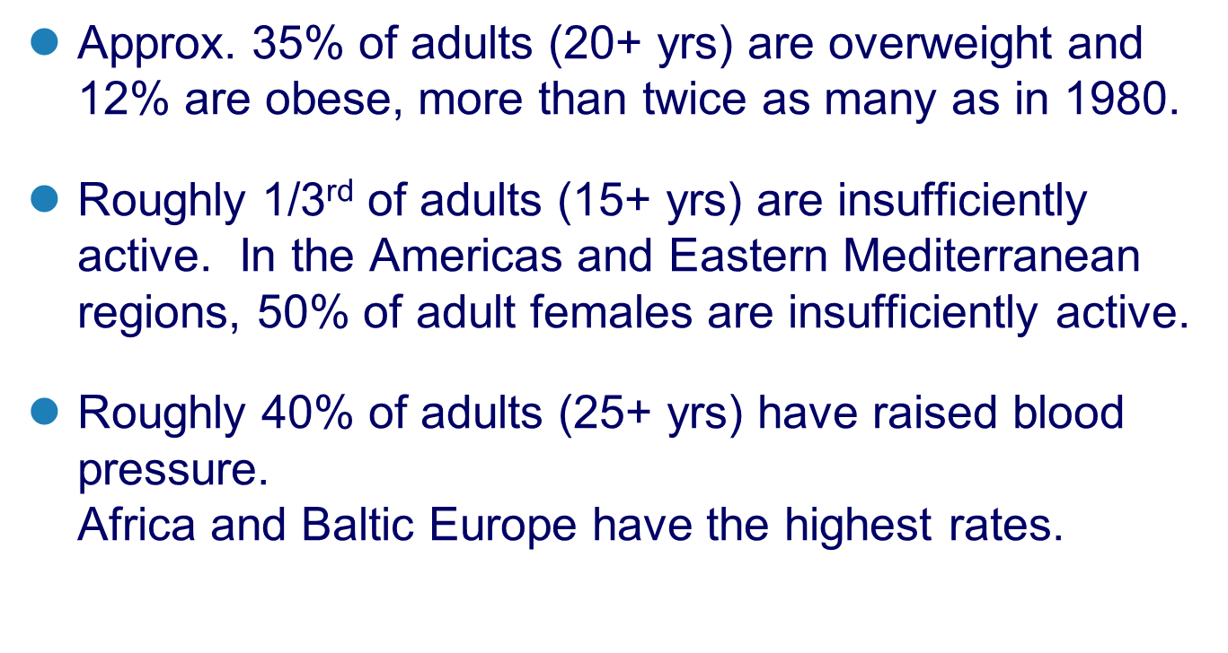
NCD Risk Factors
(2008 estimates)

Slide 13
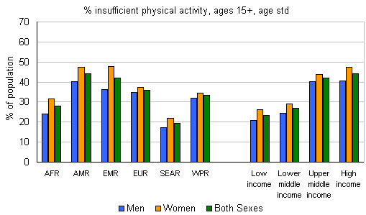
% insufficiently active*, WHO estimates, ages 15+ years, 2008, age std, by WHO region and WB income group
*defined as not meeting any of the following criteria: 30 mins of moderate activity on at least 5 days per week OR 20 mins of vigorous activity on at least 3 days per week OR an equivalent combination.

Slide 14
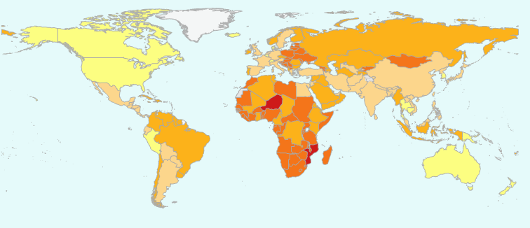
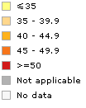
% raised blood pressure*, WHO estimates, ages 25+ years, 2008, age std
**defined as SBP ≥ 140 and/or DBP ≥ 90 or on medication for raised blood pressure.

Slide 15
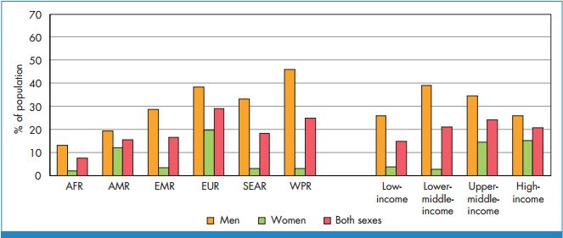
% daily tobacco smoking, WHO estimates, ages 15+ years, 2008, age std, by WHO region and WB income group

Slide 16
Overweight and obesity in people over 15 selected countries
Notes:
Just to provide examples of other risk factors-overweight and obesity are now showing very high rates in both industrialized and developing nations. This shows selected countries with very high rates which are still increasing particularly in LMICs. Around 22 million children under 5 are overweight today. Unlike most adults, children cannot choose the environment in which they live in or the food that they eat. You can see here countries of the regions with the highest rates of overweight and obesity

Slide 17
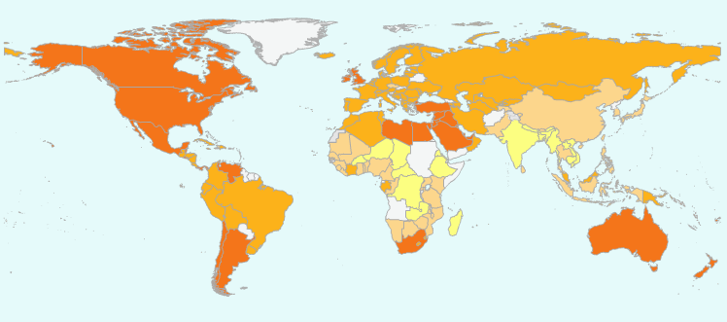
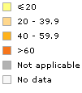
% overweight*, WHO estimates, ages 20+ years,
2008, age std
**defined as Body Mass Index ≥ 25.

Slide 18
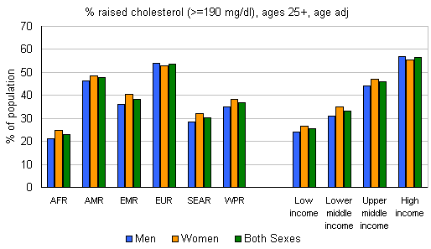
% raised total cholesterol*, WHO estimates, ages 25+ years, 2008, age std, by WHO region and WB income group
**defined as total cholesterol ≥ 5.0 mmol/L.

Slide 19
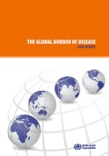
Global projections (2004 to 2030)
Global projections (2004 to 2030)
12
Cancers
10
Ischaemic HD
Stroke
8
Deaths (millions)
6
Acute respiratory
infections
4
Road traffic
accidents
Perinatal
2
HIV/AIDS
TB
0
Malaria
2000
2005
2010
2015
2020
2025
2030

Slide 20

NCDs and Development
Poverty contributes to NCDs and NCDs cause poverty
Poverty at household level
Populations in low- and middle-income countries
Population ageing and Increased exposure to common risk factors
Loss of household income
Noncommunicable diseases
Limited access to
effective and equitable health-care services
More than 8 million people die before the age of 60
in developing countries from noncommunicable diseases

Slide 21
The poorest people in developing countries are often affected the most
The poorest people smoke the most, often spending more than 10 per cent of their household income on tobacco
45
Smoking prevalence
Lowest household income quintiles
40
35
30
25
Highest household income quintiles
%
20
15
10
5
0
Low-income countries
Lower-middle
Upper-middle-income
High-income
Income

Slide 22
The poorest people in developing countries affected the most
The cost of caring for a family member with diabetes can be more than 20 per cent of low-income household incomes in developing countries
The cost per year of diabetes care at household level
 | Insulin | Syringes | Testing | Consultation | Travel | Total cost | % of per capita Income
Mali (2004) | 38% | 34% | 8% | 7% | 12% | $339.4 | 61%
Mozambique (2003) | 5% | 24% | 1% | 9% | 61% | $273.6 | 75%
Nicaragua (2007) | 0% | 73% | 0% | 0% | 27% | $74.4 | 7%
Zambia (2003) | 12% | 63% | 6% | 6% | 12% | $199.1 | 21%
Vietnam (2008) | 39% | 8% | 5% | 3% | 46% | $427.0 | 51%

Slide 23
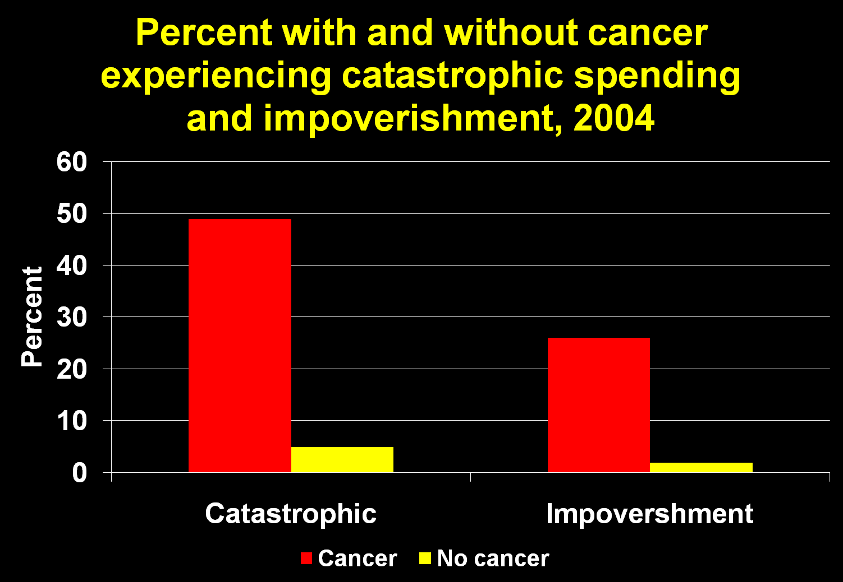
Source: Mahal et al 2010
Catastrophic spending >30% HH income in one year; Impoverishment from above poverty line to below during year

Slide 24

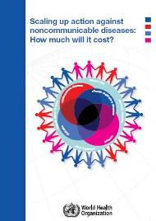
Economics
The cost of inaction versus action and the costs of scaling up
US$ 7T
cumulative lost output in developing countries associated with NCDs between 2011-2025
US$ 11B
average yearly cost for all LMICs to scale up action by implementing the "best buys"
US$1 per capita in LICs
US$1.5 and US$3 in LMICs and UMICs

Slide 25
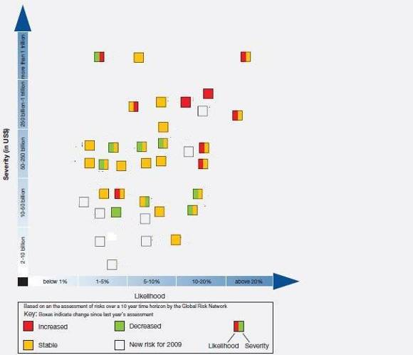
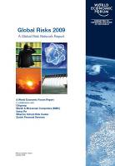
The macro-economic impact of NCDs
Oil and gas price spike
Retrenchment from globalization
Asset price collapse
NCDs
Fiscal crisis
World Economic Forum:
Global Risk Assessment 2009
Flu pandemic
Food crisis
http://www.weforum.org/pdf/globalrisk/globalrisks09/global_risks_2009.pdf
Infectious disease

Slide 26
Key messages
NCDs are already leading health problems in almost all countries and their magnitude is still increasing
Shared risk factors
Premature deaths
The poor are disproportionately affected
Negative impact on socioeconomic development
As countries continue to develop, market forces will further promote unhealthy patterns.
Action is urgently needed

Slide 27
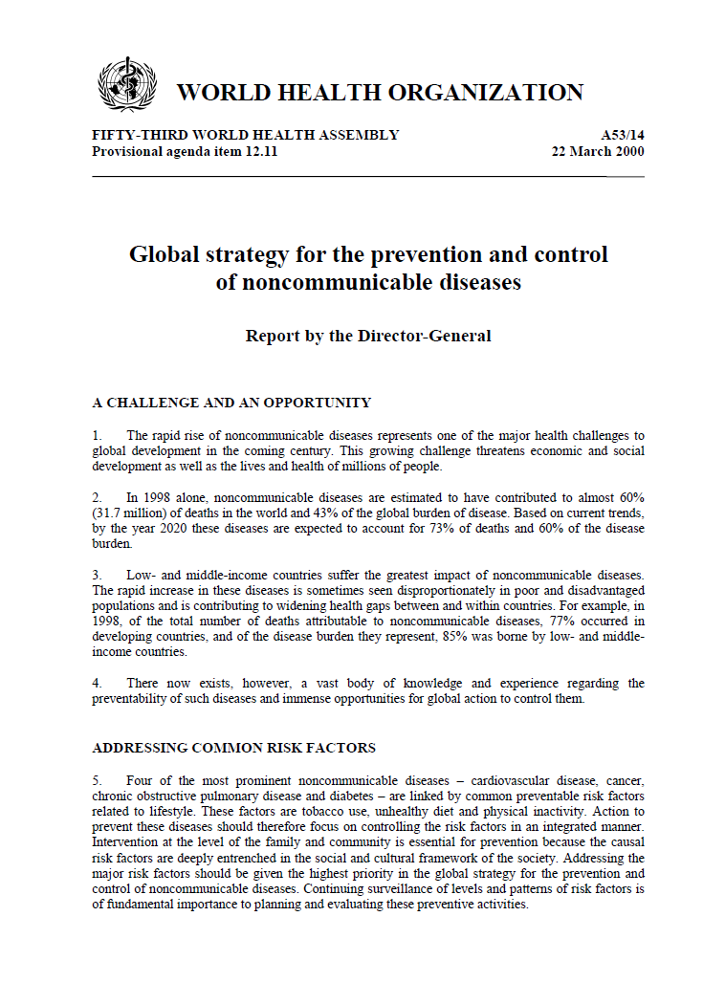
            The 2000 global strategy for the prevention and control of NCDs
              4 diseases and 4 risk factors
              Goal of reducing morbidity, disability and premature mortality from NCDs
              3 objectives
                Mapping the epidemic
                Reducing individual and population exposure to risk factors
                Strengthening health care
              Components: surveillance, prevention/health promotion and healthcare management
              Clear roles for the three partners

Slide 28







World Health Assembly in 2000:
There is a clear vision on how to address NCDs
*Surveillance*
Mapping the epidemic of NCDs
*Prevention*
Reducing the level of exposure to risk factors
*Management*
Strengthen health care for people with NCDs
Notes:
We know what we need to do at country level

Slide 29
Clear focus on 4 NCDs and 4 common risk factors for NCDs
 | Tobacco use | Unhealthy diets | Physical inactivity | Harmful use of alcohol
Heart disease and stroke | ✓ | ✓ | ✓ | ✓
Diabetes | ✓ | ✓ | ✓ | ✓
Cancer | ✓ | ✓ | ✓ | ✓
Chronic lung disease | ✓
Notes:
four groups of NCDs that constitute around 80%of NCD deaths and that share the same risk factors and therefore also the same strategies

Slide 30

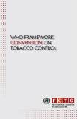

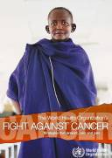
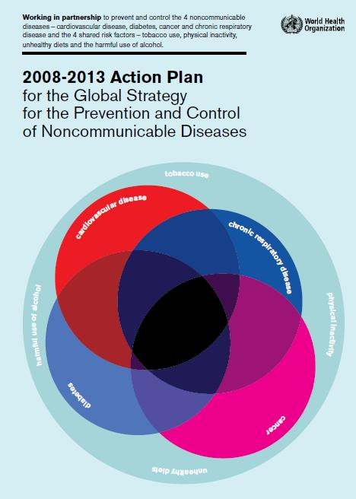
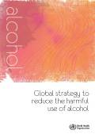

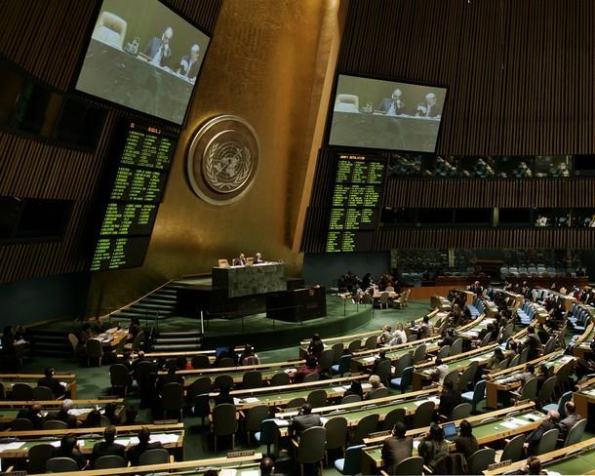
In May 2000, WHO Member States began mobilizing a global response to address NCDs,
with a particular focus on developing countries…by 2011 this issue was addressed at the UN GA
2000
Global Strategy for the Prevention and Control of Noncommunicable Diseases
Global Strategy on Infant and Young Child Feeding
2002
WHO Framework Convention on Tobacco Control
2003
Global Strategy on Diet, Physical Activity and Health
WHA resolution on cancer prevention and control
2004
Action Plan on the Global Strategy for the
Prevention and Control of NCDs
2005
Set of recommendations on the
marketing of foods and non-alcoholic beverages to children
2008
2010
Global Strategy to Reduce the Harmful Use of Alcohol
2011
High-level Meeting on NCDs (New York, 19-20 September 2011)

Slide 31
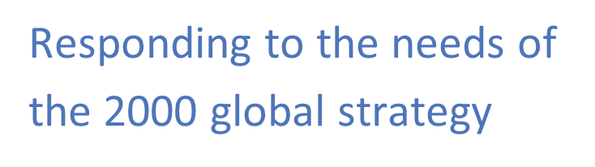
1. Integrating NCD prevention into the development agenda, and into policies across all government departments
2. Establishing/strengthening national policies and programmes
3. Reducing/preventing risk factors
4. Prioritizing research on prevention and health care
5. Strengthening partnerships
6. Monitoring NCD trends and assessing progress made at country level
Sets of actions for member states, WHO Secretariat and international partners.

Slide 32
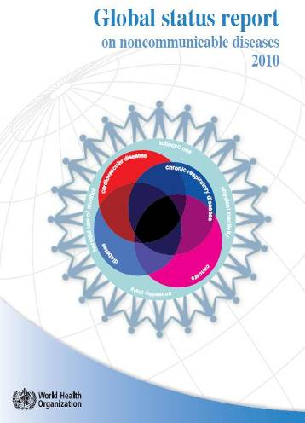
NCD Burden
framework for surveillance
Reducing risks and preventing diseases: population approaches
Improving health care: management of NCDs
Capacity

Slide 33
Framework for national NCD surveillance
  Exposures
    Behavior
    Physical & metabolic
    Social determinants
  Outcomes
  Health system capacity and response

Slide 34
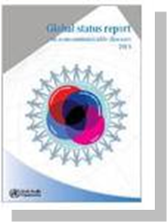
Global Status Report: interventions that work
Population-based interventions addressing NCD risk factors | Tobacco use | Excise tax increases Smoke-free indoor workplaces and public places Health information and warnings about tobacco Bans on advertising and promotion
 | Harmful use of alcohol | Excise tax increases on alcoholic beverages Comprehensive restrictions and bans on alcohol marketing Restrictions on the availability of retailed alcohol
 | Unhealthy diet and physical inactivity | Salt reduction through mass media campaigns and reduced salt content in processed foods Replacement of trans-fats with polyunsaturated fats Public awareness programme about diet and physical activity
Individual-based interventions addressing NCDs in primary care | Cancer | Prevention of liver cancer through hepatitis B immunization Prevention of cervical cancer through screening (visual inspection with acetic acid [VIA]) and treatment of pre-cancerous lesions
 | Cardiovascular disease and diabetes | Multi-drug therapy (including glycaemic control for diabetes mellitus) for individuals who have had a heart attack or stroke, and to persons at high risk (> 30%) of a cardiovascular event within 10 years Providing aspirin to people having an acute heart attack
Notes:
31/05/2013
34

Slide 35
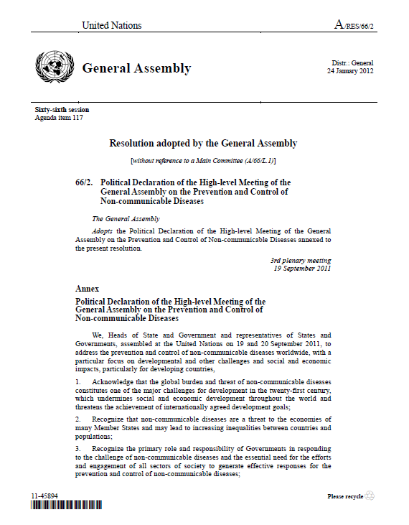
19-20 September 2011: UN General Assembly HLM. New York
2nd time in the history of the UN that the GA meets on a health issue
Countries adopted a 13-page action-oriented outcome document to shape global agendas for generations to come.
Articulated roles and responsibilities for Member States and others including WHO

Slide 36
The Political Declaration…
A whole-of-government and a whole-of-society effort
Reducing risk factors and create health-promoting environments
Strengthening national policies and health systems
Encouraging international cooperation, including collaborative partnerships
Promoting research and development
Strengthening monitoring and evaluation
Follow up and way forward

Slide 37
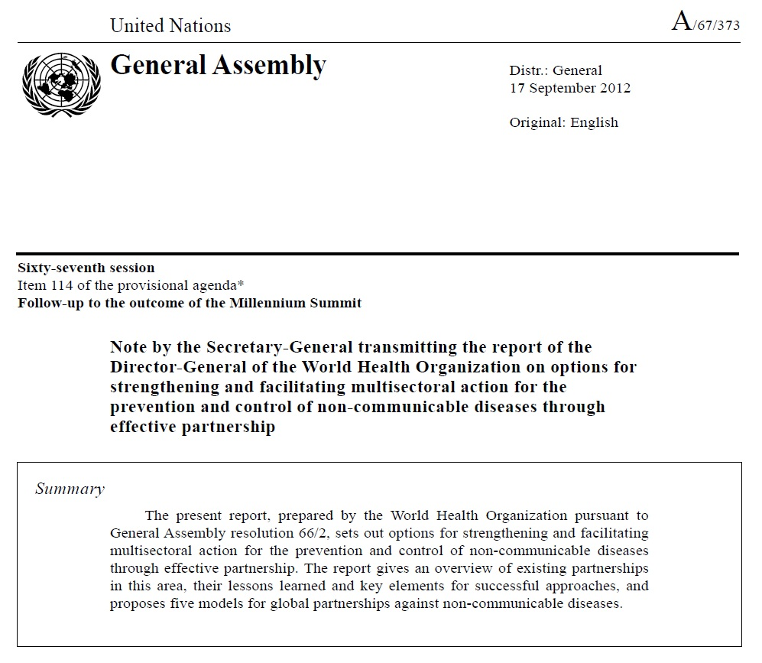
Discussed at the United Nations
General Assembly on
28 November 2012

Slide 38
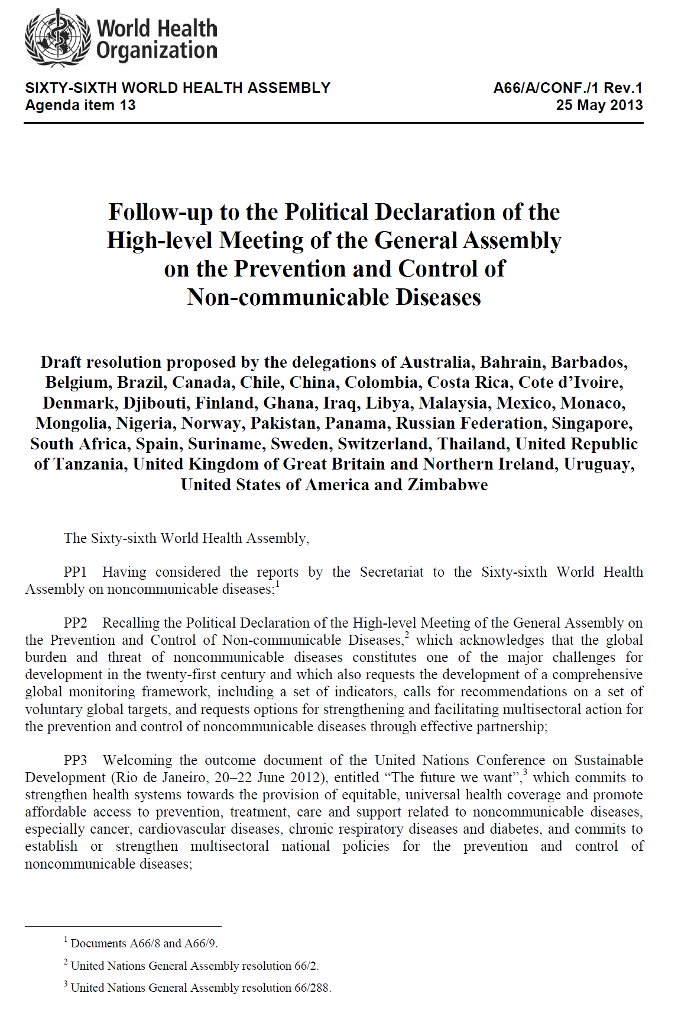
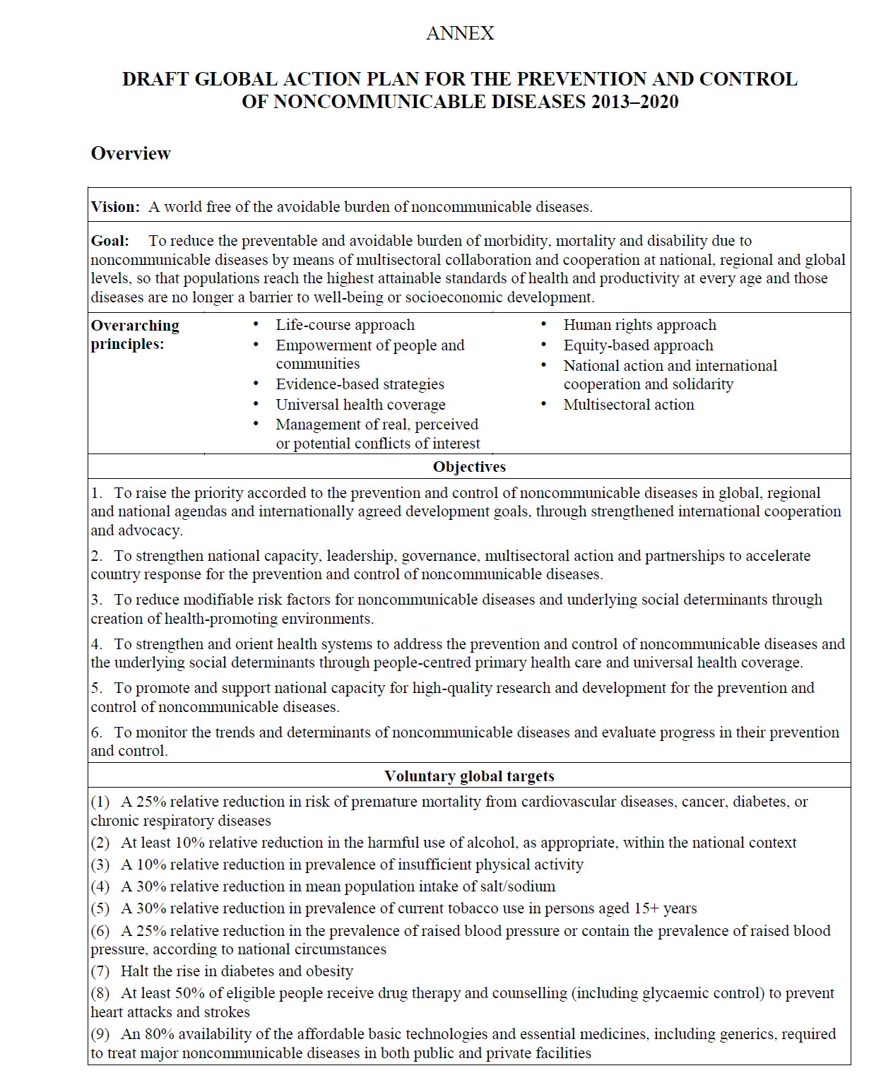

Slide 39
