Slide 1

Physical inactivity: meeting the 2025 global targets
Leo Nederveen
Technical Officer
Surveillance and Population-based Prevention Unit
Department of Prevention of Noncommunicable Diseases
World Health Organization

Slide 2
Outline
Health benefits of physical activity
Global recommendations on physical activity for health
Effective interventions in physical activity promotion
From data to action

Slide 3
Health benefits of physical activity
1

Slide 4
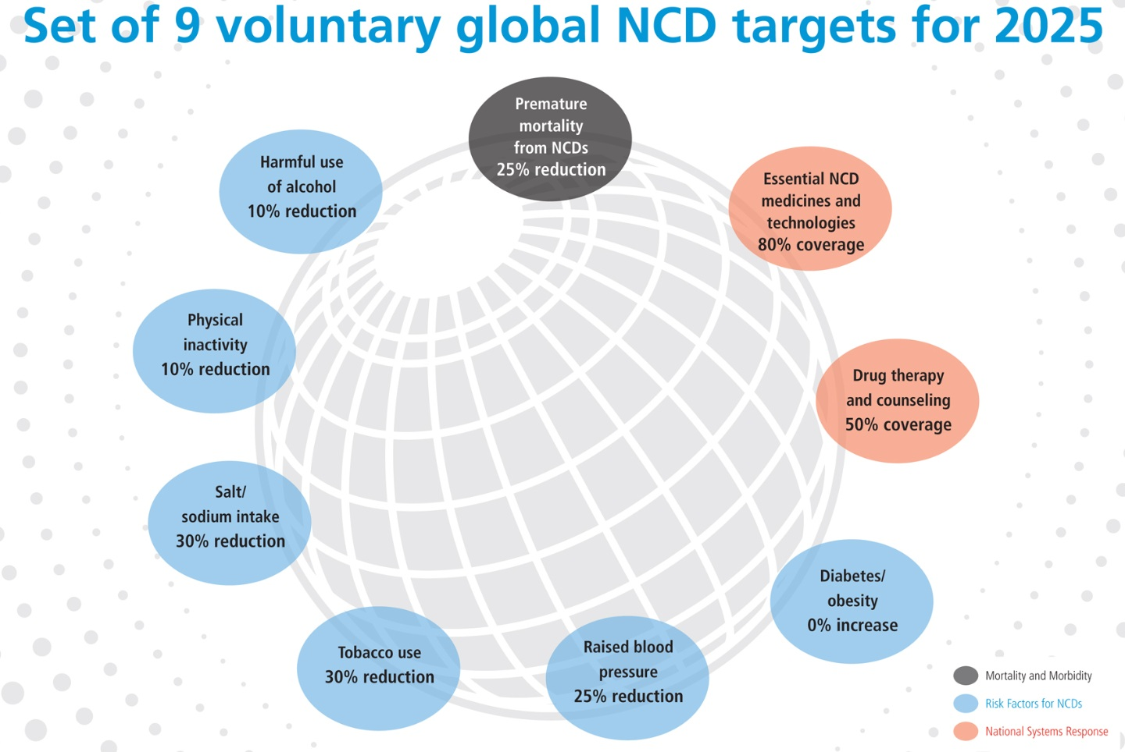

Slide 5
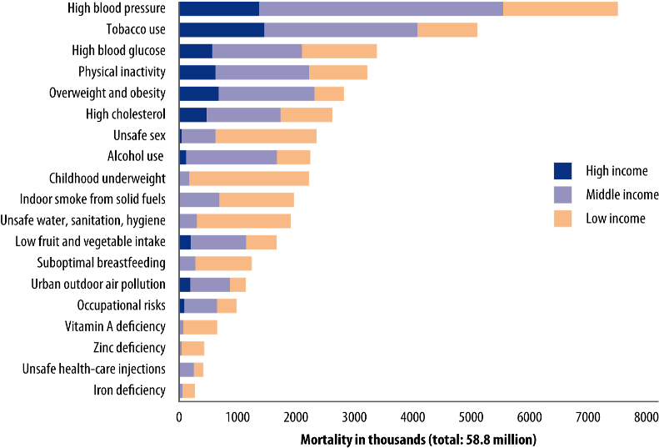
Physical inactivity - 4th leading risk factor for global mortality
Source: WHO's report on "Global health risks"
1.5 billion adults
are insufficiently active

Slide 6

Percentage of insufficient physical activity comparable country estimates, 2008
Age standardized: by WHO Region and World Bank income group, men and women
Source: Global Status Report on NCDs, WHO, 2010

Slide 7
What is Physical Activity
Physical activity is defined by WHO as:
"Any bodily movement produced by skeletal muscles that requires energy expenditure"
Regular moderate intensity physical activity – such as walking, cycling, or participating in sports – has significant benefits for health.

Slide 8
What is Sport
UN Inter-Agency Task Force on Sport for Development and Peace defined sport, for the purposes of development, as:
‘All forms of physical activity that contribute to physical fitness, mental well-being and social interaction, such as play, recreation, organized or competitive sport, and indigenous sports and games’
http://www.un.org/wcm/content/site/sport/lang/en/home/sport

Slide 9
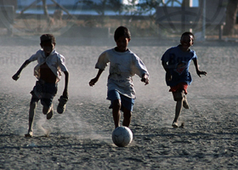
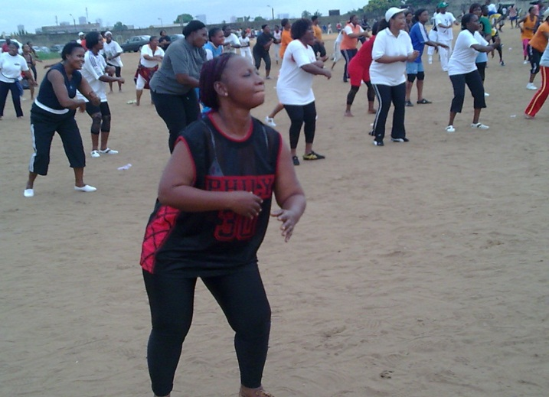
Health effects of physical activity
Being physically active:
Reduces the risk of heart disease by 30%, diabetes by 27%, breast and colon cancers by 21-25%.
Helps maintain a healthy weight.
Has a positive influence on mental health.

Slide 10

Global Strategy on Diet, Physical Activity and Health
Recognizing the unique opportunity that exists to formulate and implement an effective strategy for substantially reducing the deaths and disease burden worldwide by improving diet and promoting physical activity, WHO and 192 Member States adopted, in May 2004, the "Global Strategy on Diet, Physical Activity and Health"
www.who.int/dietphysicalactivity

Slide 11
Global recommendations on physical activity
2

Slide 12

Global Recommendations on Physical Activity
Main aim: providing guidance on dose response relation between frequency, duration, type and total amount of PA needed for prevention of NCD’s
Three age-groups:
  5-17 year olds;
  18-64;
  65+
Main target audience: national and local policy makers

Slide 13
National guidelines for physical activity: why?
Support the development of physical activity policy;
Be used by all relevant stakeholders to communicate valid and consistent messages on the frequency, duration, intensity, type and total amount of physical activity for health;
Be used as reference by health professionals to inform patients;
Represent the translation of research findings into actionable, achievable and measurable messages for practitioners, policy-makers and communities;
Be used as benchmarks for public health monitoring and surveillance purposes.
Notes:
Global recommendations on PA are relevant for the following health outcomes:
Cardiorespiratory health (coronary heart disease, cardiovascular disease, stoke and hypertension)
Metabolic health (diabetes and obesity)
Musculoskeletal health (bone health, osteoporosis)
Cancer (breast and colon cancer)
Functional health and prevention of falls
Depression

Slide 14




Key concepts of the global recommendations
Intensity of activity
Domains of activity
recreation and sports
moderate
transportation
vigorous
household
work/school
Type of activity
Aerobic
Strength
Balance
Flexibility
Notes:
Moderate intensity = PA performed at 3.0 to 5.9 times the intensity of rest (5-6 on a scale of 0-10 relative to an individual's personal capacity)
Vigorous intensity = PA performed at 6.0 (adults)/7.0 (children and youth) or more times the intensity of rest (7-8 on a scale of 0-10 relative to an individual's personal capacity)
Aerobic activities improve cardiorespiratory fitness (walking, running, swimming, bicycling)

Slide 15
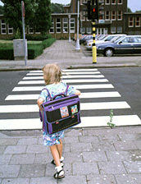
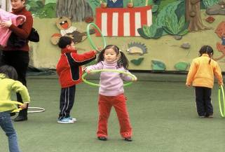
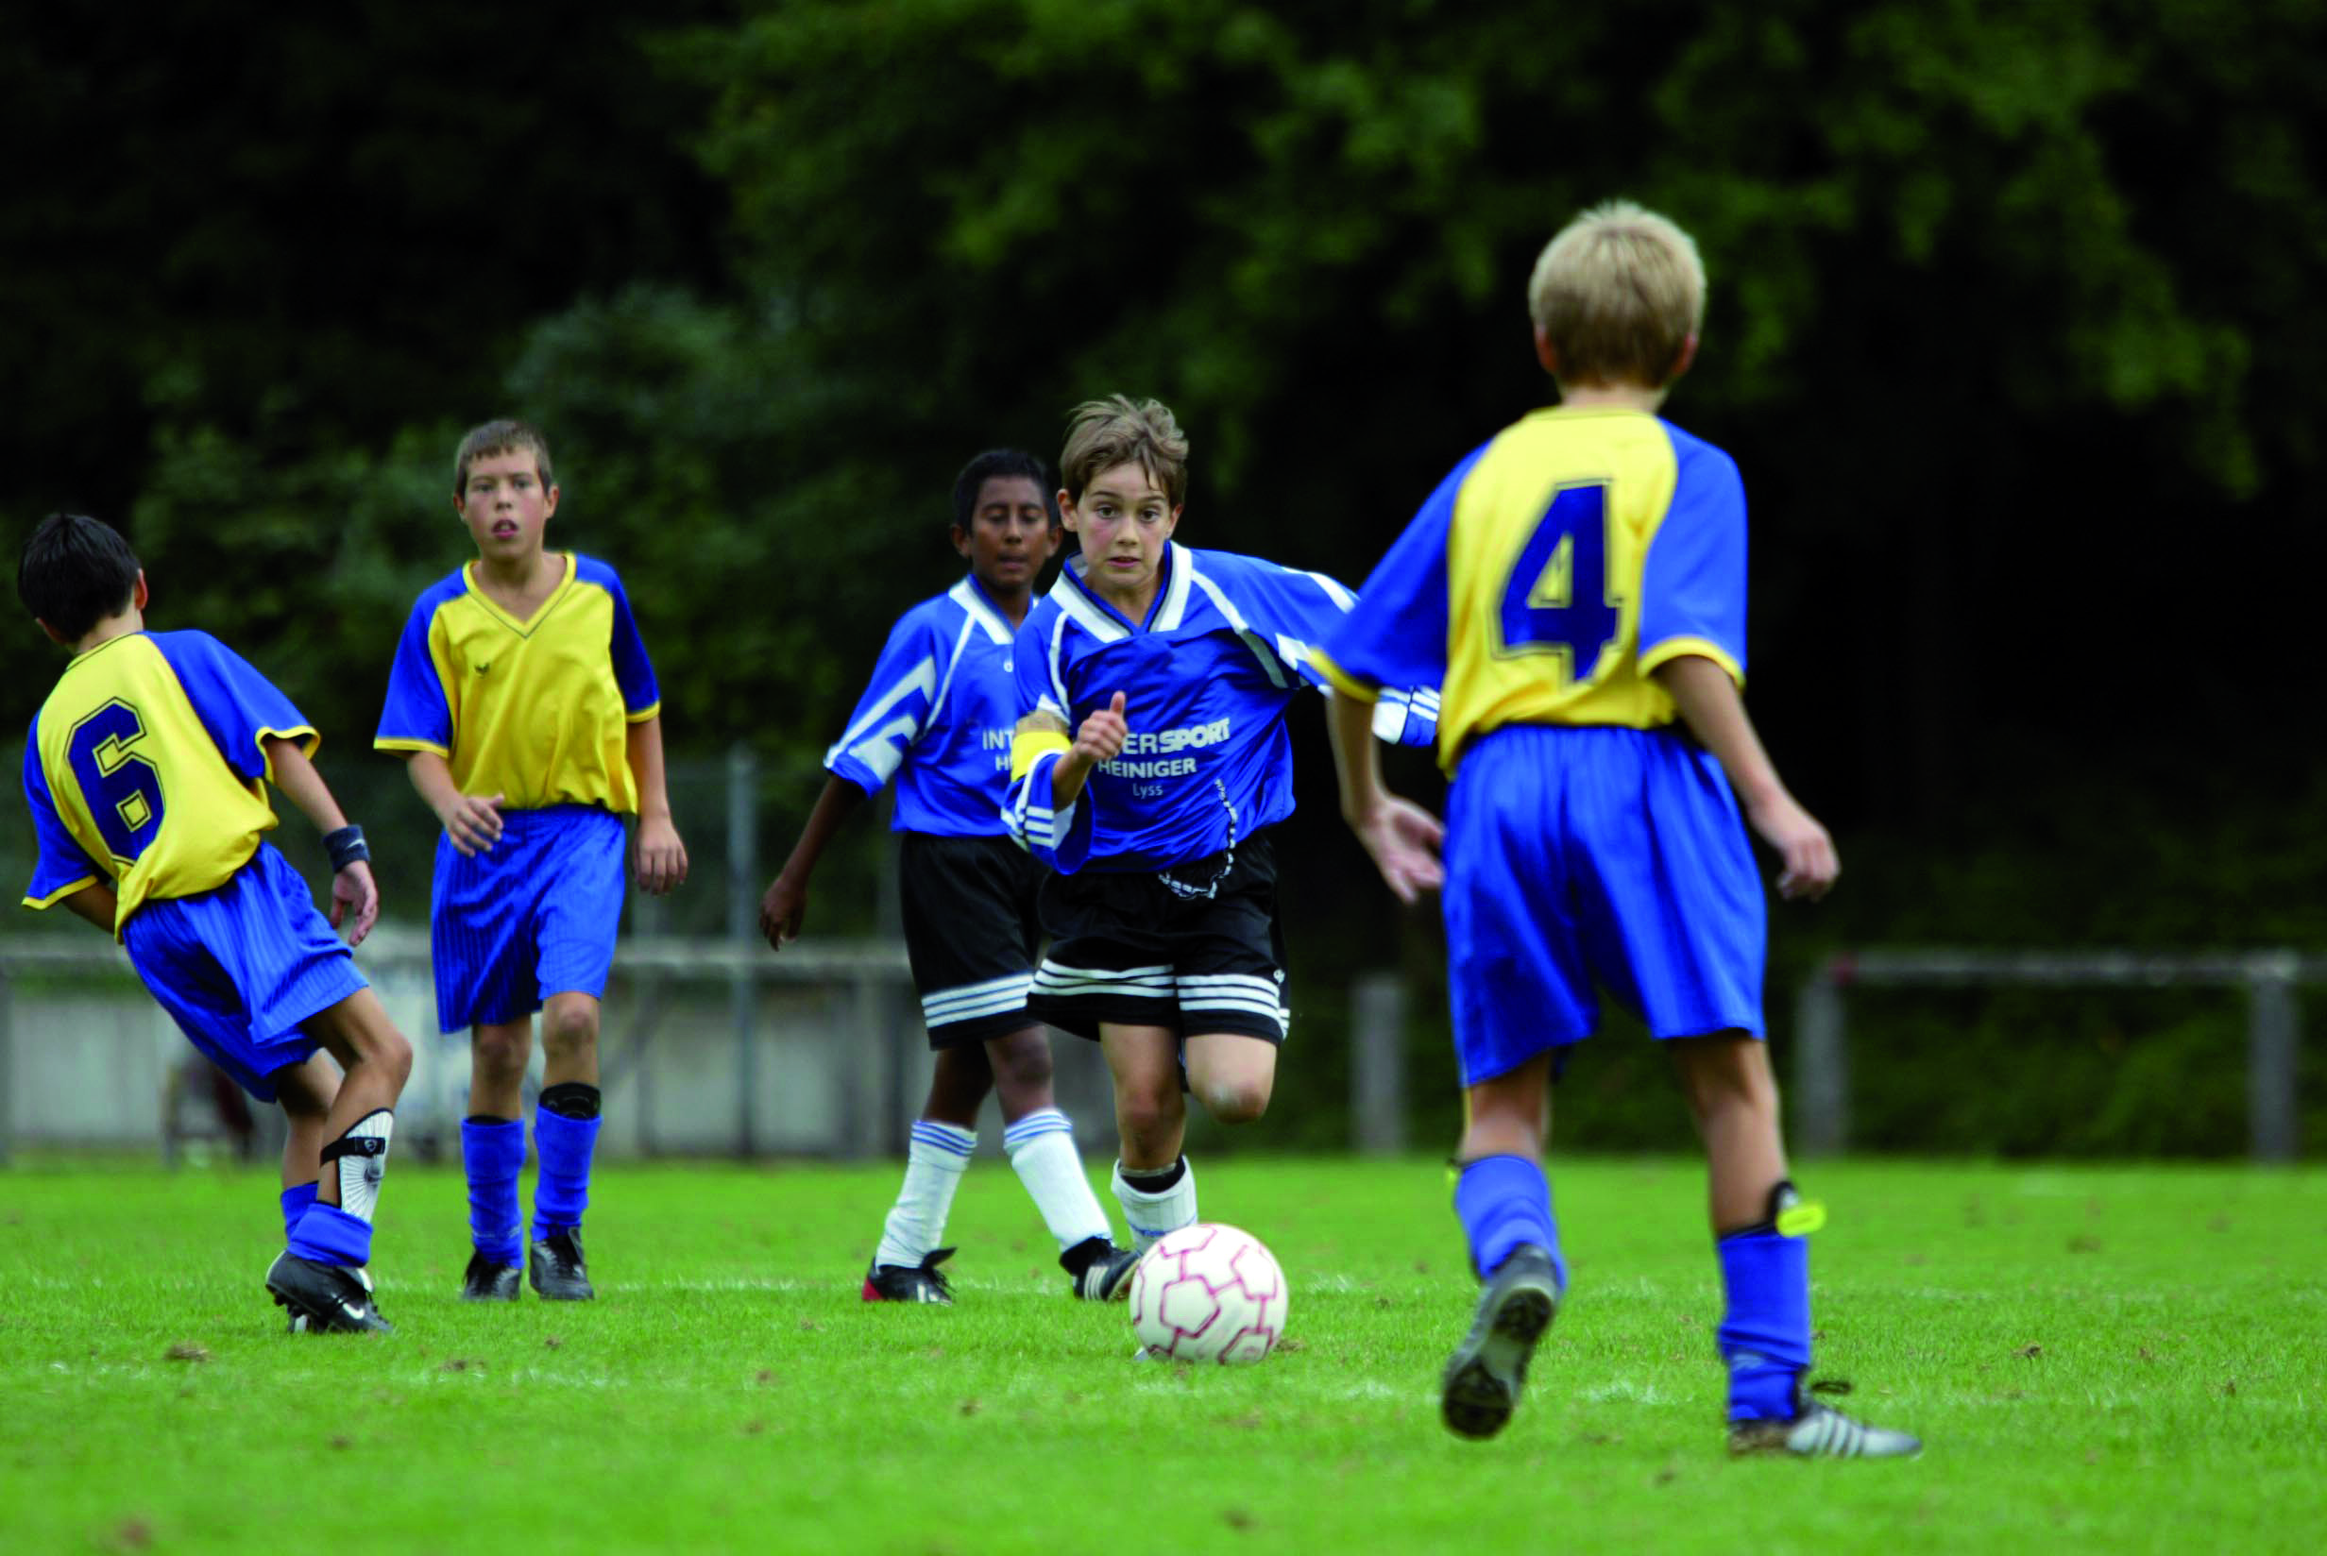
Children and youth - aged 5-17
at least 60 minutes of moderate to vigorous intensity physical activity daily
> 60 minutes provide additional health benefits
Should:
  be mostly aerobic activity
  include vigorous intensity activities
  including muscle strengthening and bone health activities at least 3 times per week.
Notes:
15
In order to improve cardiorespiratory and muscular fitness, bone health, and reduce the risk of NCDs.
Muscle-strengthening activity = Physical activity that increases muscle strength, power, endurance, and mass (e.g. strength training, resistance training, endurance exercises)
Bone-strengthening activity = Physical activity to increase the strength of specific sites in bones that make up the skeletal system (promotes bone growth and strength) (e.g. running, jumping rope, lifting weights)

Slide 16
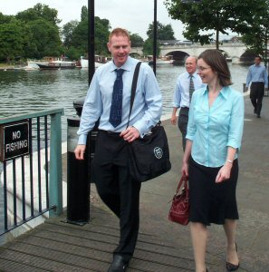
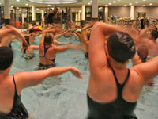
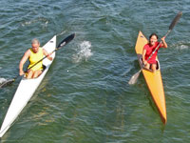
Adults aged 18-64
At least 150 minutes of Moderate intensity PA spread throughout the week OR
at least 75 minutes of Vigorous PA spread throughout the week OR
an equivalent combination of those two
Bouts of at least 10 minutes.

Slide 17
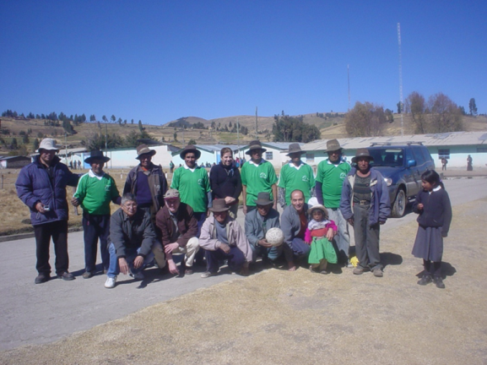
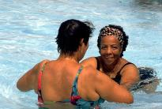
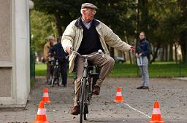
+65 years old :
Same recommendations as for adults
Specific recommendations:
perform PA to enhance balance and prevent falls on 3 or more days/ week.
Muscle-strengthening activities on 2 or more days a week.
be as physically active as their abilities and conditions allow.
Notes:
Balance training = Static an dynamic exercises that are designed to improve an individual's ability to withstand challenges from postural sway or destabilizing stimuli caused by self-motion, the environment, or other objects.
17

Slide 18
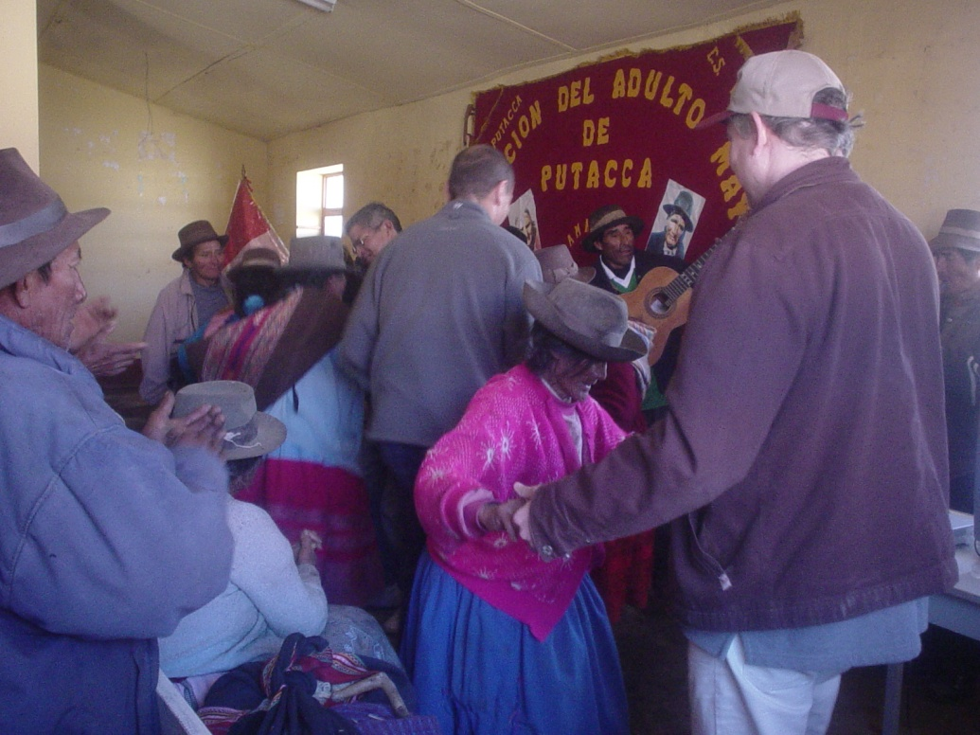
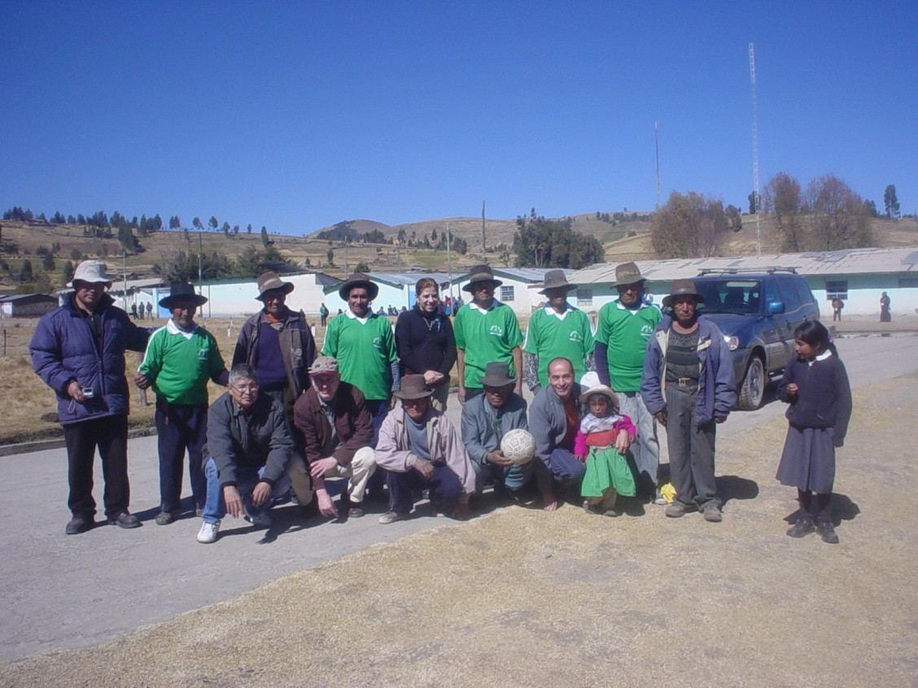
+65 years old :

Slide 19
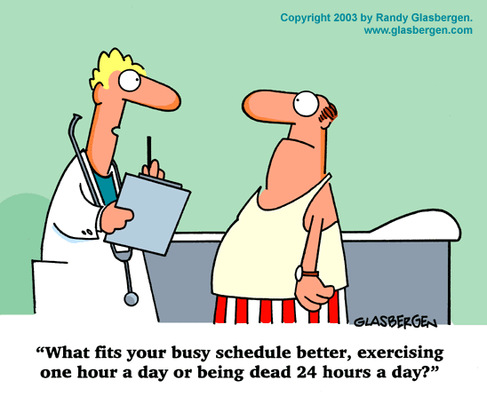
Summarizing

Slide 20
Effective interventions in physical activity promotion
3

Slide 21
"Best buys" interventions to address NCDs
Population-based interventions addressing NCD risk factors | Tobacco use | Excise tax increases Smoke-free indoor workplaces and public places Health information and warnings about tobacco Bans on advertising and promotion
 | Harmful use of alcohol | Excise tax increases on alcoholic beverages Comprehensive restrictions and bans on alcohol marketing Restrictions on the availability of retailed alcohol
 | Unhealthy diet and physical inactivity | Salt reduction through mass media campaigns and reduced salt content in processed foods Replacement of trans-fats with polyunsaturated fats Public awareness programme about diet and physical activity
Individual-based interventions addressing NCDs in primary care | Cancer | Prevention of liver cancer through hepatitis B immunization Prevention of cervical cancer through screening (visual inspection with acetic acid [VIA]) and treatment of pre-cancerous lesions
 | Cardiovascular disease and diabetes | Multi-drug therapy (including glycaemic control for diabetes mellitus) for individuals who have had a heart attack or stroke, and to persons at high risk (> 30%) of a cardiovascular event within 10 years Providing aspirin to people having an acute heart attack
Notes:
05/06/2013
21

Slide 22
Opportunities for multisectoral and multistakeholder activities
Urban planning and design
Sustainable transport
Safety and Injury prevention
Sustainable environment; climate change
Sports
Workplace
Education

Slide 23
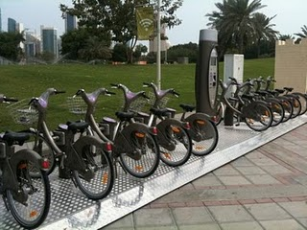

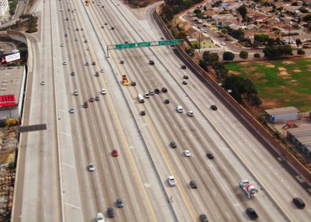
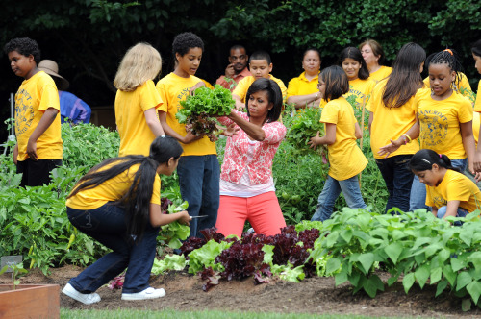
Urban Planning

Slide 24
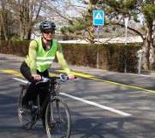
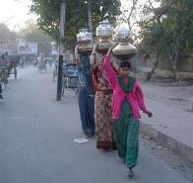
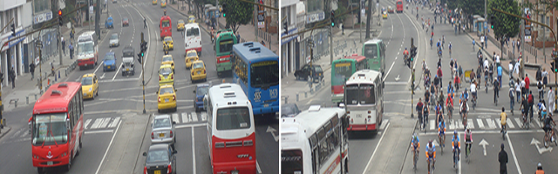
Transport policies
Introduce transport policies that promote active and safe methods of travelling to and from schools and workplaces, such as walking or cycling;
Ensure that walking, cycling and other forms of physical activity are accessible to and safe for all;

Slide 25
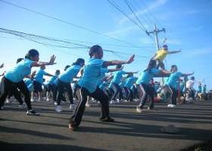
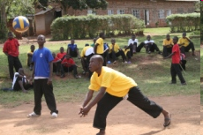
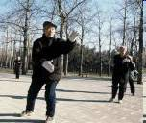
Physical environment
Improve sports, recreation and leisure facilities
Increase the number of safe spaces available for active play
Implement school-based programmes
Develop and implement national guidelines on PA for health

Slide 26





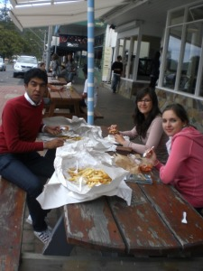
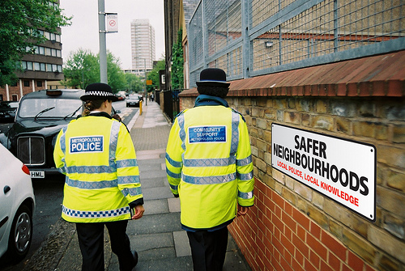

Physical environment

Slide 27


Population-wide initiatives
Physical activity policies
  Reducing barriers to physical activity
  Supportive transport policies and
  Policies to increase space for
  recreational activity.
Social marketing campaigns
  Cost-effective for physical activity
  Simple message with frequent exposure
  Combine with policies and community- based activities to address local environmental barriers to participation

Slide 28
Success: Ciclovías, Bogotá, Colombia
A cross between a street party and a marathon, Bogota's Ciclovías manages
to combine sport, recreation, health, commerce and culture in one package.
Improvements in public transport at the city level.
% persons travelling by car has dropped from 17% to 12% at peak times.
55% of programmes provide economic opportunities (temporary businesses)
63% of programs reported engaging the community (eg: volunteerism)
Ciclovía has now extended to more than 38 cities in at least 11 countries in the Americas.
Notes:
.

Slide 29

Workplace-based interventions
Workplace health promotion programmes, targeting physical inactivity and unhealthy dietary habits are effective in improving health, enhancing employee productivity, improving corporate image and moderating medical care costs.
Key elements of successful programmes include:
  clear goals and objectives;
  links with programmes to business objectives;
  strong management support;
  effective communication, and;
  supportive environments.
Notes:
Globally, approximately 65% of the population aged over 15 years is part of the workforce.
Programmes influence health behaviours through direct efforts – such as provision of health education, increased availability of healthy foods and increased opportunities for physical activity – to indirect efforts, such as fostering social support and social standards, and promoting healthy behaviours.

Slide 30
School-based interventions
High-intensity interventions that are comprehensive, multi-component and include:
  School recognition
  Curriculum on diet and physical activity taught by trained teachers
  Food service environment
  Physical activity environment
  Health promotion for school staff
  School health services
  Reach out to parents and communities
Notes:
School-based interventions show consistent improvements in knowledge and attitudes, behaviour and, when tested, physical and clinical outcomes. Notwithstanding cost-effectiveness research, there is strong evidence to show that schools should include a diet and physical activity component in the curriculum taught by trained teachers; ensure parental involvement; provide a supportive environment; include a food service with healthy choices; and offer a physical activity programme.

Slide 31

School curriculum
  Physical activity:
  improves health and fitness;
  enhances cognitive performance;
  has a positive influence on children’s psychological well-being and can counteract risk behaviour;
  decreases risk factors for future chronic diseases.

Slide 32
School curriculum
  Schools have the mandate and responsibility for enhancing all aspects of development of children
  Through schools all children can have access to physical education and sports facilities
  Schools should offer a variety and choice of physical education classes, covering needs and interests of students
  Physical education should be enjoyable, appropriate, promote fair play and encourage participation

Slide 33
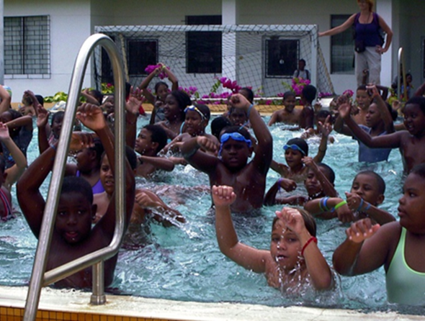
School curriculum
  Use physical education as a learning opportunity, developing confidence and skills for life long participation
  Establish adequate safety precautions
  Physical education
  teachers should be
  well qualified and trained

Slide 34
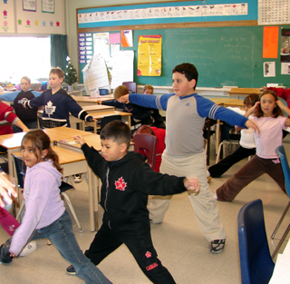
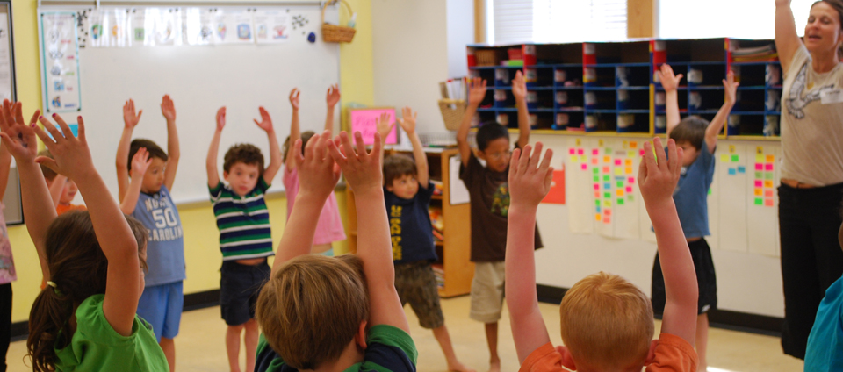
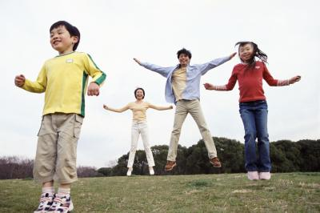
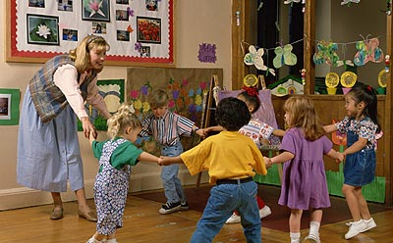
Whole of school approach

Slide 35
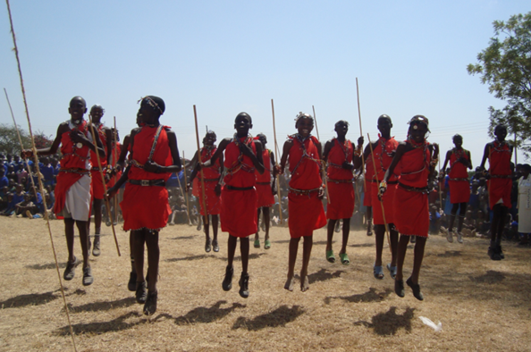
Extracurricular opportunities
  Extracurricular opportunities for physical activity:
  Comprehensive programmes of after-school gatherings offering physical activity opportunities, both competitive and non-competitive;
  Active recess, morning, lunch and after-lunch exercises, traditional dances, etc.;
  School sports competitions.
Notes:
Physical education classes offered by schools often do not meet the recommended levels of physical activity for children and adolescents.

Slide 36

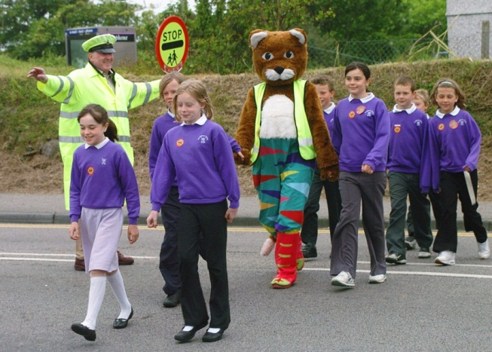
Physical school environment
  Schools should have safe and appropriate spaces and facilities so that children can spend their time actively and establish partnership with communities to use community recreation and sporting facilities, and vice versa.
  Promote safe walking and cycling to schools:
    Crossing guards at road crossings;
    Secure bike racks in schools;
    Traffic free zones in peak hours;
    Safe walking and cycling trails;
    Adequate lighting during hours of darkness.
Notes:
Establish partnerships with ministries of transportation, local councils municipalities, parents' and teachers' associations and traffic planners.
Organize public awareness campaigns to alert the general population to the fact that students are walking and cycling to and from schools.

Slide 37


Opportunities for Sport and Health to work together
Sports for All – making sports fun and non-competitive
Sports facilities safe, accessible and affordable
Marketing of Foods to children
Making sports venues tobacco free
Making sports venues alcohol free
Giving Physical Activity a more important profile in schools
Making Physical Activity and Sports a health promoting issue
Making sports an important part of leisure time
Creating Health Legacies for Sporting Events

Slide 38
From data to action
4

Slide 39
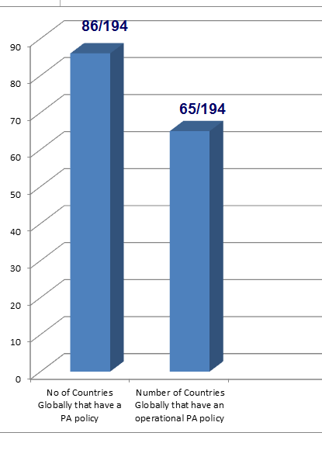

National physical activity policies

Slide 40
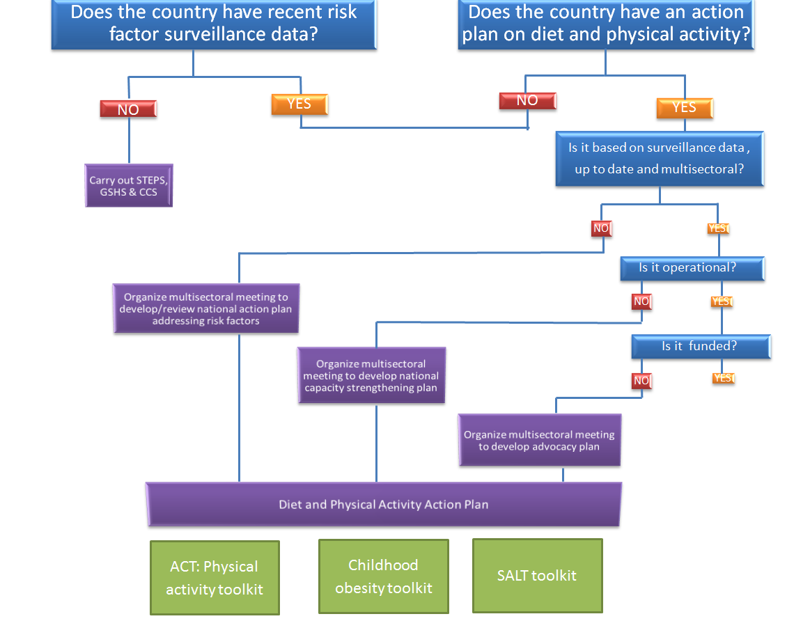
From data to action toolkit

Slide 41
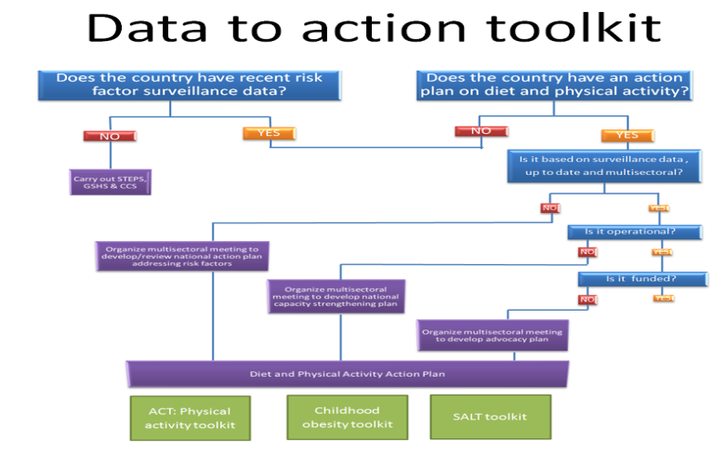
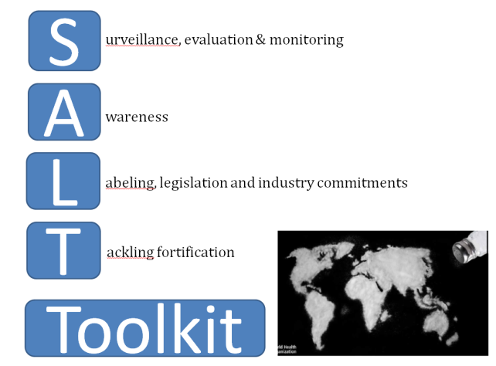
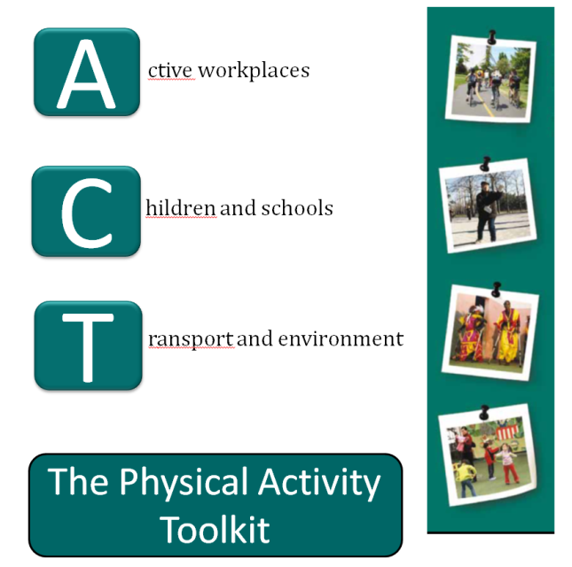
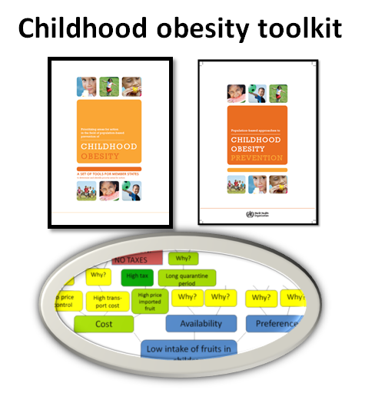
Diet and physical activity toolkits
Notes:
WHO is has or is developing toolkits on:
- Tobacco use (MPOWER),
- Physical activity (ACT),
- Salt reduction (SALT),
- Childhood obesity prevention,
- From data to action on diet and physical activity,
- Tools of the alcohol action plans.

Slide 42
Thank you
http://www.who.int/dietphysicalactivity/en/

