Slide 1


Social determinants of non-communicable diseases
Silvia Stringhini
IUMSP

Slide 2
Objectives
Understand the role of social factors as determinants of NCDs
Understand the main drivers of social inequalities in NCDs
Recognize interventions impacting on social inequalities in NCDs
Outline
Social inequalities in NCDs: definitions and evidence
Specificities of social inequalities in NCDs in LMICs
Underlying mechanisms, prevention strategies
The UN and the social determinants of NCDs
Take home messages
SES: Socioeconomic status

Slide 3
Social inequalities in NCDs: definitions and evidence

Slide 4
Inequalities in male life expectancy at birth between and within countries
Country | Male life expectancy at birth
Angola | 40
UK, Glasgow (Calton) | 54
India | 62
Lithuania | 65
Mexico | 72
United States | 75
Cuba | 76
Switzerland | 79
UK, Glasgow (Lenzie N.) | 82
Sources: WHO, World Health Statistics 2008; Hanlon, Walsh & Whyte 2006; Murray et al. 2006
Notes:
Inequalities in health between countries are large (male life expectancy at birth 40 years in Angola and 79 years in Switzerland). However, inequalities in health within countries can be of the same magnitude: in Glasgow (Scotland), male life expectancy at birth ranges between 54 years in the most deprived district to 82 years in the least deprived.

Slide 5
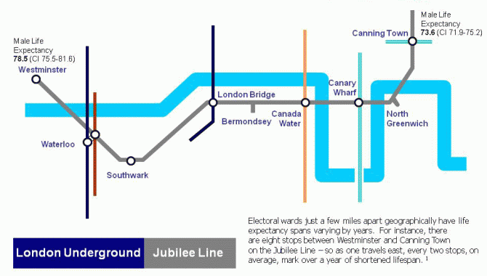
Differences in male life expectancy within a small area in London
Life expectancy decreases of more than 1 year every two metro stops
Sources: Analysis by London Health Observatory of ONS and GLA, data for 2004-2008.
Notes:
Travelling east from Westminster, every two tube stops represent over one year of life expectancy lost

Slide 6
Definitions
Health inequalities: differences, variations, and disparities in the health achievement of individuals and groups.
  → Does not necessarily imply a moral judgment
  Higher mortality in men vs women, old vs young, poor vs rich
Health inequities: inequalities in health that are perceived as unfair
  Involves normative judgment
  Health inequalities by SES perceived as unjust because reflect unfair distribution of underlying social determinants of health
Social inequalities in health: Systematic disparities in health status of groups with different levels of underlying social (dis)advantage including wealth, power or prestige (Exworthy et al.,2006 after Braveman & Gruskin, 2003)

Slide 7
Cardiovascular disease mortality by smoking status and SES
3.5
SES powerfully predicts NCDs
Effect of SES ~ smoking
2.2
Source: Stringhini S et al. JAMA, 2010.
Notes:
Socioeconomic status is a powerful predictor of NCDs and its effect might be comparable to that of cigarette smoking for certain health outcomes

Slide 8
Relative risk of smoking and obesity in people with low vs high education
Smoking
Higher prevalence of smoking and obesity among low educated people
Exceptions, e.g. Southern Europe
Magnitude varies between countries
Obesity
Source: Mackenbach et al NEJM 2008.

Slide 9
Relative risk of mortality in low vs. high income groups (USA), by cause of death
HIGHER MORTALITY IN LOW SES
LOWER MORTALITY IN LOW SES
Relative risk of death depends on underlying risk factors.
E.g. Poor die more of car accidents (lower quality cars); rich die more of flying accidents (they fly more frequently).
For main NCDs, mortality is higher in low income vs. high income groups.
Source: Davey Smith et al AJPH, 1996
Notes:
These are data from a US population of white men. SES measure=income

Slide 10
Specificities of social inequalities in NCDs in LMICs

Slide 11
Under-five mortality rate by quintile of wealth score
Under-5 mortality rate increases with decreasing quintile of wealth.
But under-5 mortality mainly due to infectious diseases, issue of inequalities more complex for NCDs (next slides).
Sources: Gwatkin et al World Bank 2007.

Slide 12
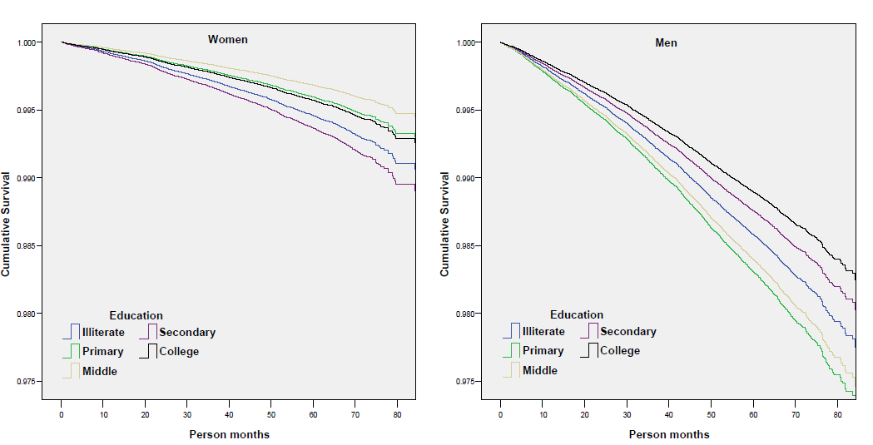
Cumulative survival for cardiovascular mortality in India by education
College
Primary
Illiterate
Higher education associated with higher survival among literates.
Cumulative survival of illiterates intermediate.
Sources: Pednekar et al BMC Public Health 2011.
Notes:
Among women there is no clear pattern

Slide 13
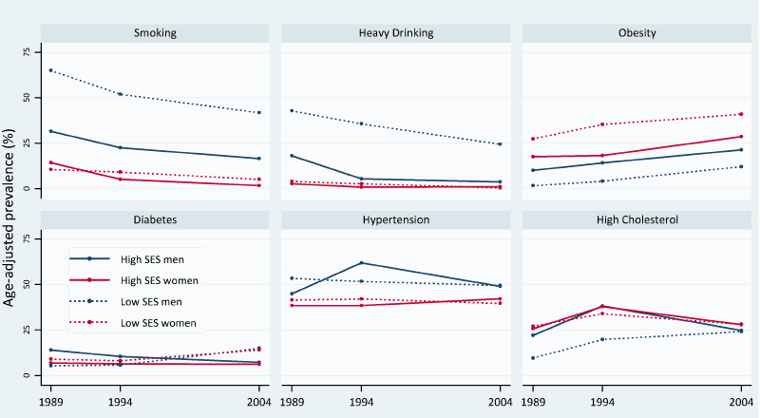
Trend in the social patterning of NCDs risk factors, repeated surveys in the Seychelles
Prevalence of NCDs risk factors (exception of smoking in men) often higher among the rich in LICs and higher among the poor in MICs.
But secular shift towards the poor along the progression of the epidemiological transition.
Sources: Stringhini et al IJC 2012.

Slide 14
Change in prevalence of overweight/obesity among women from 7 African countries (1992-2005)
Prevalence of overweight/obesity higher among high vs low educated women.
But obesity decreases over time in high SES and increases in low SES.
Sources: Ziraba et al BMC Public Health 2009.

Slide 15
Social inequalities in NCDs: underlying mechanisms

Slide 16
Three main explanations for social inequalities in NCDs
1) Artefact
Inequalities result of an error in measuring social class
Confounding factors in the association between SES and health
2) Natural or social selection
Direction of association between SES and health is from health to SES (e.g: poor health causes low SES).
3) Social causation
Low SES causally related to poor health, through higher exposure of low SES individuals to risk factors for diseases
We’ll refer to causal explanations (i.e., SES “causing” poor health) from now on
Notes:
Social selection (opposed to social causation) explanations refer to the selection of sick individuals into lower social classes. For example, if an individual is sick in childhood/adolescence he’ll probably have difficulties in attaining high levels of education and therefore he’ll be “selected out” into lower social classes in adult life. Several studies (especially longitudinal studies) have shown that although social selection might play a role, the majority of social inequalities in health are explained by social causation, whereby low socioeconomic status is causally related to poor health, through higher exposure of low SES individuals to risk factors for diseases. NOTE: Natural selection also refers to “natural” characteristics such as intelligence or other abilities, which may cause both low social class and poor health. But this discourse is more complex and difficult to summarize here.

Slide 17
Social inequalities in NCDs: underlying mechanisms
ENVIRONMENTAL EXPOSURES
- Pollution
- Living/working conditions
Lifecourse SES
PSYCHOSOCIAL EXPOSURES
- Social relationships/support
- Job strain
HEALTH
BEHAVIORAL EXPOSURES
- Lifestyle factors
ACCESS TO/USE OF HEALTH CARE
Environmental, psychosocial and behavioural exposures major factors explaining the link between SES and health.
Social patterning of behavioral factors explains largest part of social differences in NCDs (40-60%).
Increasing role of environmental exposures.
Access to/use of health care accounts for <15% of SES differences in health in US/Europe. No studies in LMICs but probably high.

Slide 18
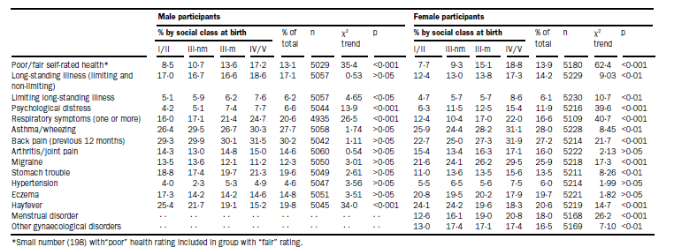
Lifecourse exposures to adverse risk factors associated with low SES
HIGH
LOW
HIGH
LOW
Long-lasting influence of exposure to adverse SES in critical periods of development on NCDs in adult life.
In Figure, higher prevalence of morbid conditions among individuals with a low vs. high social class at birth.
Sources: Power et al. Lancet 1997.
Notes:
Note that the population is young (33 years). Morbidity prevalence at age 33 by social class at birth

Slide 19
Social inequalities in NCDs: prevention strategies

Slide 20
Social inequalities in NCDs: prevention strategies
Burden NCDs
Existing social inequalities in NCDs
SCENARIO 1
Whole population approach: ‘agentic’ prevention strategies
Whole population approach:
‘structural’ prevention strategies
SCENARIO 2
Low SES
High SES
IDEAL
Prevention strategies relying on individuals' capacity to respond (“agentic”) are likely to increase the health gap between SES groups → disproportionally benefit high SES individuals
Structural strategies likely not only to reduce NCD burden but also have impact on social inequalities in NCDs (example: ban on public smoking affects everybody the same).
Notes:
Let’s assume that we know which are major determinants of NCDs and that they are more prevalent in lower socioeconomic groups. So let’s also assume that this line represents existing social inequalities in health and that this would be the ideal situation, with low mortality and no inequalities. Of course the ideal scenario is very unlikely to happen. However, one type of intervention could be based on agentic prevention strategies which rely on individual’s capability. In this case, if the intervention is targeting important determinants of NCDs the population burden would be reduced, however, inequalities in NCDs would increase because people from lower SES groups are less likely to respond to these kind of prevention strategies. On the other hand, if structural prevention strategies are implemented, individuals are in some way “forced” to respond to interventions so structural prevention strategies would not only reduce the burden of NCDs but also reduce social inequalities in NCDs.

Slide 21
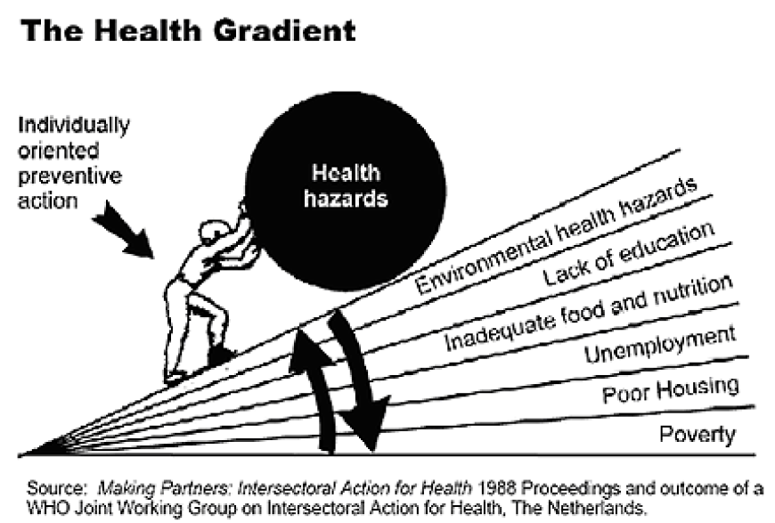
Intervention strategies to reduce social inequalities

Slide 22
Structural prevention strategies likely to reduce social inequalities in NCDs
– acting on proximal determinants:
Fluoridation of drinking water
Clean indoor air laws
Elimination of trans fats/reduction or salt content in foods by jurisdiction
Mandatory folate fortification of cereal-grain products
Free child care
– acting on distal determinants:
Redistributive policies aimed at reducing socio-economic disparities
Policies promoting public education and public health care
Policies promoting safer work places
Notes:
Example of “structural” prevention strategies are: fluoridation of drinking water

Slide 23
Intervention strategies to reduce social inequalities in NCDs should:
Consider the diffusion of innovations theory: differences in uptake between early adopters (likely high SES) and later adopters (likely low SES), who may require special efforts.
Assess where the proposed intervention falls on a continuum from agency to structure→ Strategies relying on individual agency more likely to worsen social inequalities in NCDs.
Issue of lifecourse. Important to limit the consequences of exposure to low SES in critical periods of development as they will impact health in adulthood.
Notes:
Assess where the proposed intervention falls on a continuum from agency (pertaining to an individual’s capacity to make the choice to act) to structure (pertaining to social institutions and norms that shape the actions of individuals).

Slide 24
Social inequalities in NCDs: intervention programs

Slide 25
Hyderabad nutrition trial (1987-90), India
Food supplementation to pregnant women in 15 poor Indian rural villages (14 villages controls)
Baseline (1987-90)
Children born to supplemented mothers +61g birthweight
Follow-up (2003-05)
14mm taller
Same fat mass
Lower risk of cardiovascular disease
Insulin resistance (HOMA): 20% lower
Arterial stiffness: 3% lower
Systolic blood pressure: 0.6mm Hg lower
Sources: Kinra et al. BMJ 2008.

Slide 26
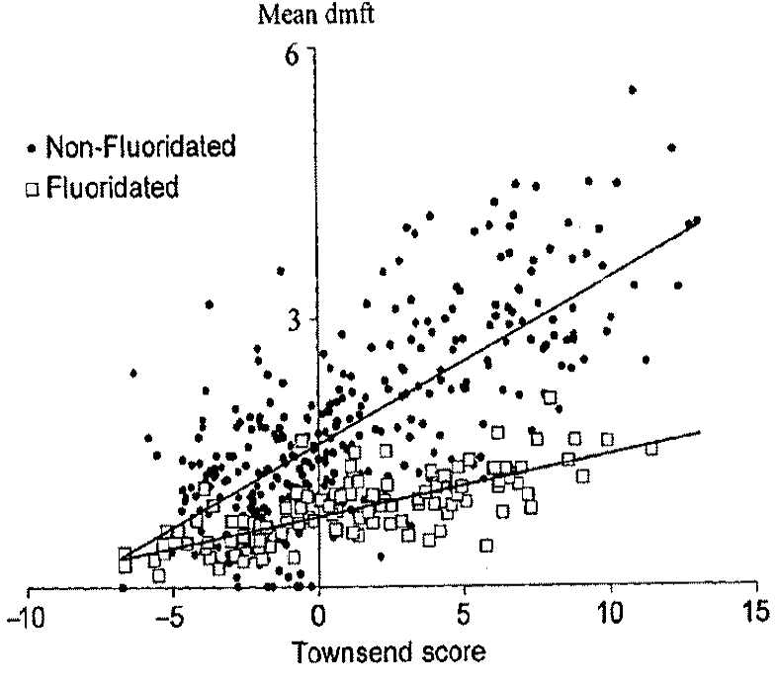
Water fluoridation (1993-94), United Kingdom
Water fluoridation in 7 districts vs 7 control of same SES
Decayed theet (DT)
  Mean 0.87 in fluoridated district; 1.8 in non-fluoridated district (p<0.0001)
The intervention benefits most the most disadvantaged areas
→inequalities reduced
DECAYED THEET
Probably same effects for other structural interventions such as trans fats/salt reduction in food
DEPRIVATION
Sources: Riley et al. IJE 1999.

Slide 27
Social inequalities in NCDs and the UN

Slide 28
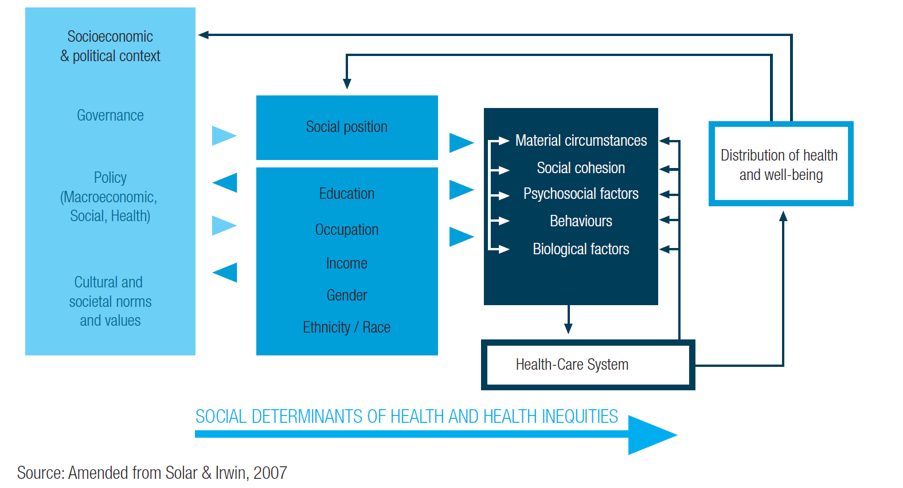
WHO commission on social determinants of heath: conceptual framework

Slide 29
WHO commission on social determinants of heath: overall recommendations
Improve daily living conditions
  Equity from the start (focus on early life)
  Healthy places healthy people
  Fair employment and decent work
  Social protection
  Universal health care
Tackle the Inequitable Distribution of Power, Money, and Resources
  Health equity in all policies
  Market responsibility → reinforce primary role of state in provision of basic health-related services (i.e.: water/sanitation) and the regulation of goods and services with major health impact (i.e.: tobacco, alcohol, and food)
Good governance

Slide 30
Social inequalities in NCDs: Rio Political Declaration on Social Determinants of Health (October 2011)
More relevant acknowledgments:
Health inequities within and between countries are politically, socially and economically unacceptable, as well as unfair and largely avoidable
Health inequities arise from the societal conditions in which people are born, grow, live, work and age
Good health requires a universal, comprehensive, equitable, effective, responsive and accessible quality health system
More relevant actions:
Work across different sectors and levels of government
Develop inclusive policies (specific attention to vulnerable groups)
Strengthen occupational health safety
Promote and strengthen universal access to social services
Build, strengthen and maintain health financing and risk pooling systems

Slide 31
Social inequalities in NCDs: New York Political Declaration on NCDs (September 2011)
ART 23: “Note with concern that [...] NCDs affect people of all ages, gender, race and income levels, and further that poor populations [...] in particular in developing countries, bear a disproportionate burden. ”
ART 29: “Acknowledge also the existence of significant inequalities in the burden of NCDs and in access to prevention and control, both between countries, and within countries.”
BUT
Little mention of health inequalities in policies for prevention/control of NCDs
Little mention of lifecourse influences on NCDs
Essential to prioritize policies focusing on early life exposures to NCDs risk factors

Slide 32
Social inequalities in NCDs: WHO Global NCDs Monitoring Framework (March 2012)
The global reporting system should be able to ascertain trends in inequality.
Monitor core indicators for NCDs by key dimensions of equity including gender, age, and socioeconomic status.
“Global monitoring framework should set targets that aim to reduce inequities and take the key social determinants into account.”

Slide 33
Social inequalities in NCDs: WHO Global Action Plan for the Prevention and Control of NCDs for 2013-2020
→ Promote health and equity in relation to prevention and control of NCDs.
When making public health decisions, consideration should be given to cost-effectiveness and affordability, implementation capacity, feasibility, impact on equity and poverty, as well as the balance between population wide interventions and individual interventions.
Policies, plans and services for the prevention and control of NCDs need to take account of health and social needs at all stages of the life course, starting with maternal health, ..., and continuing through proper infant feeding practices, ..., followed by promotion of a healthy working life, healthy ageing and care for people with NCDs in later life.

Slide 34
Social inequalities in NCDs: Action Plan for European Strategy for the Prevention and Control of NCDs
→ A focus on equity. Specific attention to whether social determinants affect people’s opportunities to make and sustain healthy choices.
→ A life course approach. Exposure to the risk of NCDs accumulates throughout the life course, starting with influences that occur during pregnancy and continuing through early childhood, adolescence and adulthood.
→ Balance population-based and individual approaches. Most cases of disease are found in those at low or moderate risk, and only a minority of cases are in those at high risk.
→ Disseminate and advocate for improved universal access to more comprehensive and equity-sensitive packages of NCD interventions.

Slide 35
Social inequalities in NCDs: Take home messages

Slide 36
Take home messages
The social environment is a powerful predictor on NCDs → low socioeconomic status is among the major risk factors for NCDs
Magnitude and direction of association between SES and NCDs vary between countries and change over time.
Mechanisms underlying social differences in NCDs are not stable across space, time and health outcomes.
In LMICs, NCDs and their risk factors might be still more prevalent in the high SES groups, but burden of NCDs tends to shift towards the poor along with a country’s socio-economic development and the health transition.
Exposure to adverse socioeconomic conditions across the lifecourse (starting in utero) has an impact on NCDs risk in adulthood.

Slide 37
Take home messages
For policies aimed at reducing social inequalities in NCDs crucial to consider that different SES groups are likely to respond differently to prevention strategies targeting the whole population → prioritizing “structural” prevention strategies
Whenever possible, the fact that SES acts across the lifecourse to affect NCDs risk should be considered → attention to exposures in early life not only relevant for communicable diseases but also for NCDs (also emphasized in the global action plan for the prevention and control of NCDs 2013-2020)
Critical to put health equity in all policies.
Health equity issues are more and increasingly present in the global agenda of international organisations (UN, WHO) → good window of opportunities in LMICs to implement policies developed to prevent and control NCDs, with specific attention to their social distribution

Slide 38
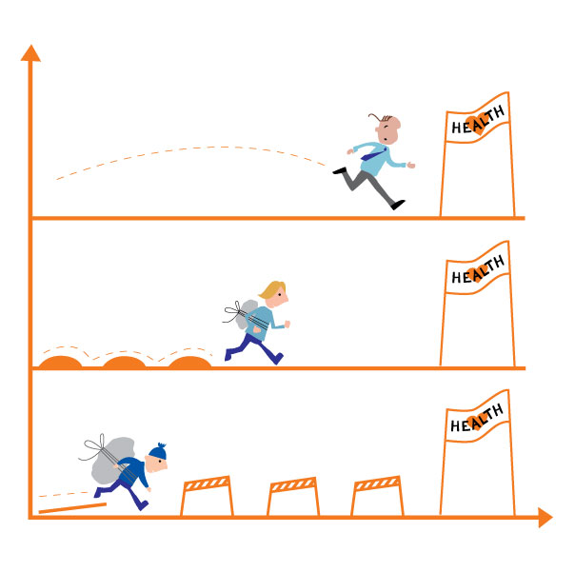
Thanks for your attention
Source: National strategy to reduce social inequalities in health, The Norwegian Institute of Public Health (2006-2007)

