Slide 1
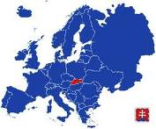
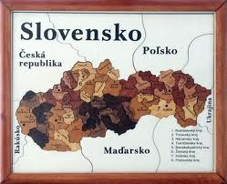
Country profile: SLOVAKIA
Political system: Parliamentary democracy
Total population: 5 431 024 (2010)
48,6% males
51,4% females
Life expectancy at birth:
Males: 71,62 (2010)
Females: 78,84 (2010)
Unemployment rate:
Males: 12% (2010)
Females: 13% (2010)
Source: Statistical Office of the Slovak Republic, www.statistics.sk
Jana Kollárová, MD

Slide 2
NCDs situation in Slovakia
From the group of deaths caused by CVD most deaths
fall on myocardial infarction and vascular diseases of brain.
The highest mortality in the group of cancers remains the tumor of trachea and lungs, as well as malignant colorectal neoplasm.

Slide 3
Public Health System in Slovakia
Act No. 355/2007
on Protection, Promotion and Development of Public Health
Executive bodies
Ministry of Health of the Slovak Republic
- defines priorities of the State Health Policy in the field of PH
Public Health Authority of the Slovak Republic
- develops priorities of the State Health Policy, leads, coordinates and controls activities of the Regional Public Health Authorities
Network of Regional Public Health Authorities
- 36 in accordance to 8 regions and 79 districts
Public Health Expenditures (as a percentage from the Ministry of Health budget)
2006 – 4,68% 2008 – 3,09% 2009 – 2,7% 2010 – 2,33% 2011 – 2,23%
Public health system in Slovakia still maintains the mainly control based centralized hygiene, sanitation and epidemiology oriented
Notes:
3
Executives – organy vykonnej moci

Slide 4
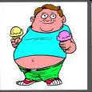
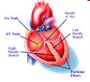
Selected NCDs policies/programs/activities
Key document: State health policy of the Slovak republic -
Chronic diseases – one of four priorities
National Programs
National Health Promotion Program (updated in 2005).
National Program for Prevention of Cardiovascular Diseases
National Program on Obesity Prevention
National Program on Mental Health
National Action Plan on Alcohol Problems
National Program on Tobacco Control
National Program of Health Care for Children and Youth
Health promotion program of marginalized communities
Specific tasks
CINDI program,
I am 65+ and Happy to Live a Healthy Life,
Dental Health for pre-school children,
HBSC study (Health Behaviour at School Children),

Slide 5
Main achievements – in statistic
Median age, cancer, males
Median age, CVD, males
Median age, cancer, females
Median age, CVD, females
Source: http://www.infostat.sk/vdc/pdf/umrtnost93-07.pdf

Slide 6
Main achievements – in statistic
Avoidable mortality, IHD, males
Avoidable mortality, males
Avoidable mortality, IHD, females
Avoidable mortality, females
Source: http://www.infostat.sk/vdc/pdf/umrtnost93-07.pdf
Notes:
IHD – ischemická choroba srdca
Muži: Pozitívny vplyv zdravotníctva dokazuje klesanie odvrátiteľnej úmrtnosti

Slide 7
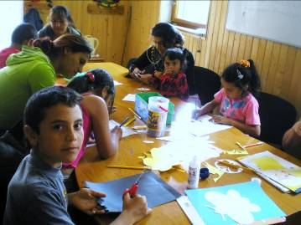
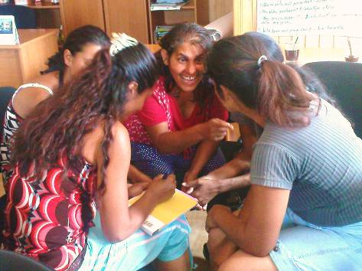
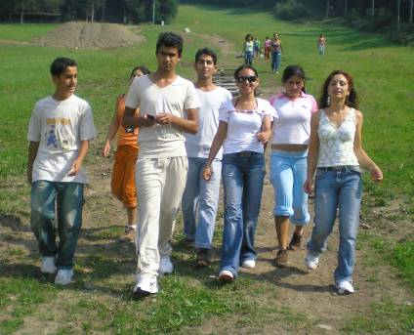
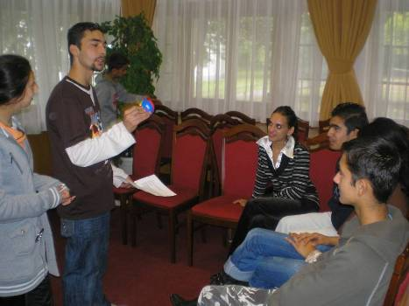
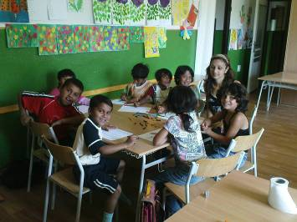
Main achievements – in practice
Implementation of the Health Promotion Program of Disadvantaged Roma Communities (2007 – 2015)

Slide 8
Main challenges
Current situation: a lot of strategies/programs/action plans, but...
Most of them are overlapping
Problematic implementation (formal documents)
Unclear direct responsibility
Unclear funding
Missing evaluation plans/indicators
Missing arguments for politicians
General problem in tackling NCDs:
more health care than public health
(more treatment than primary prevention/health promotion)

Slide 9
Lessons learnt
Fruitful cooperation: research – policy – practice (working at regional/local level – my own experience)
Speaking to decision/policy makers is not easy, but it is possible
Using full chain approach (policy – determinants of health – risk factors – health outcomes) might be useful risk assessment tool on policy level

Slide 10
Thank you for attention!
Ďakujem za pozornosť!
Contact: ke.kollarova@uvzsr.sk

